Slide 1
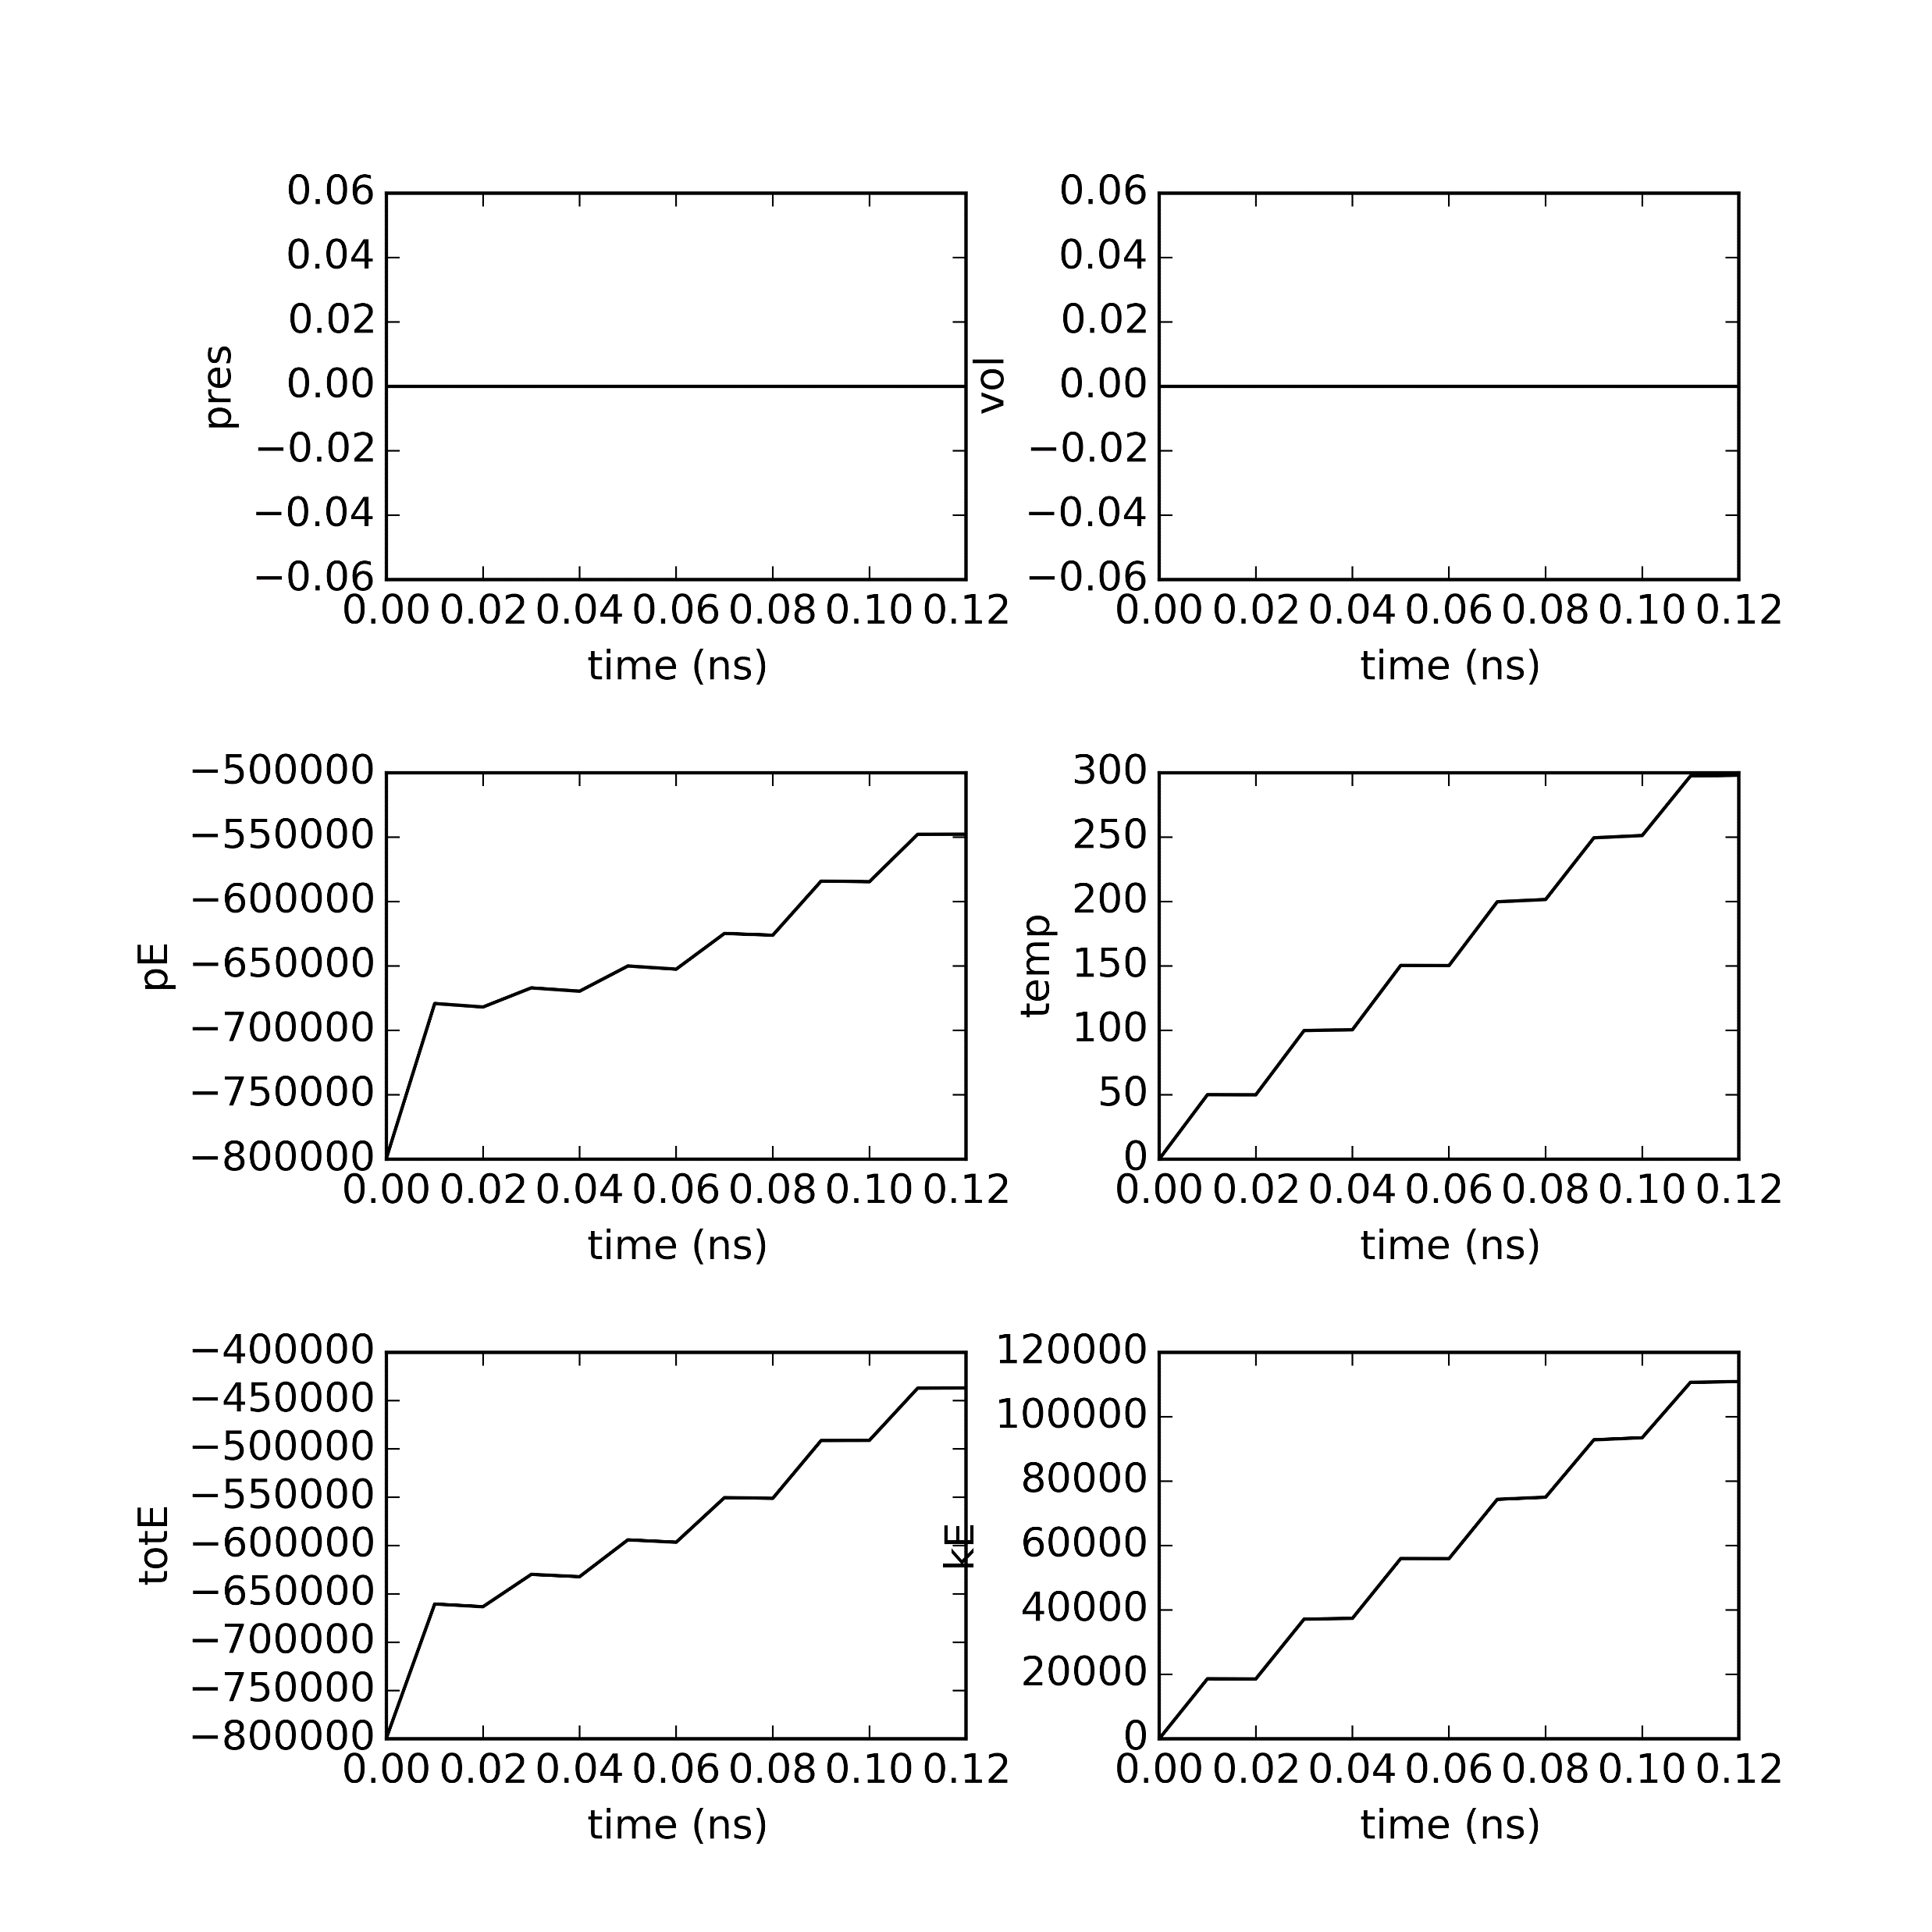
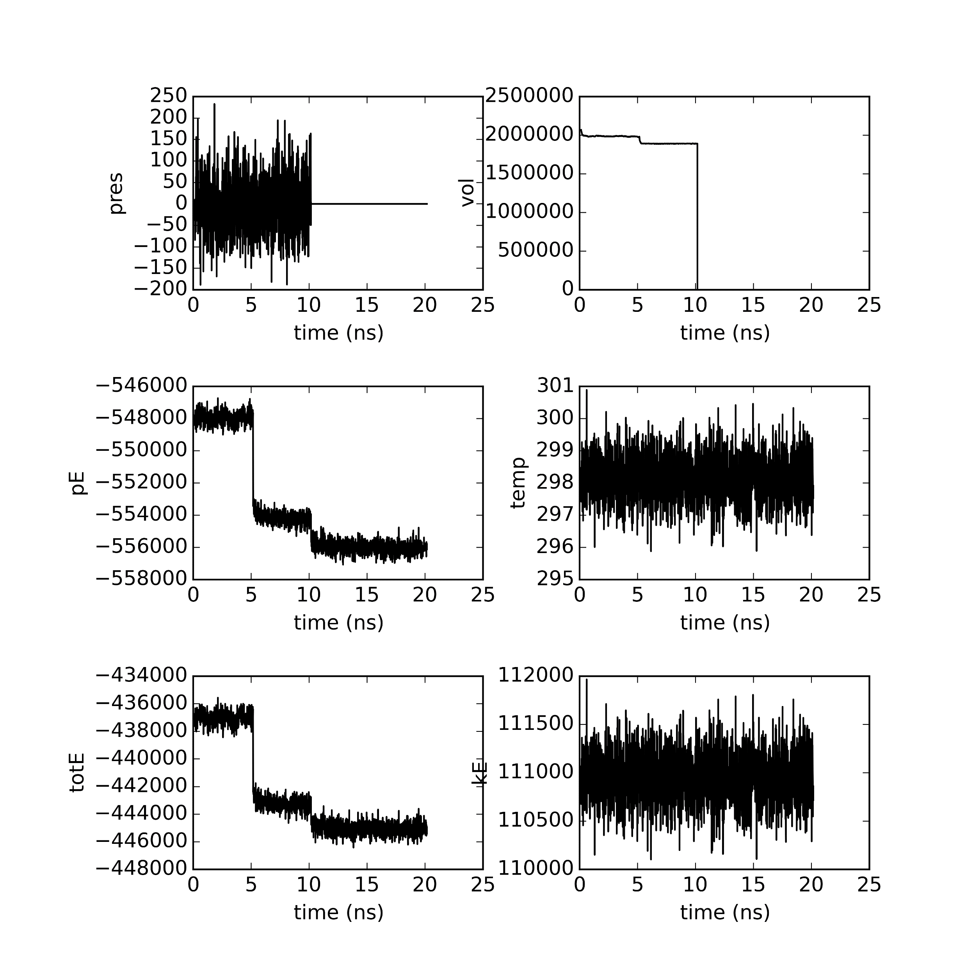
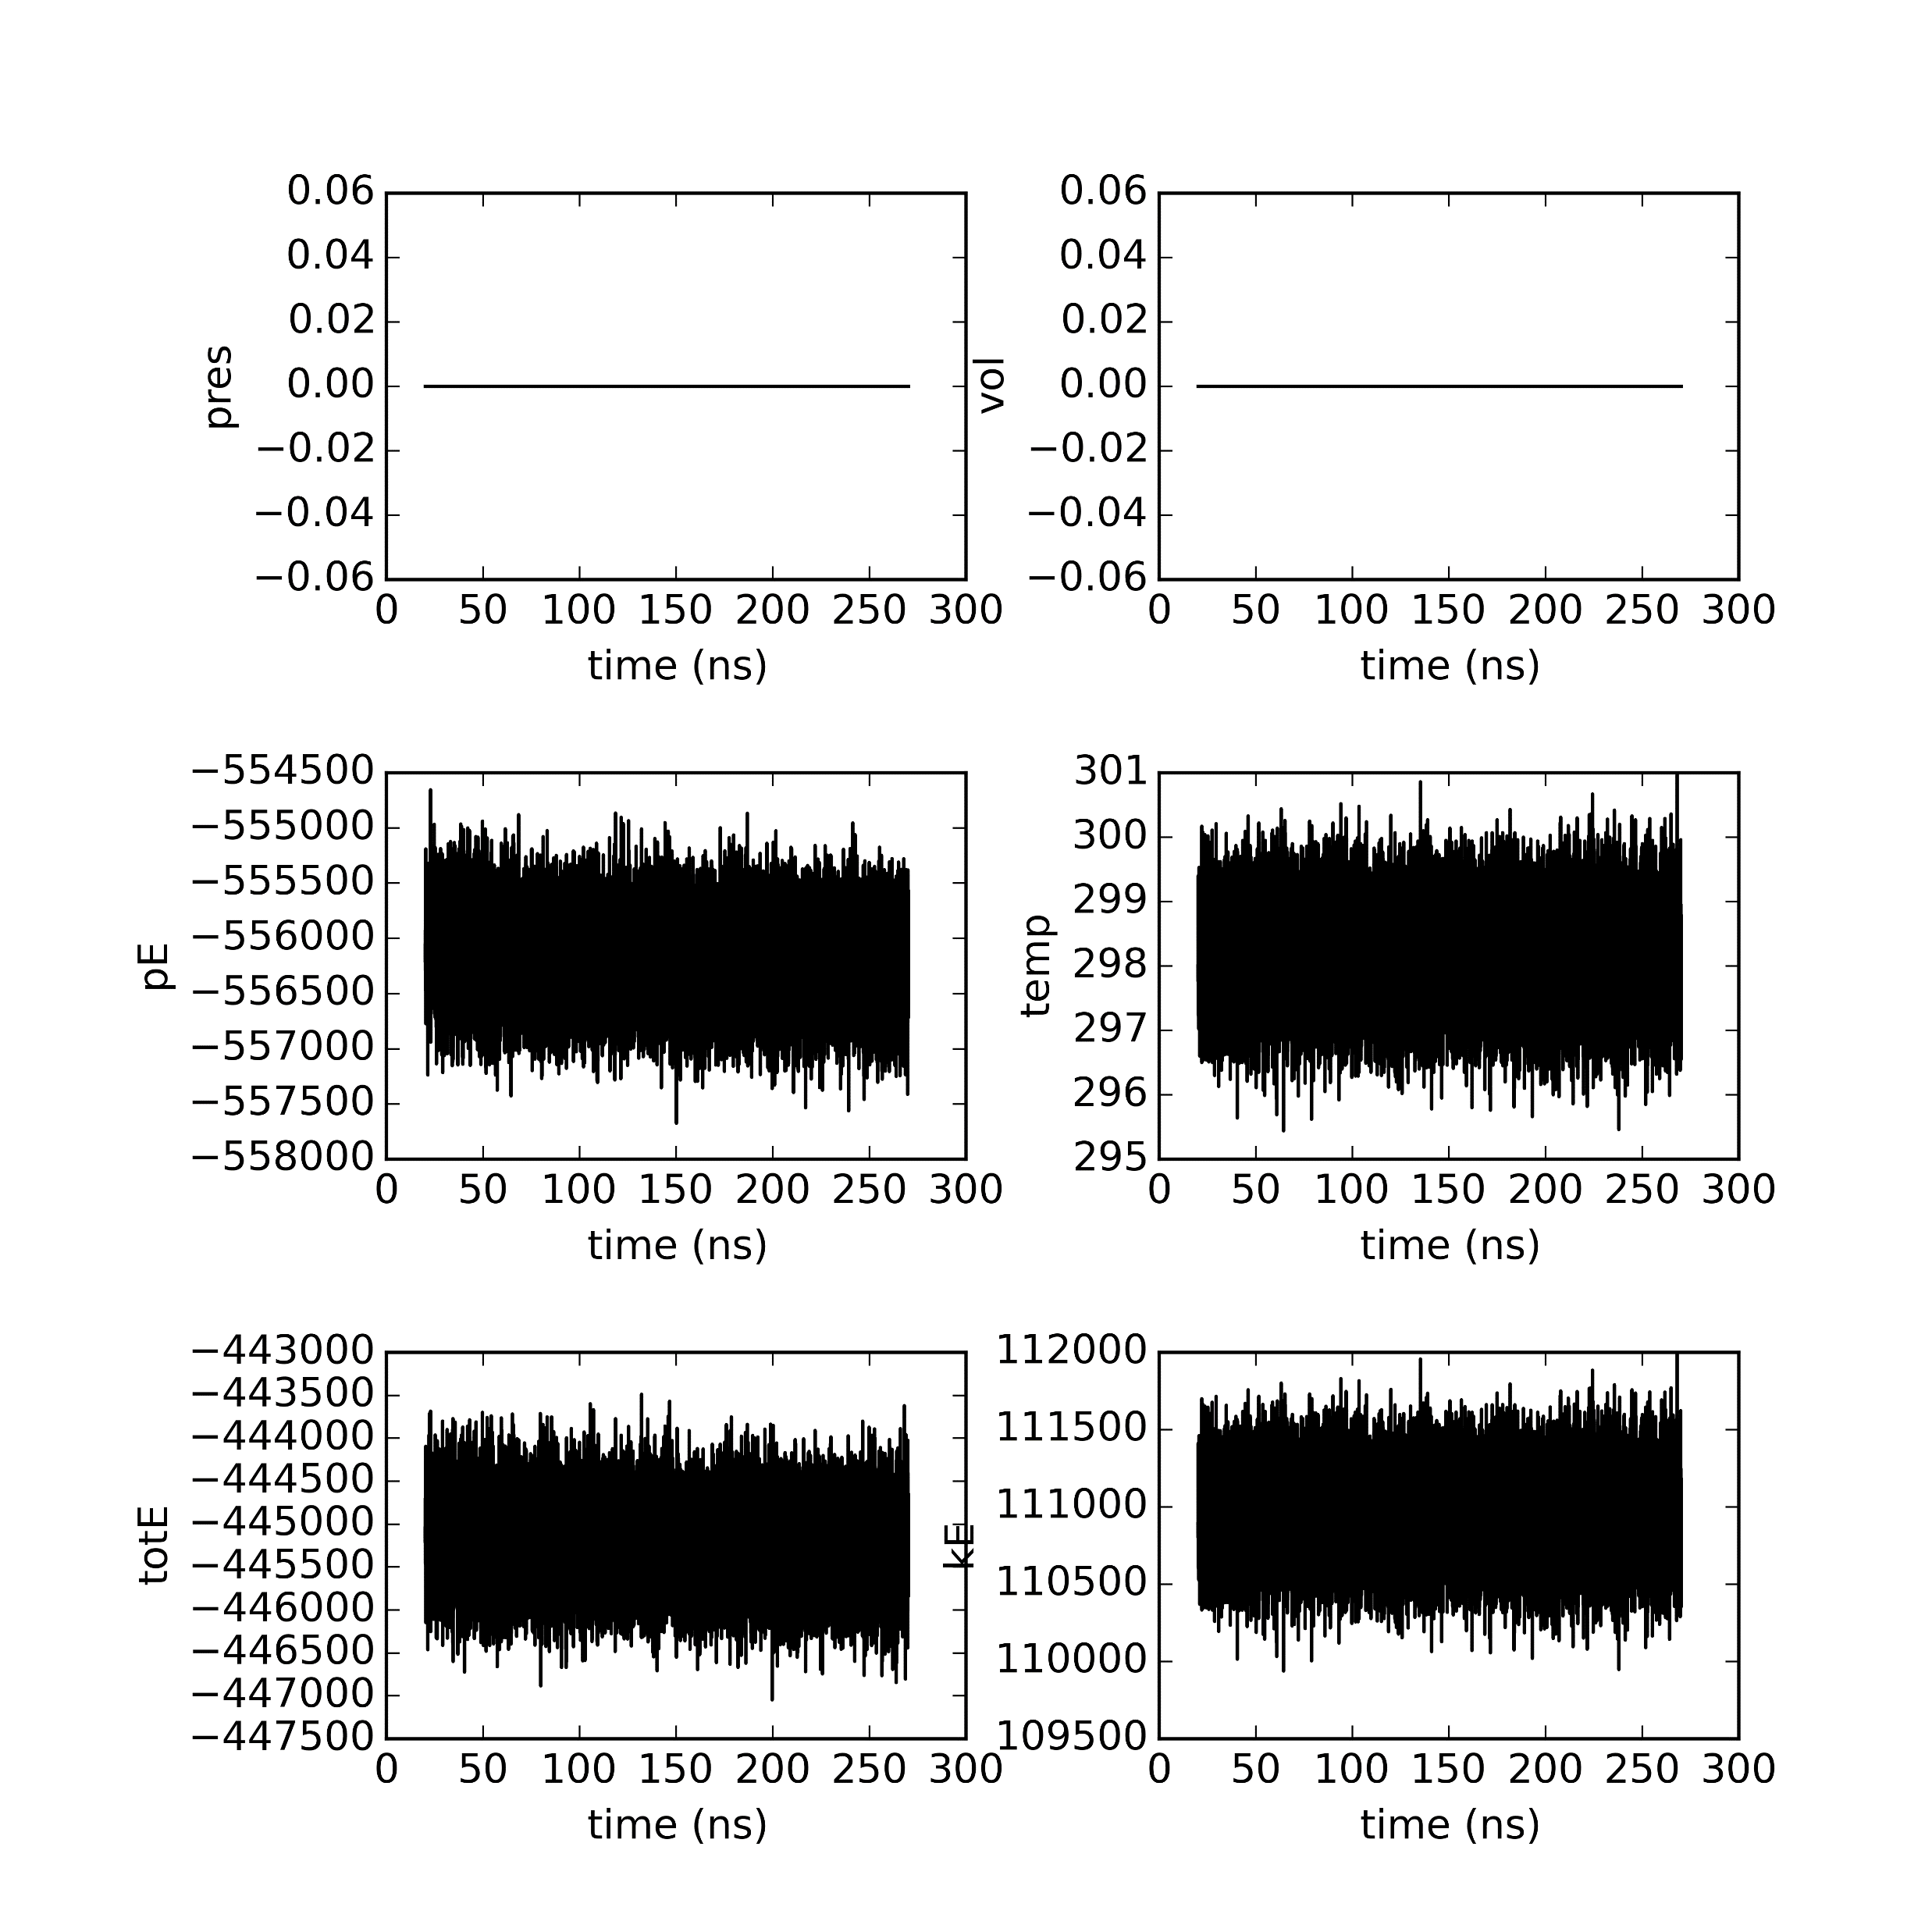
Semi-cross seed 0

Slide 2

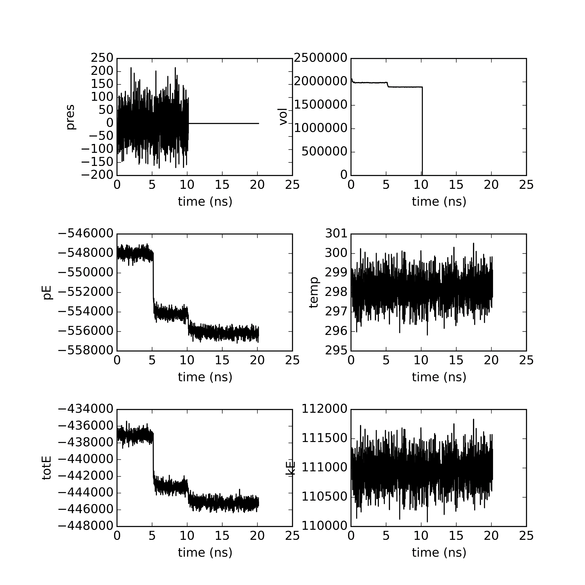
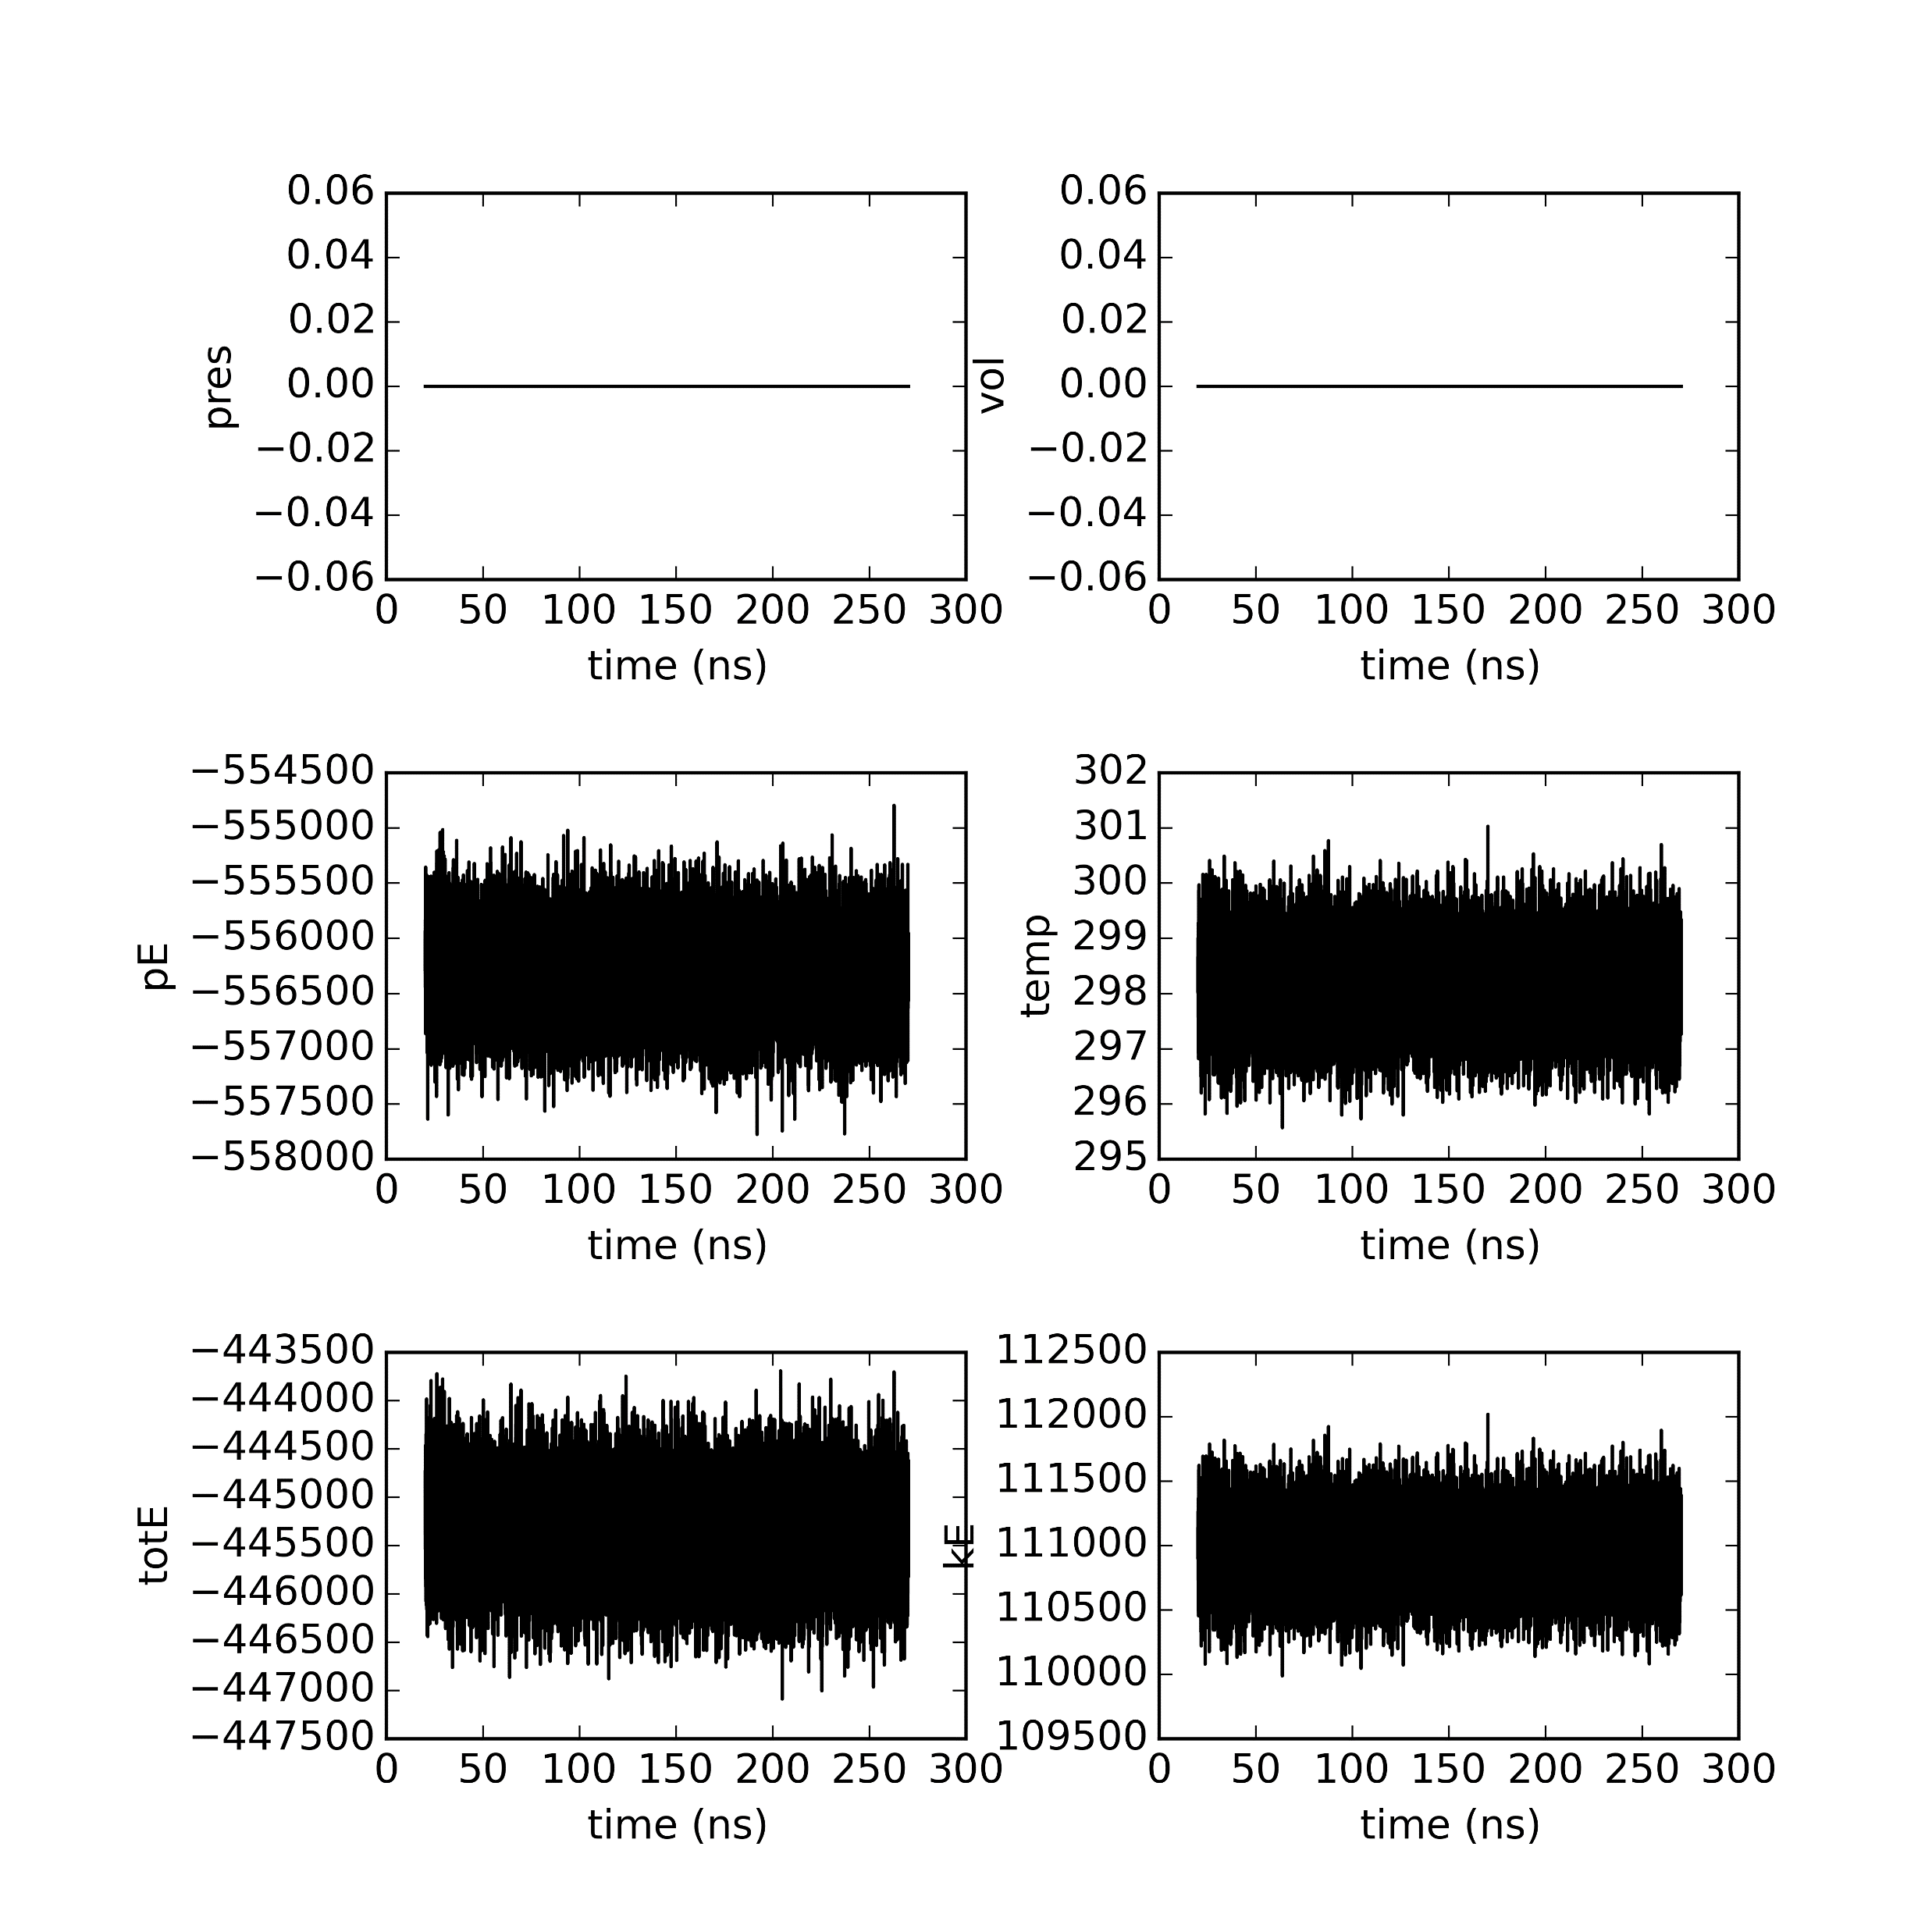
Semi-cross seed 5

Slide 3

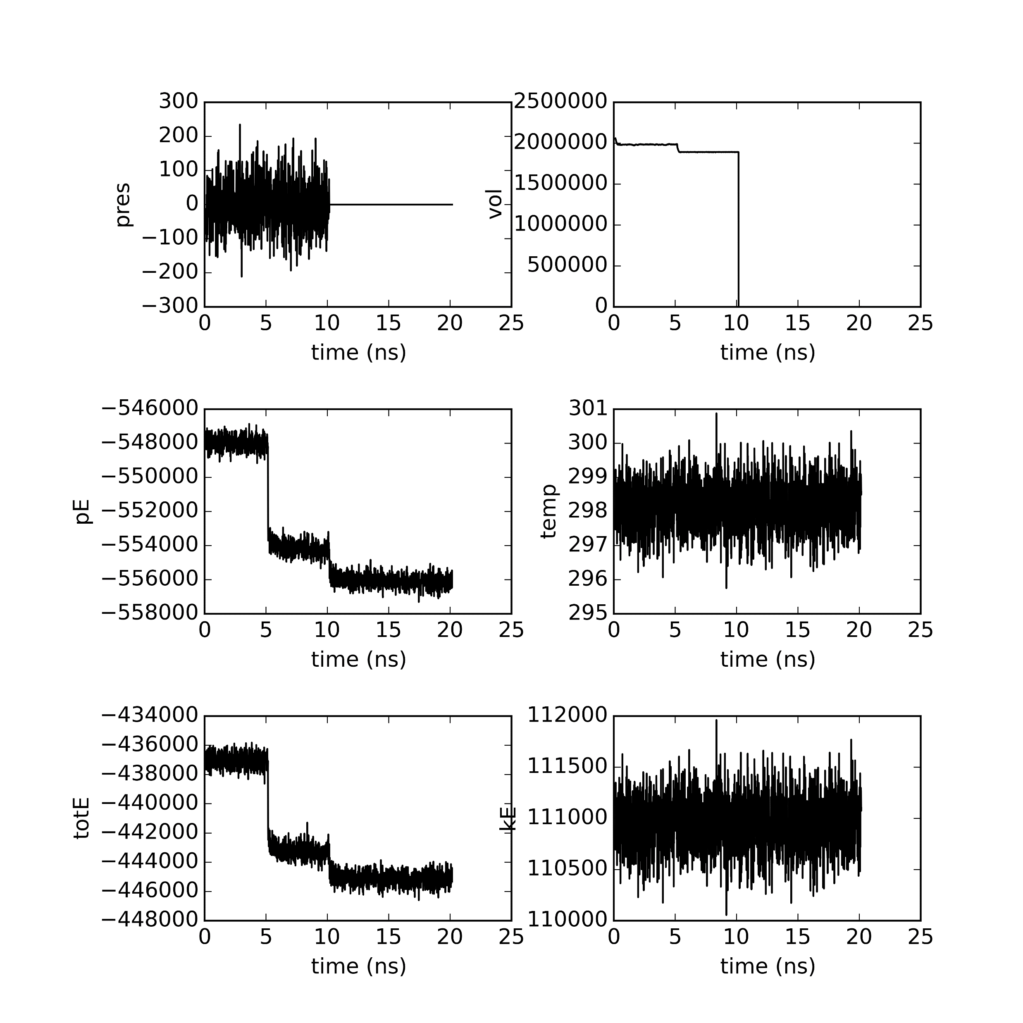
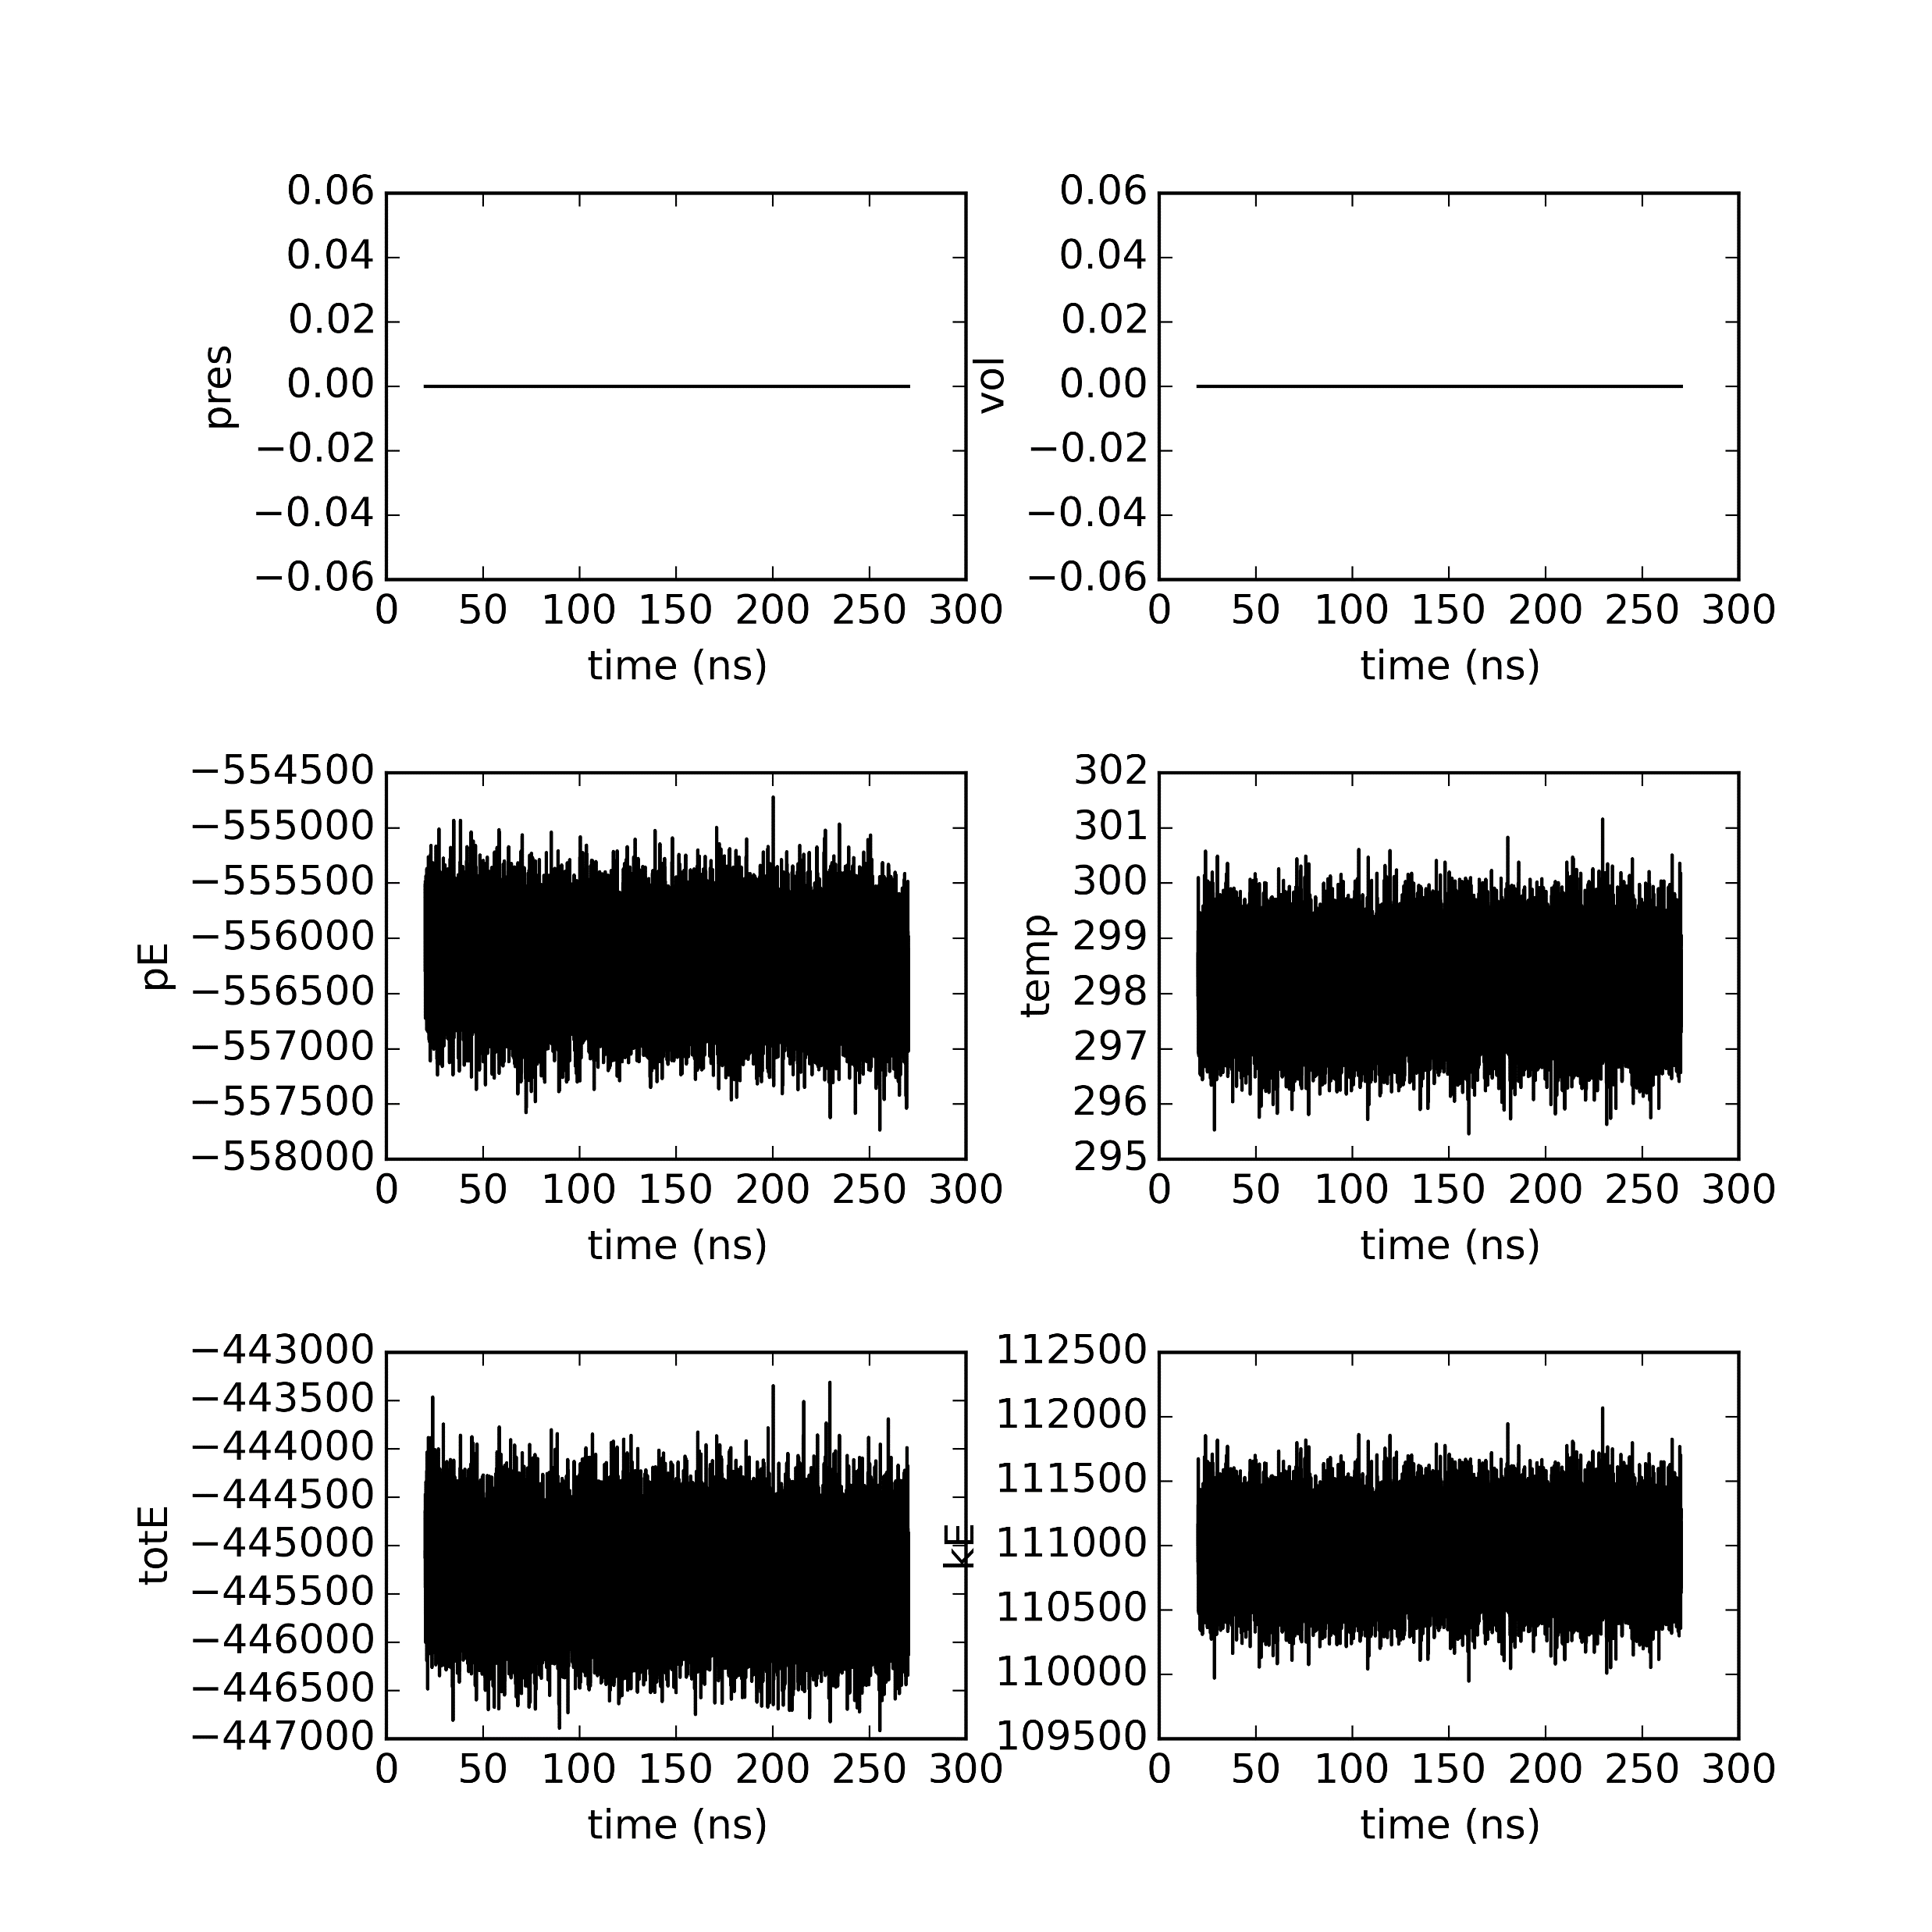
Semi-cross seed 50

Slide 4

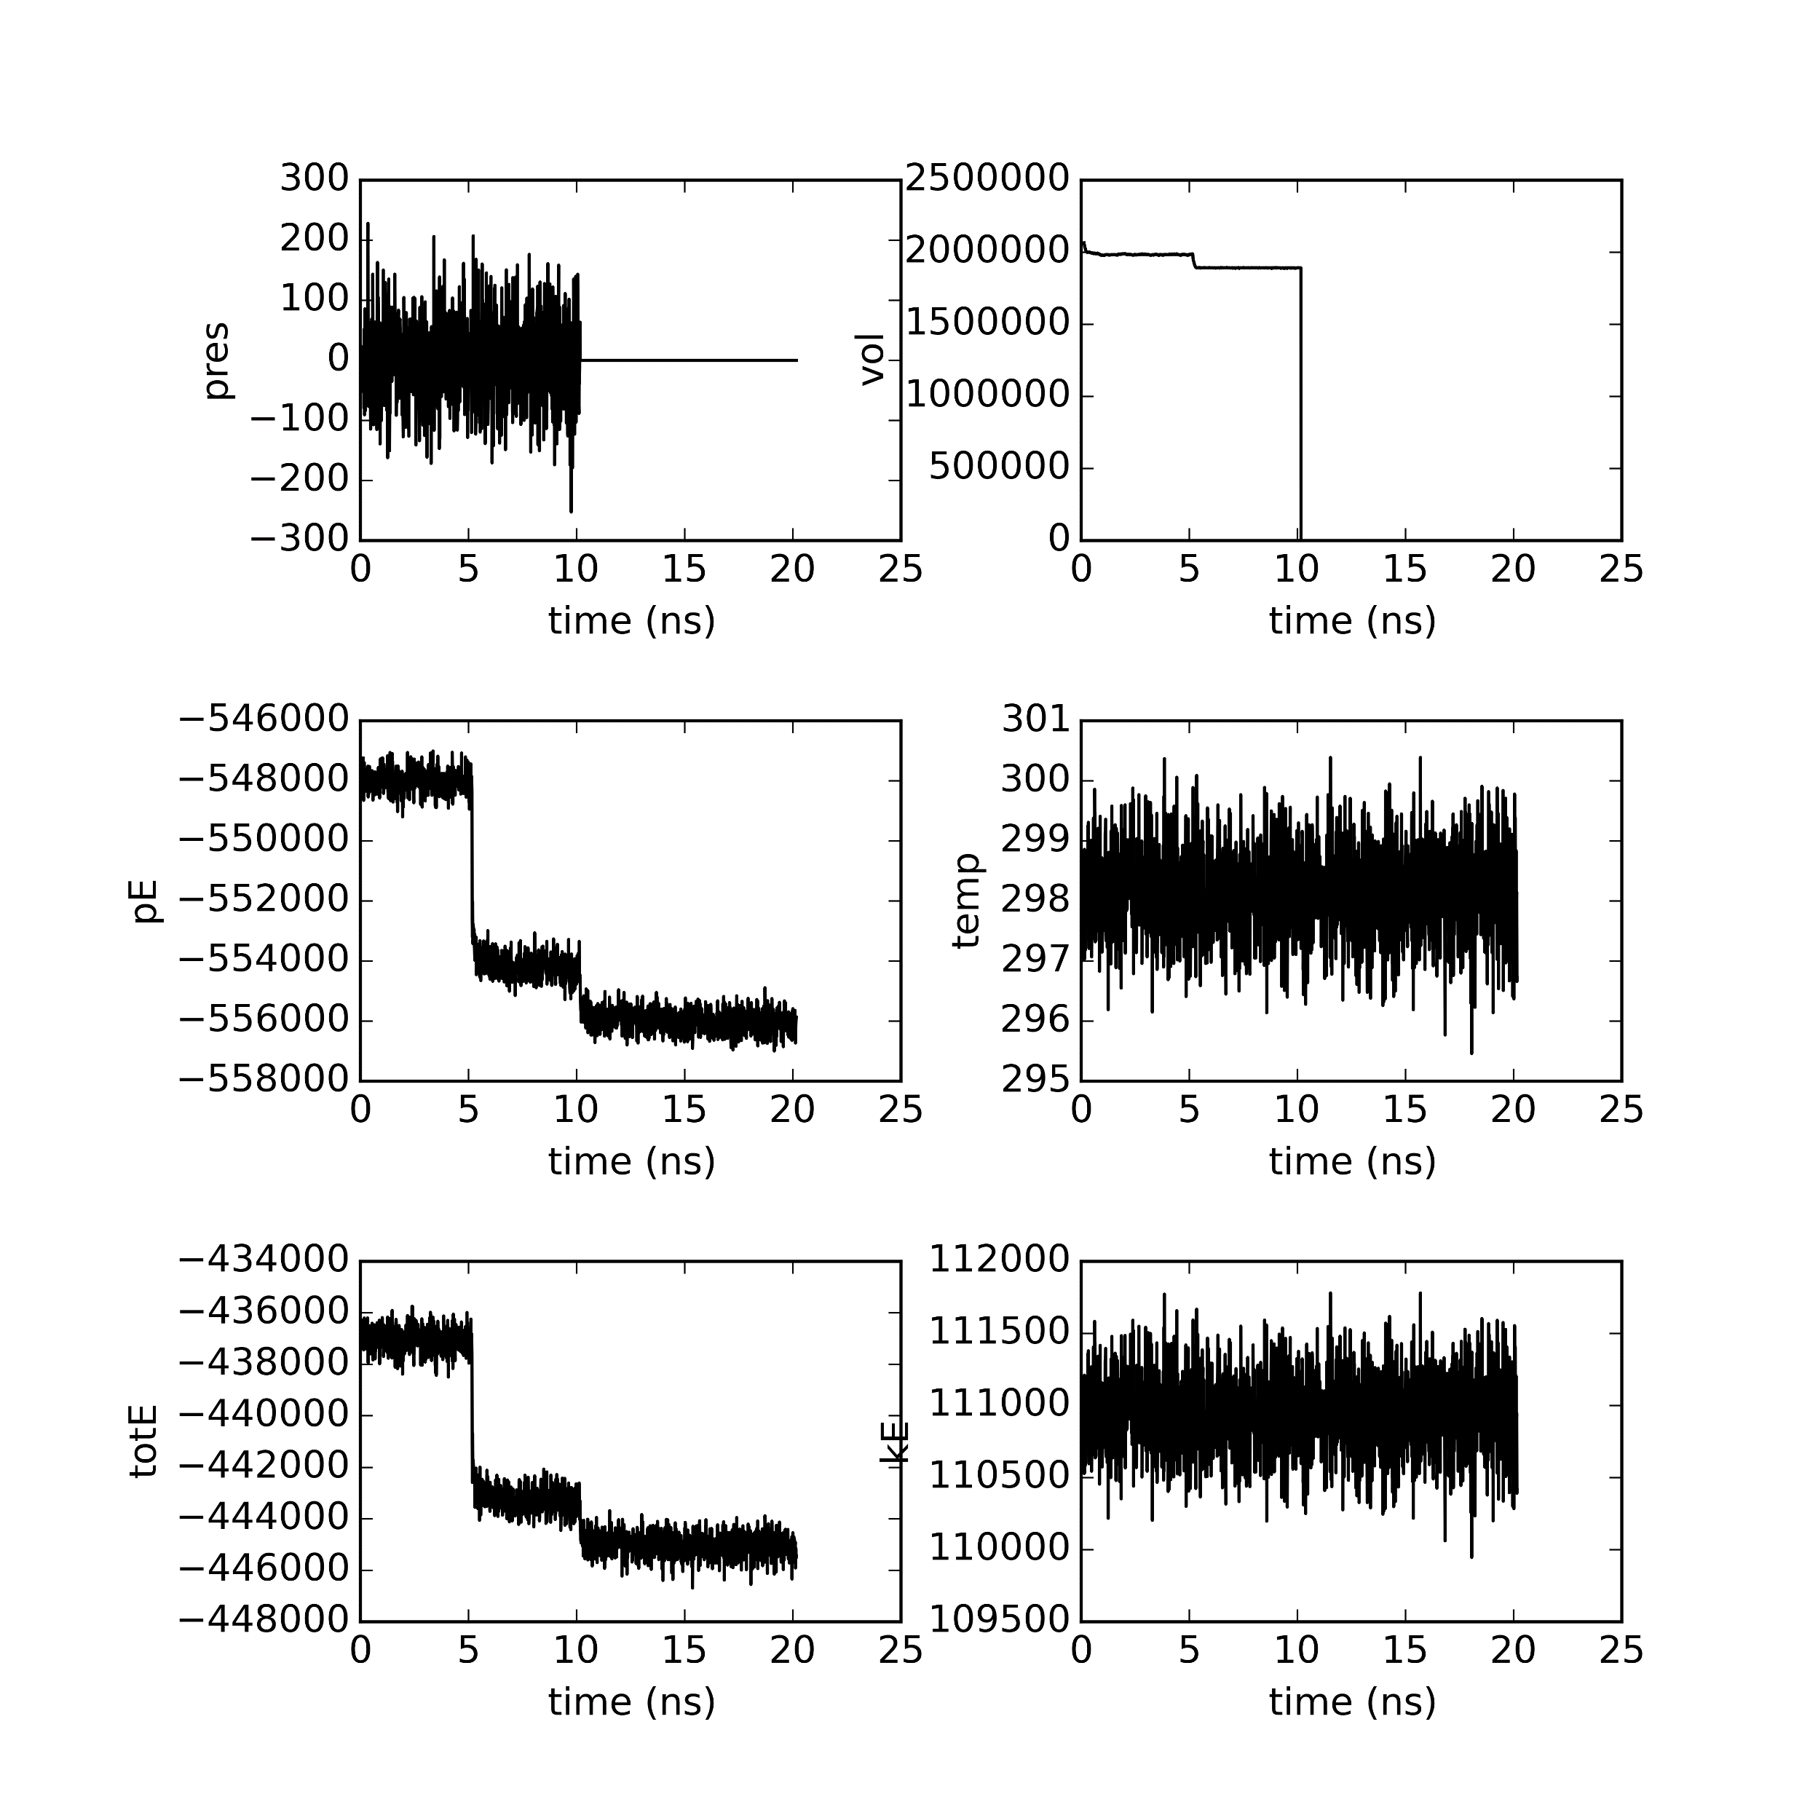
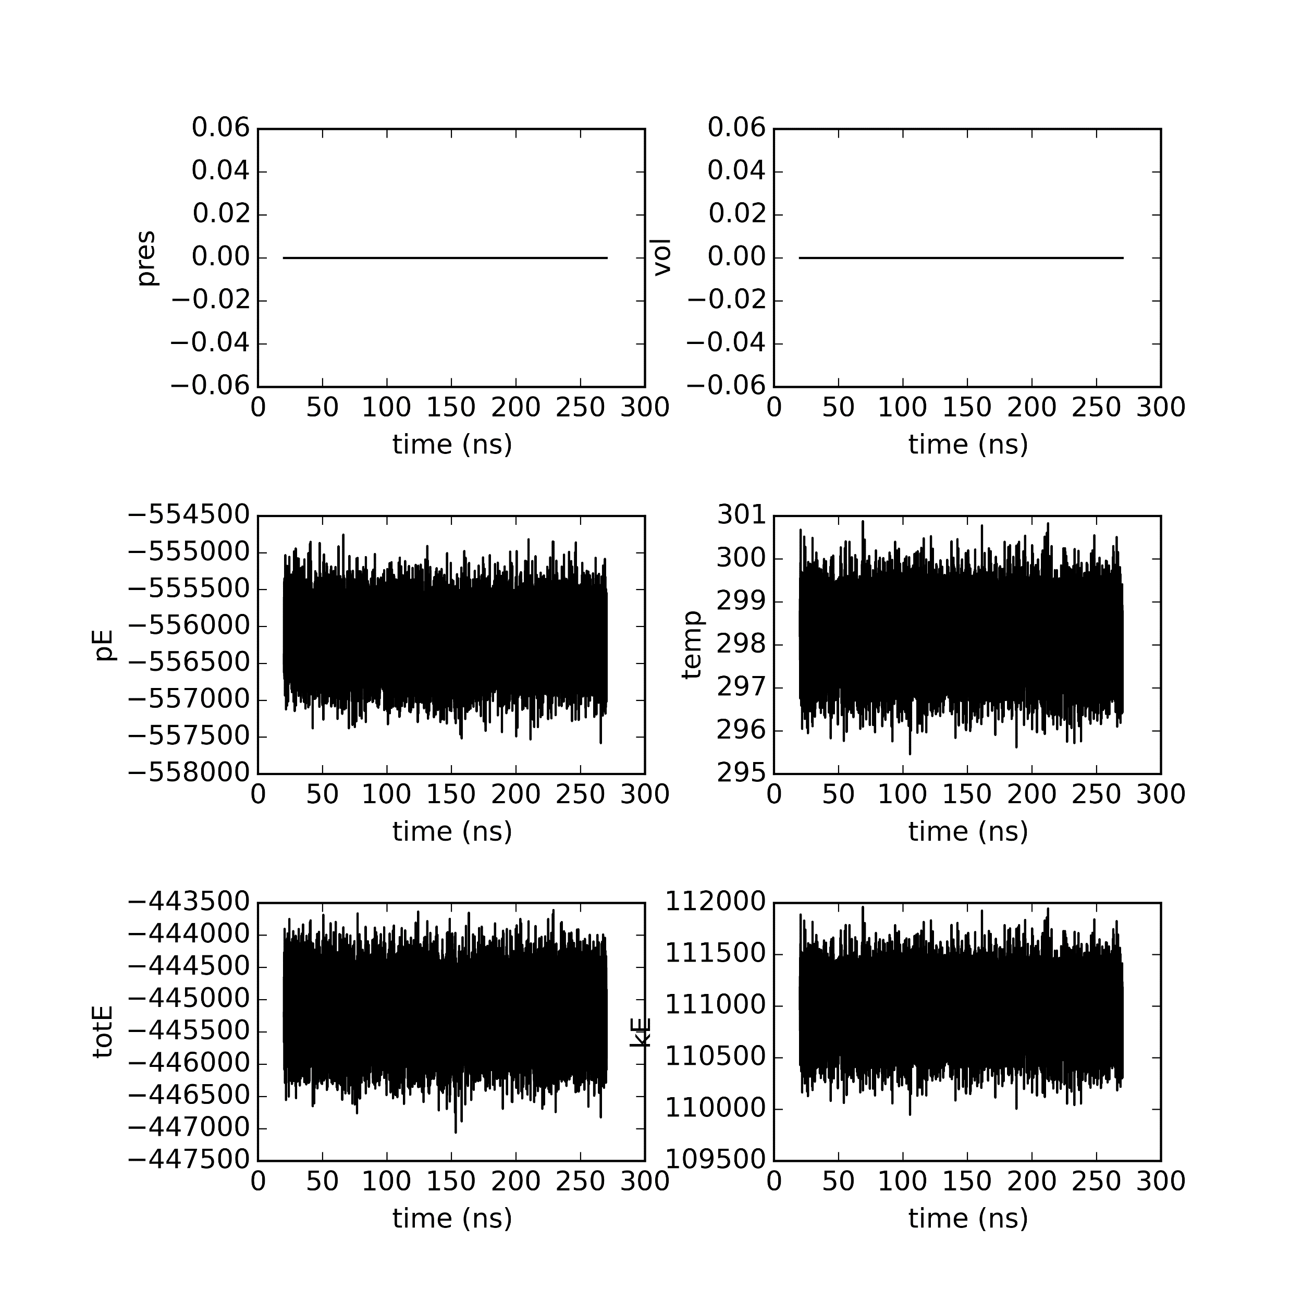
Semi-cross seed 500

Slide 5
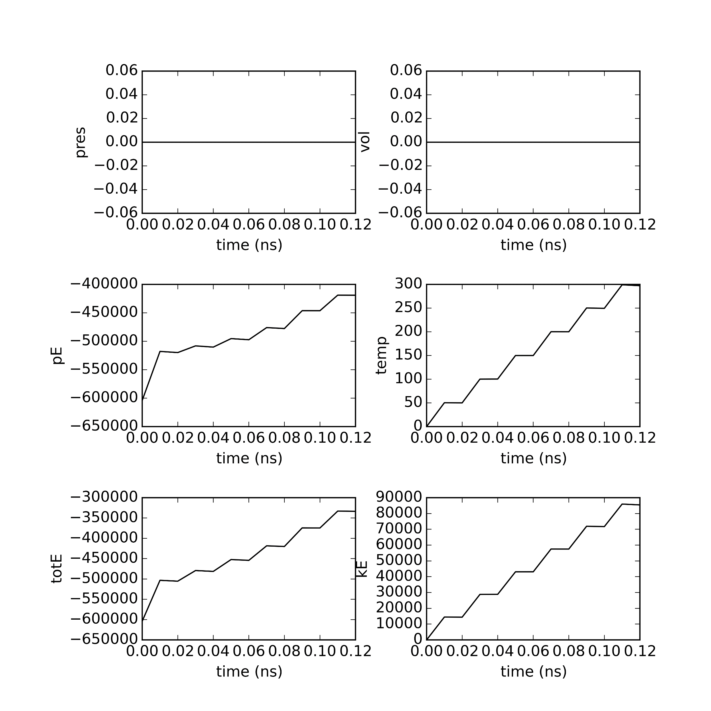
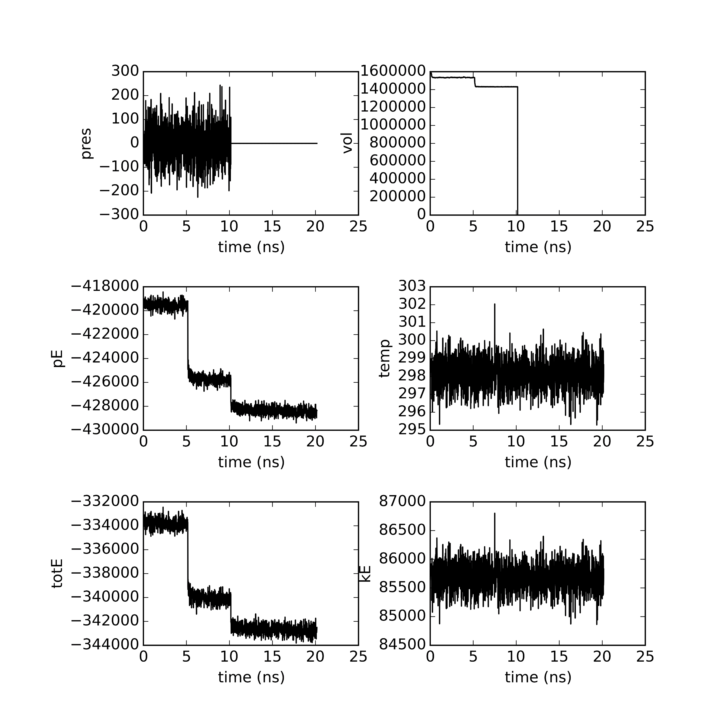
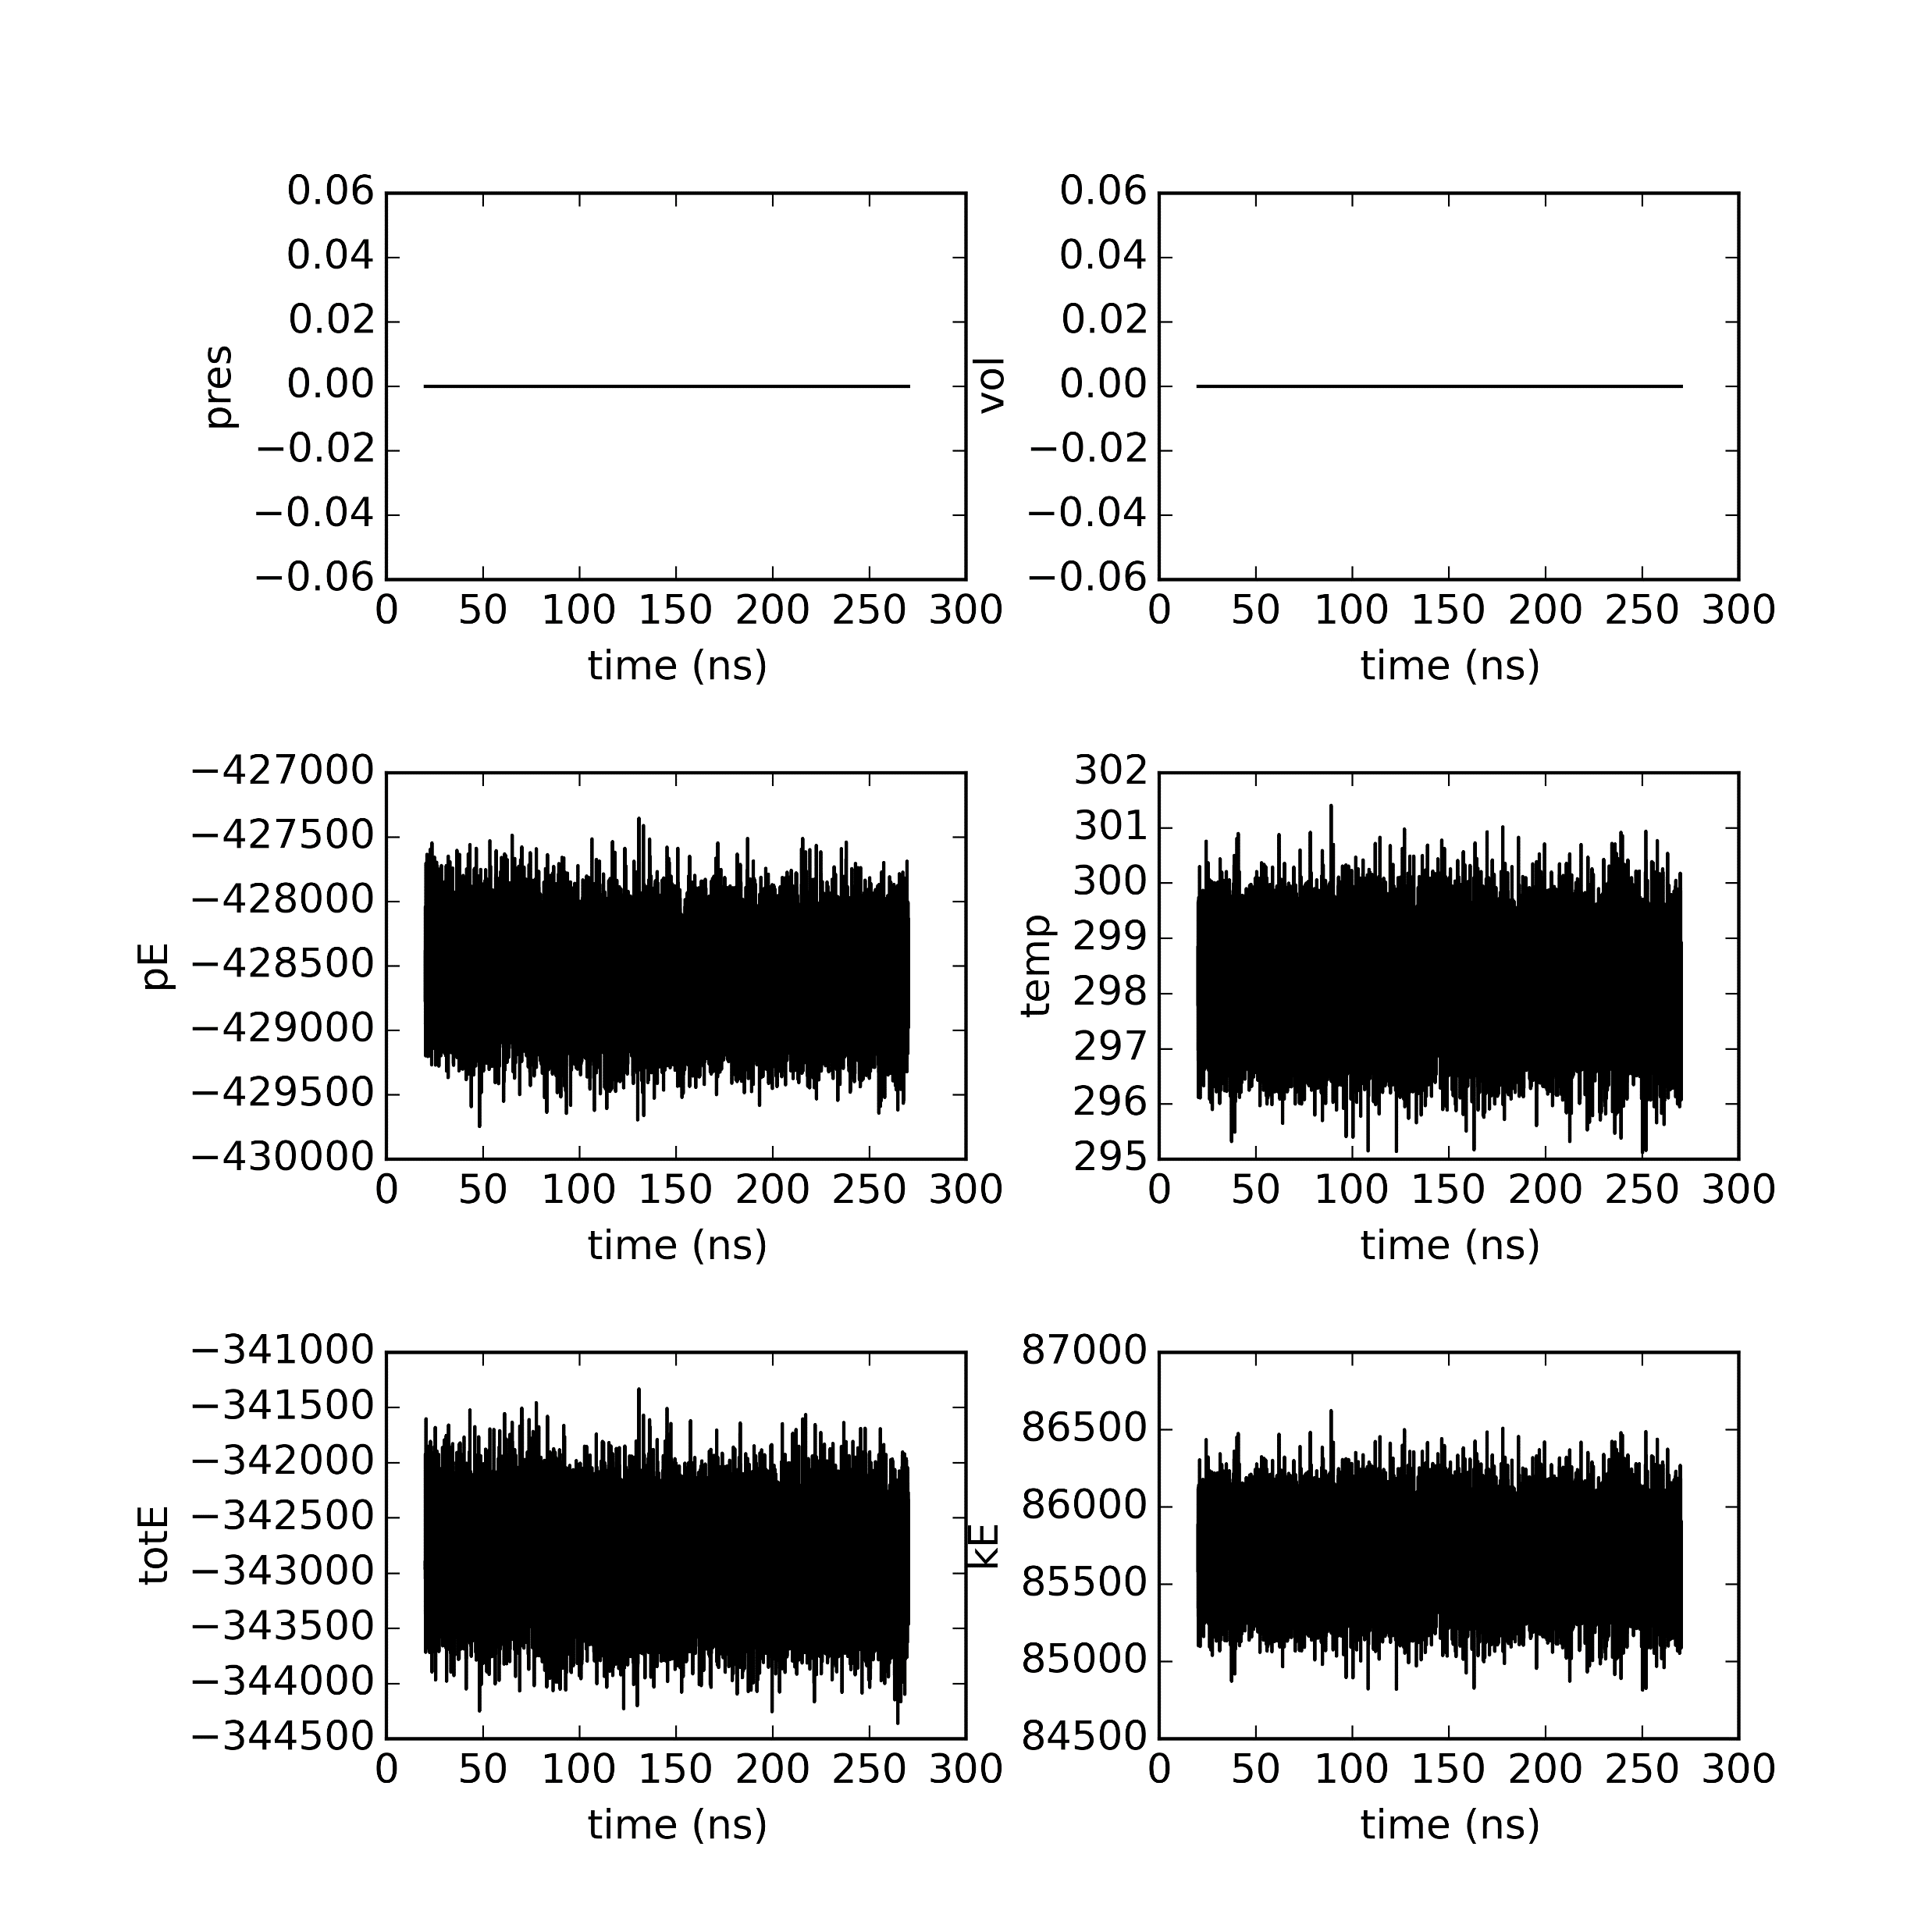
Semi seed 0

Slide 6

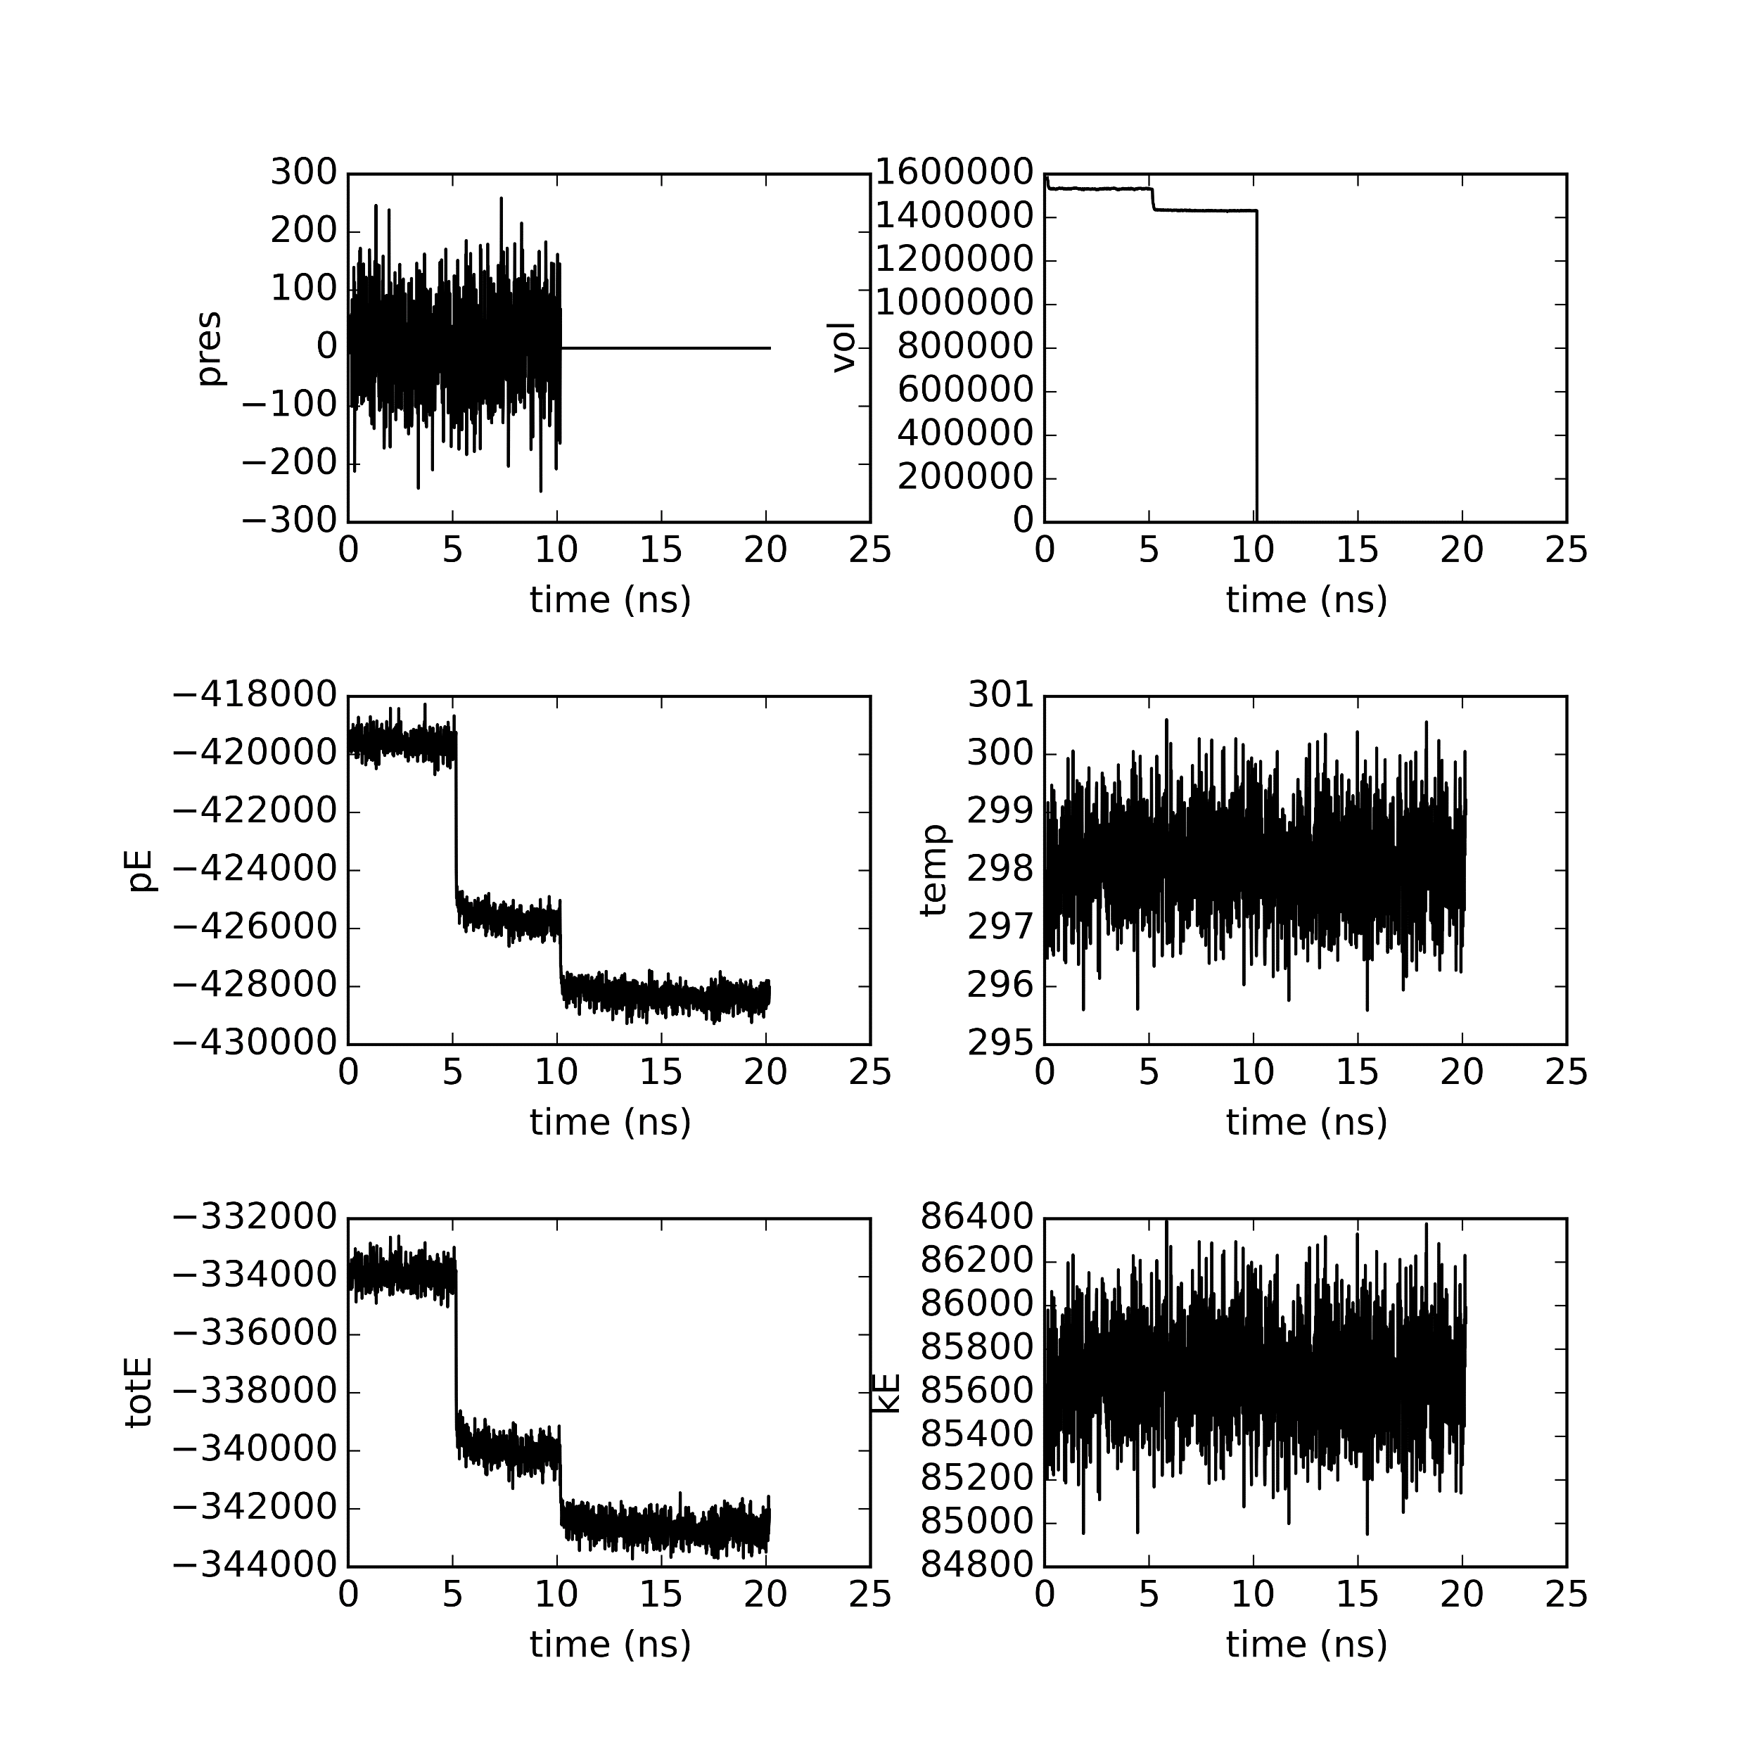
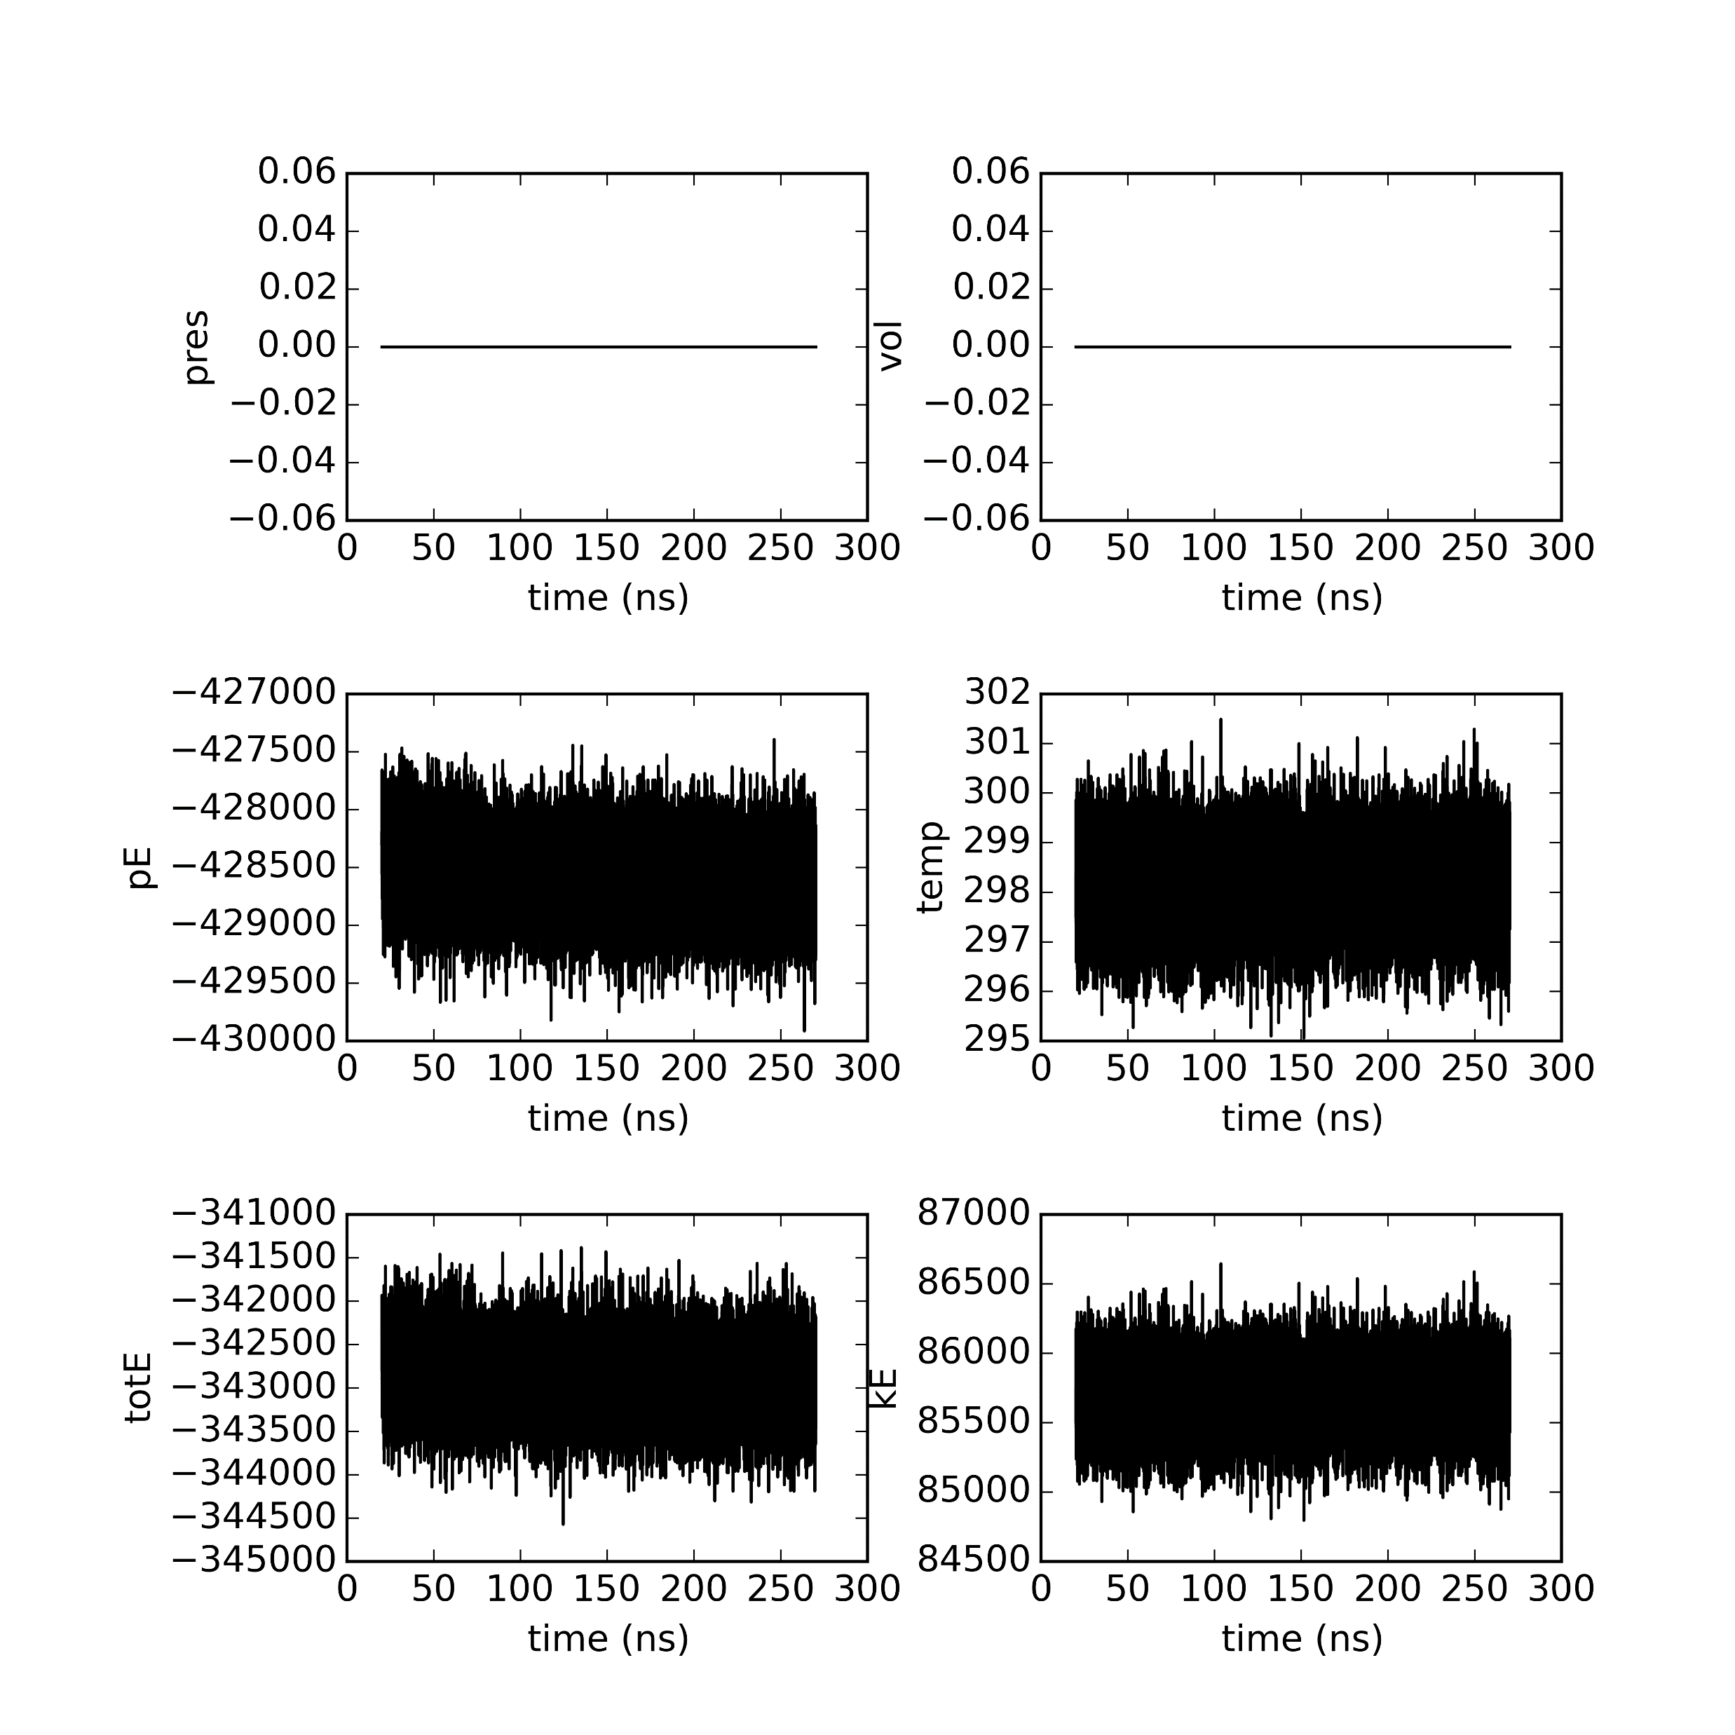
Semi seed 5

Slide 7


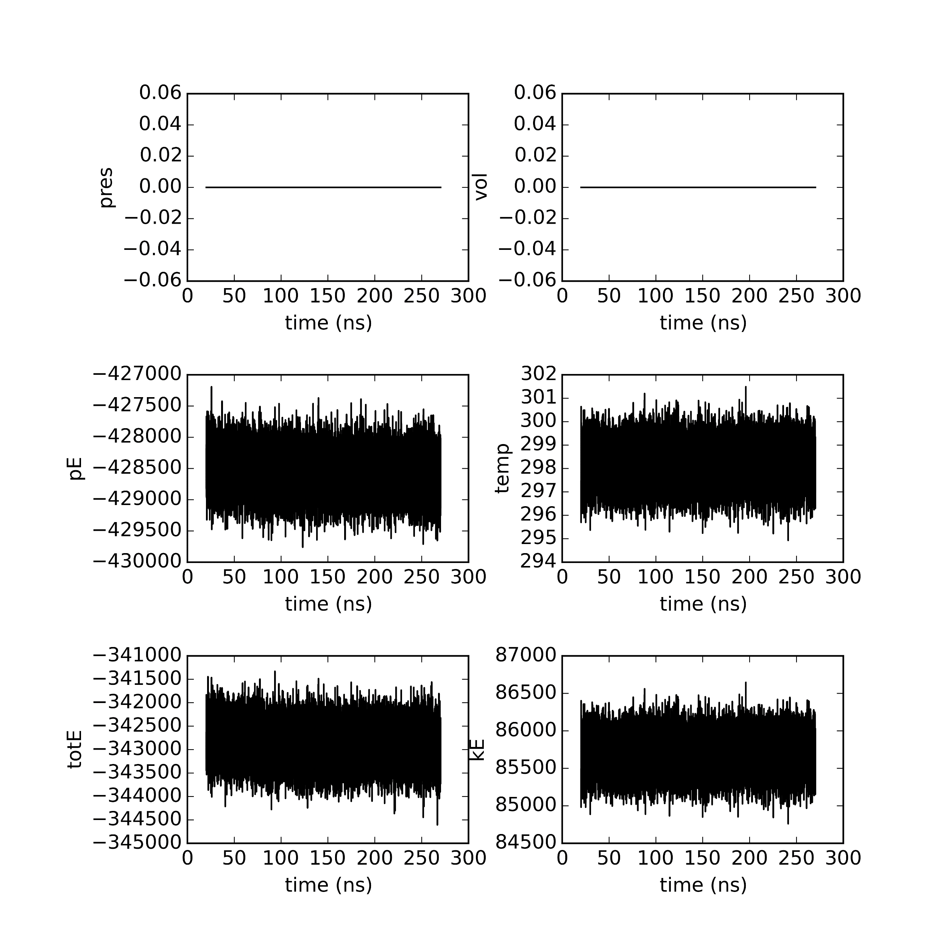
Semi seed 50

Slide 8


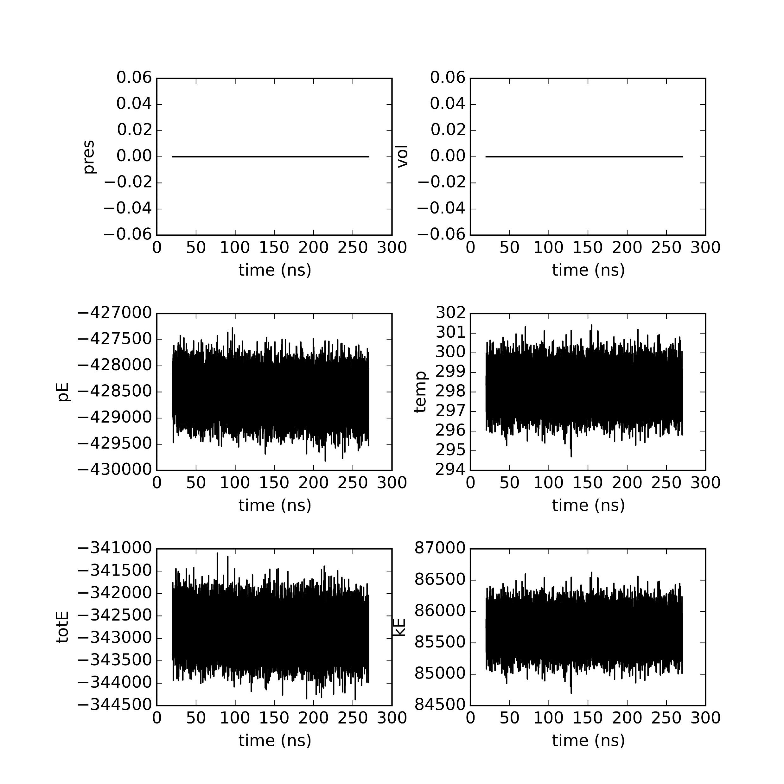
Semi seed 500

Slide 9
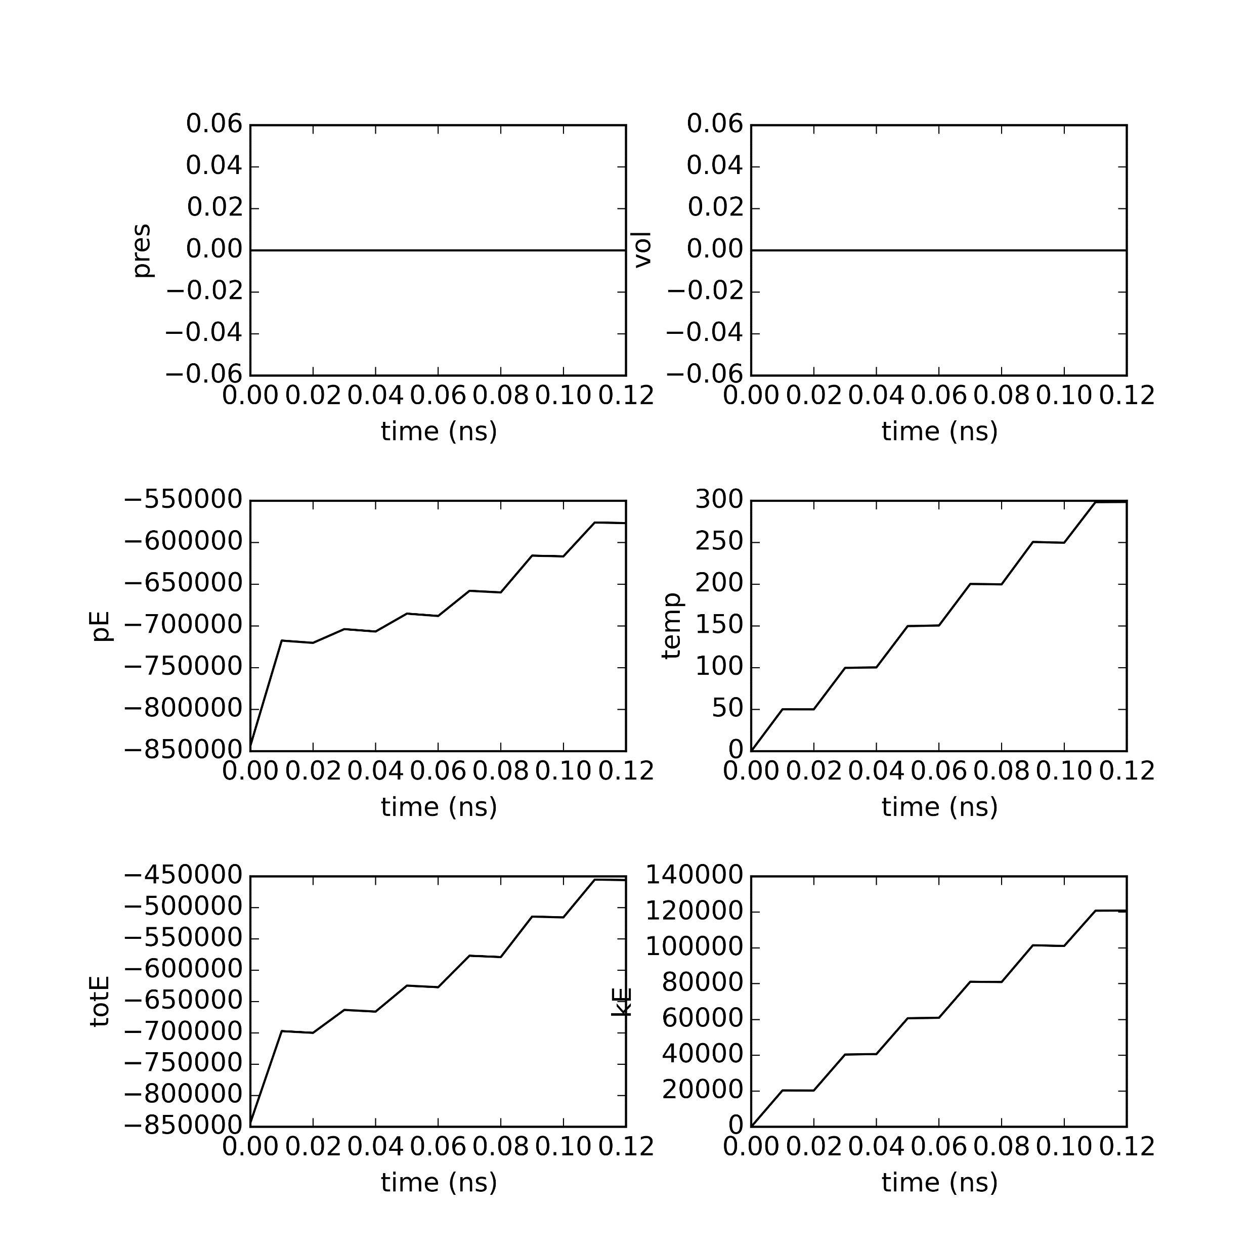
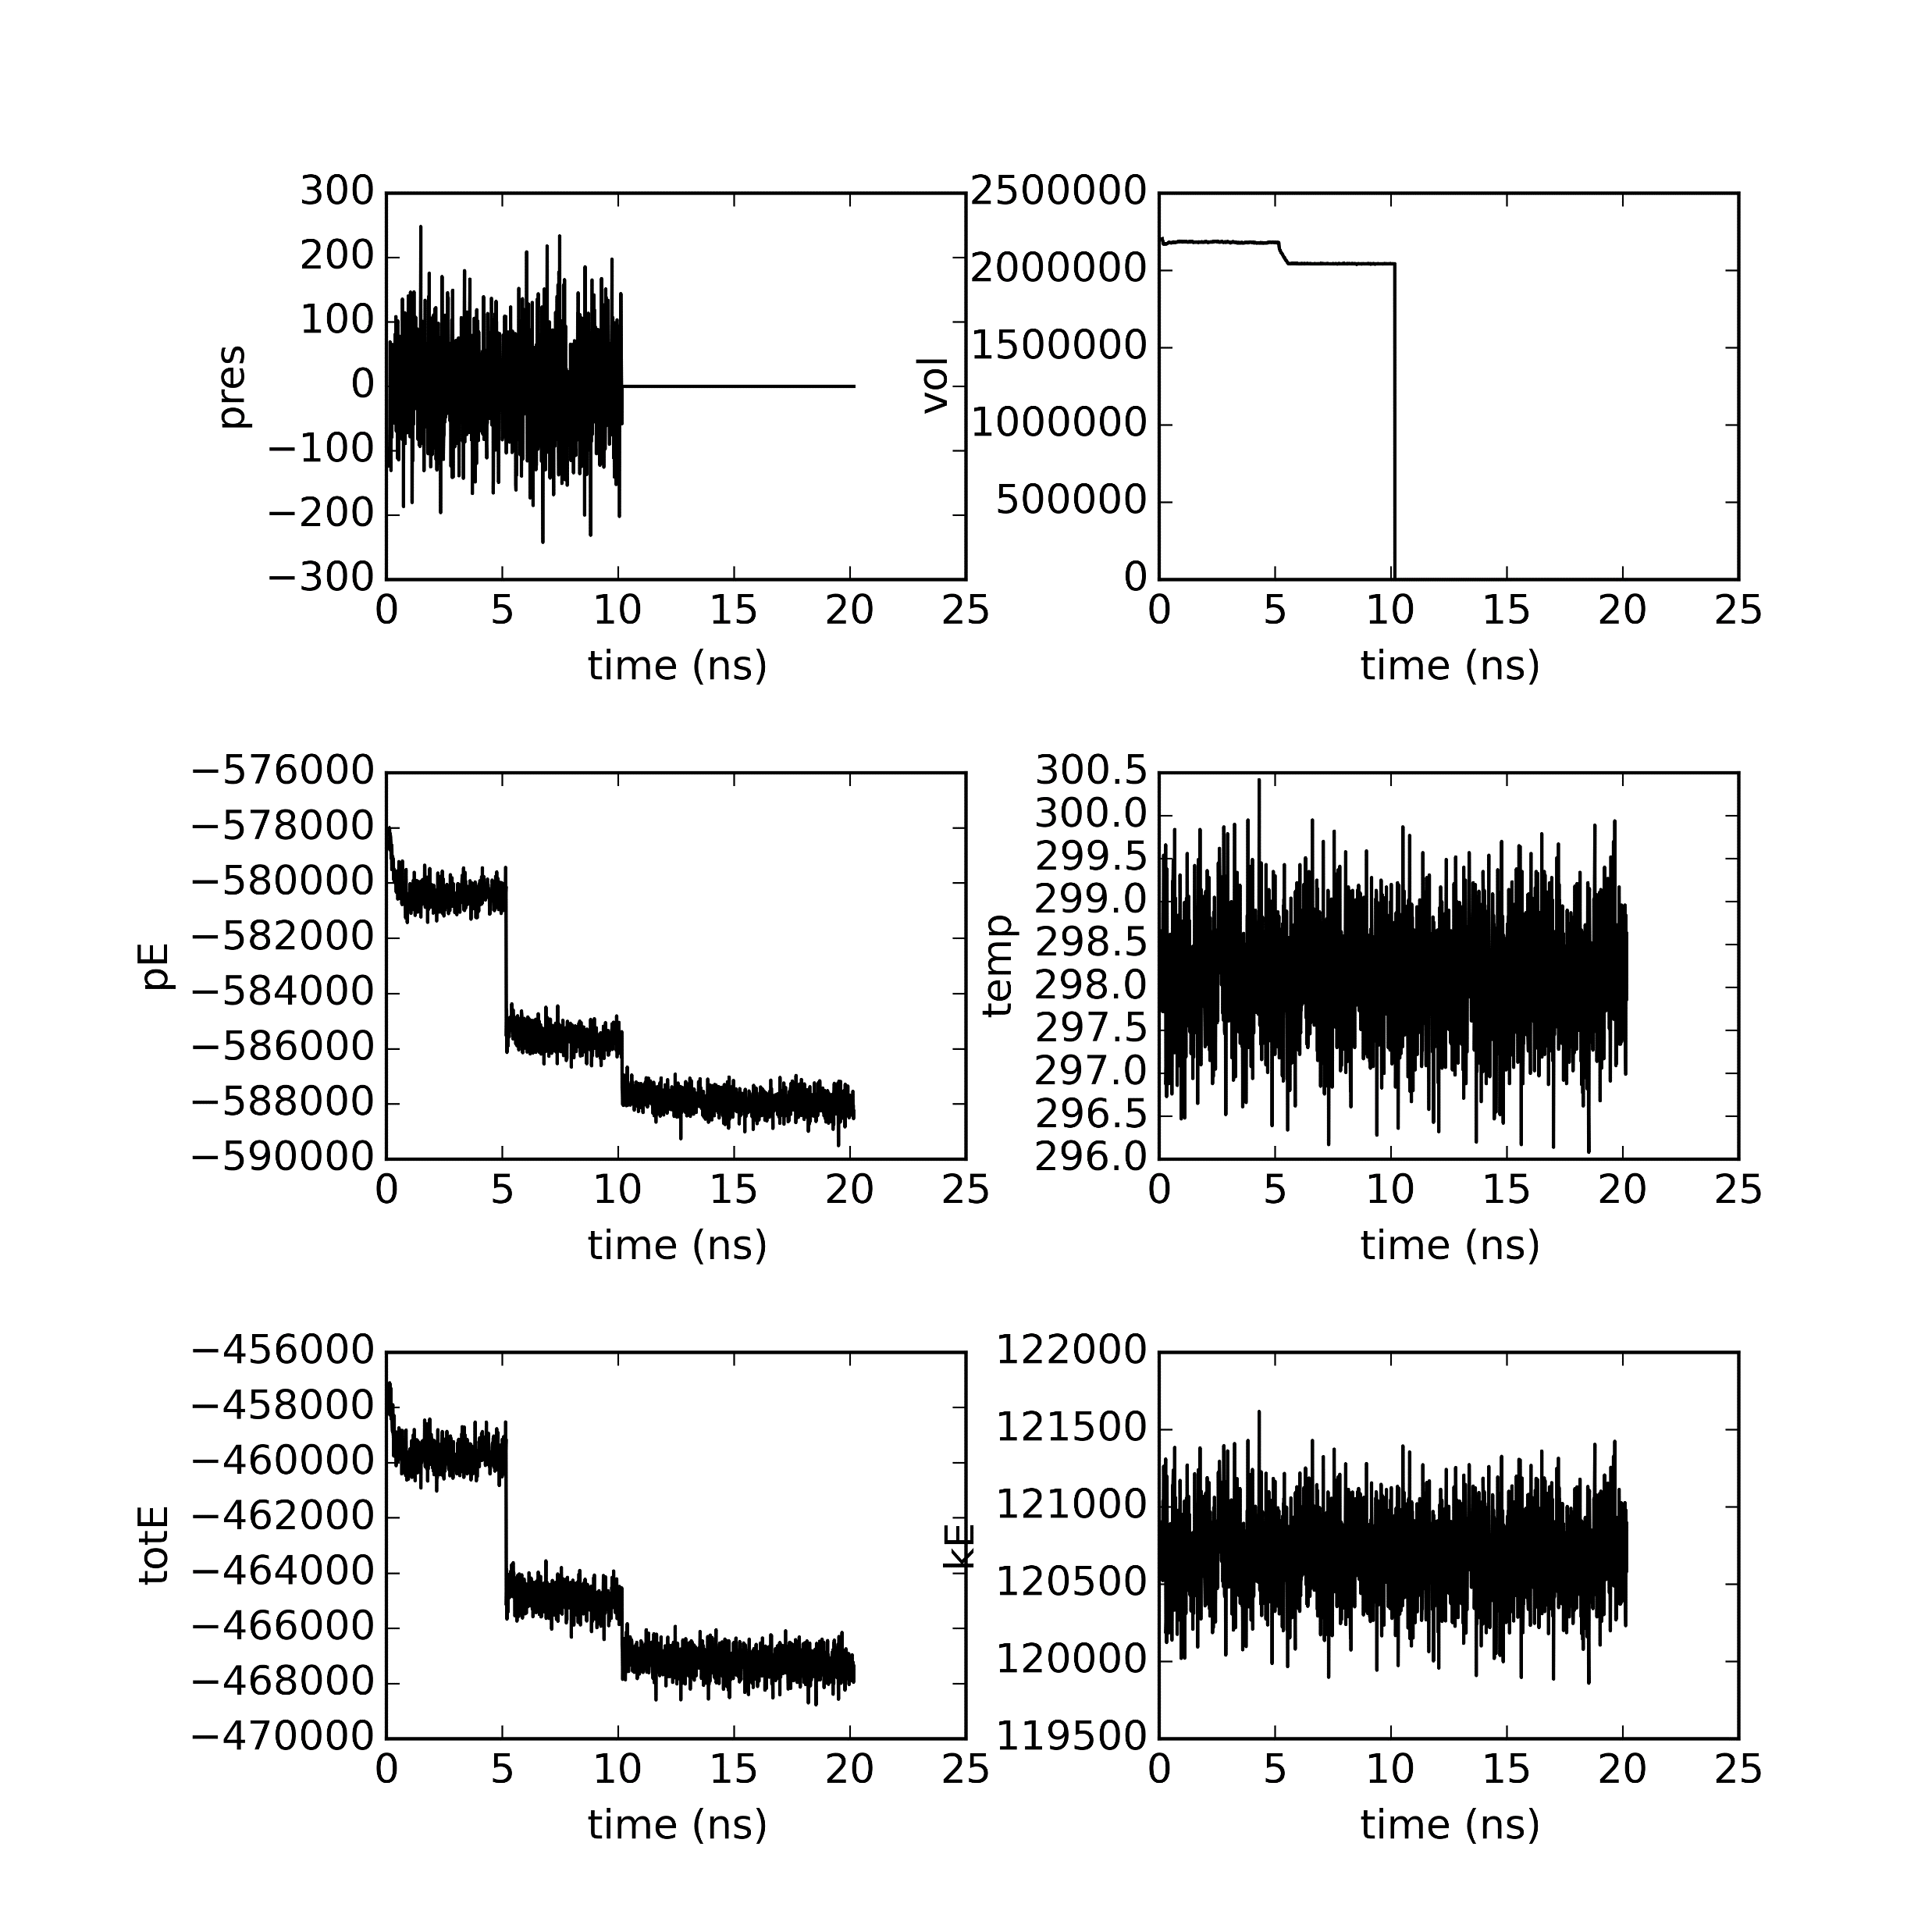

Closed seed 0

Slide 10

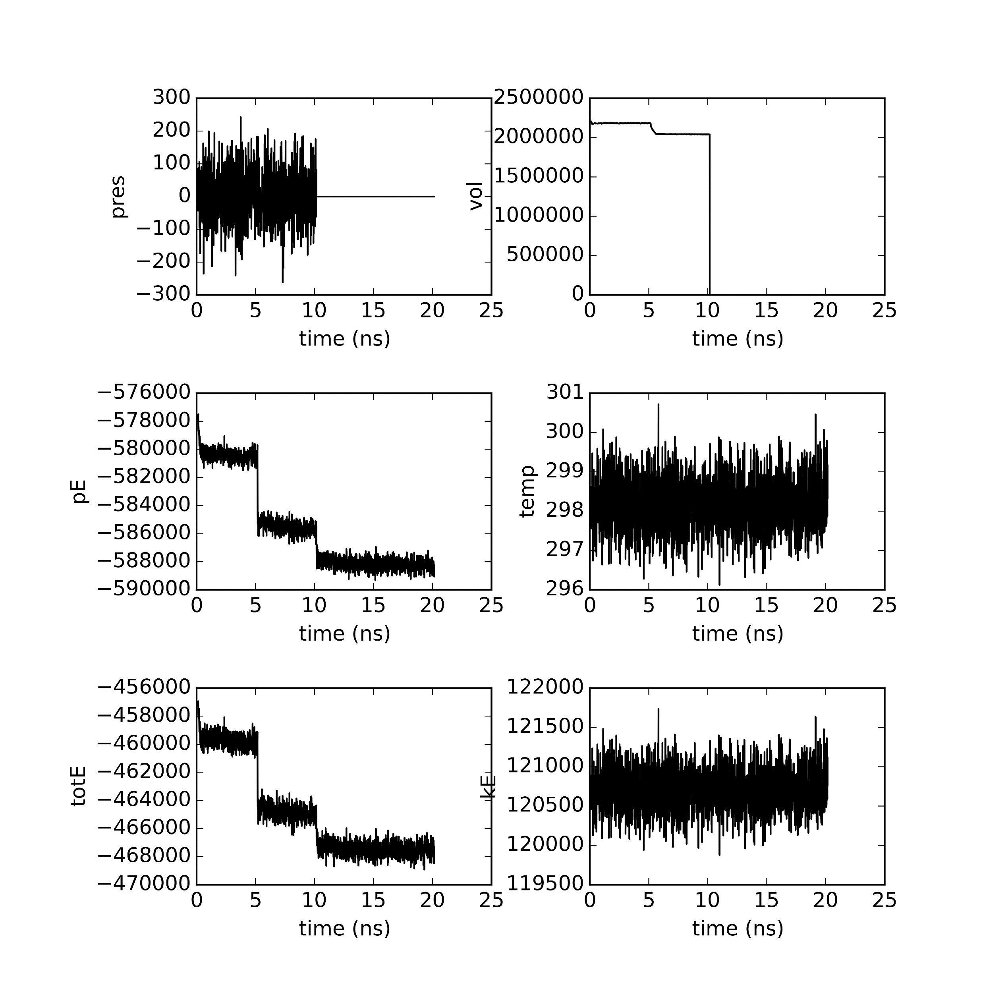
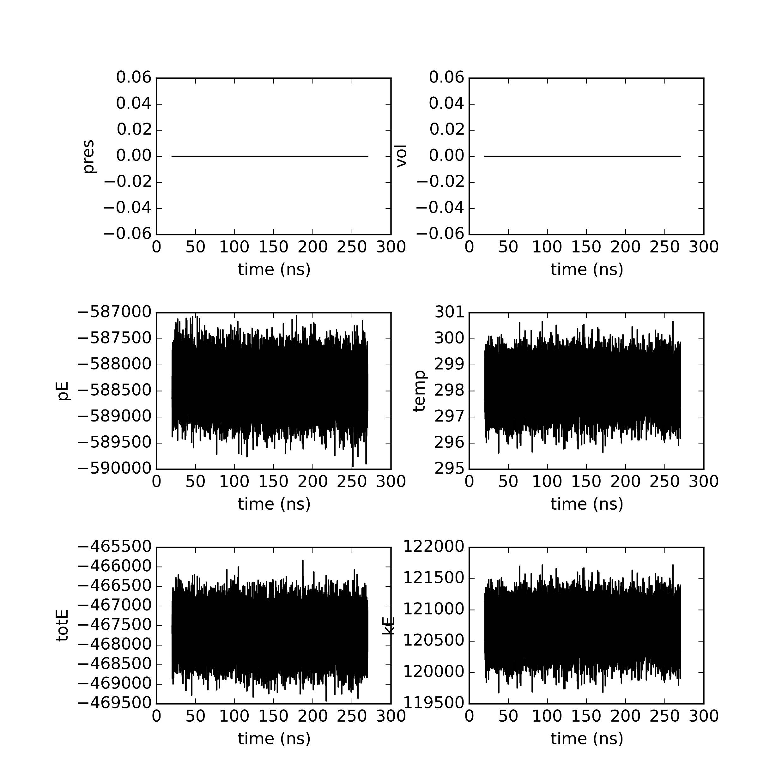
Closed seed 5

Slide 11

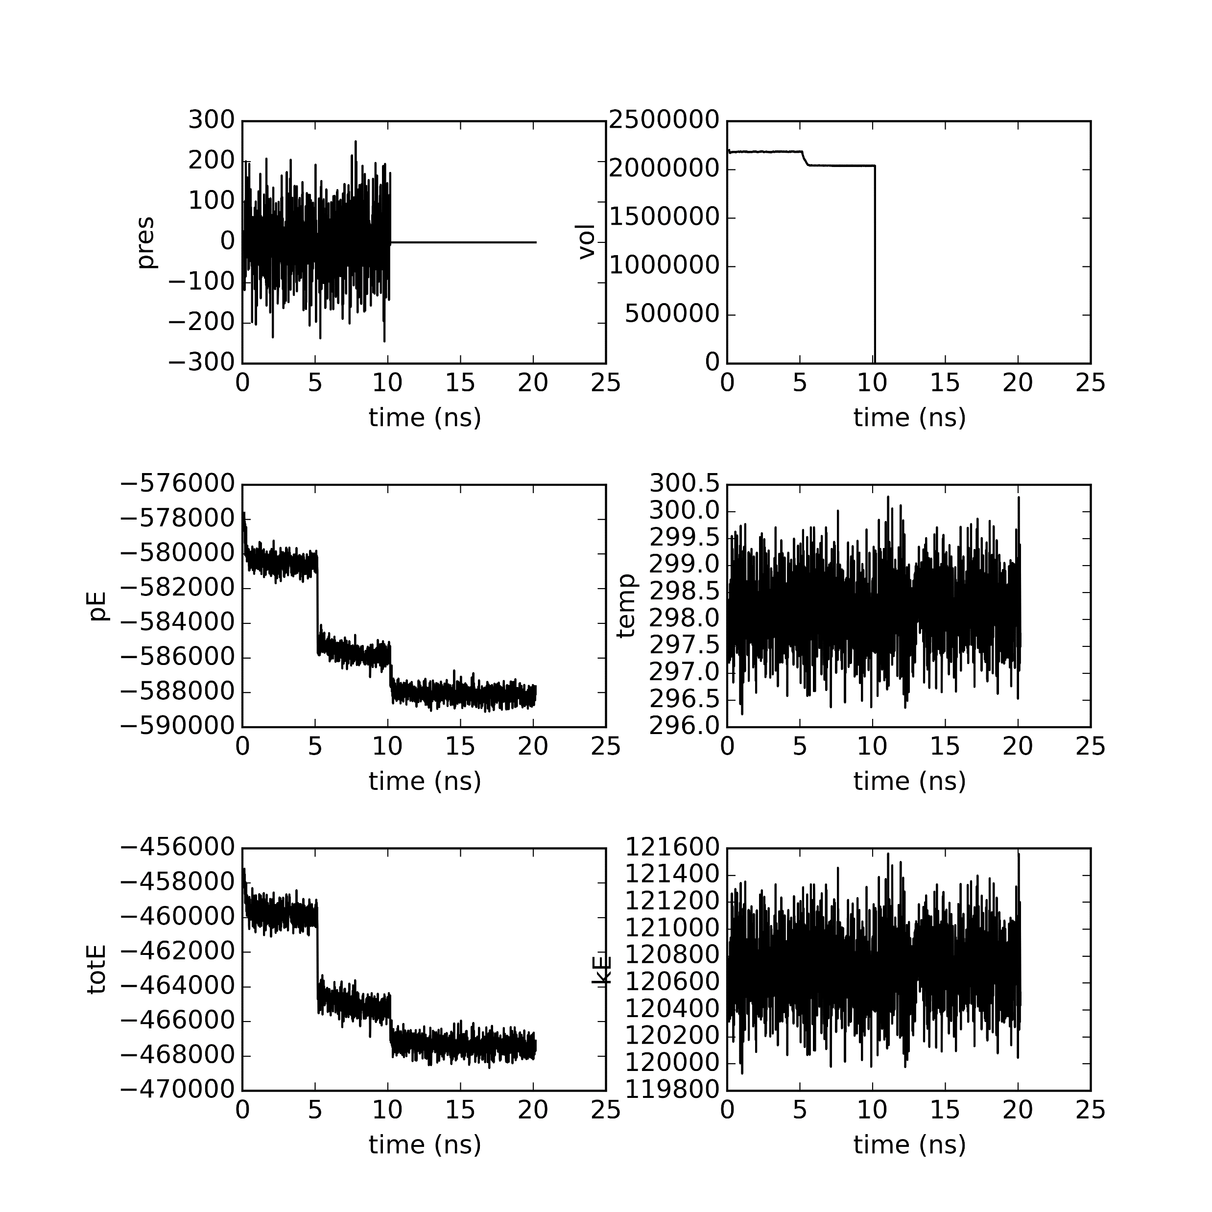
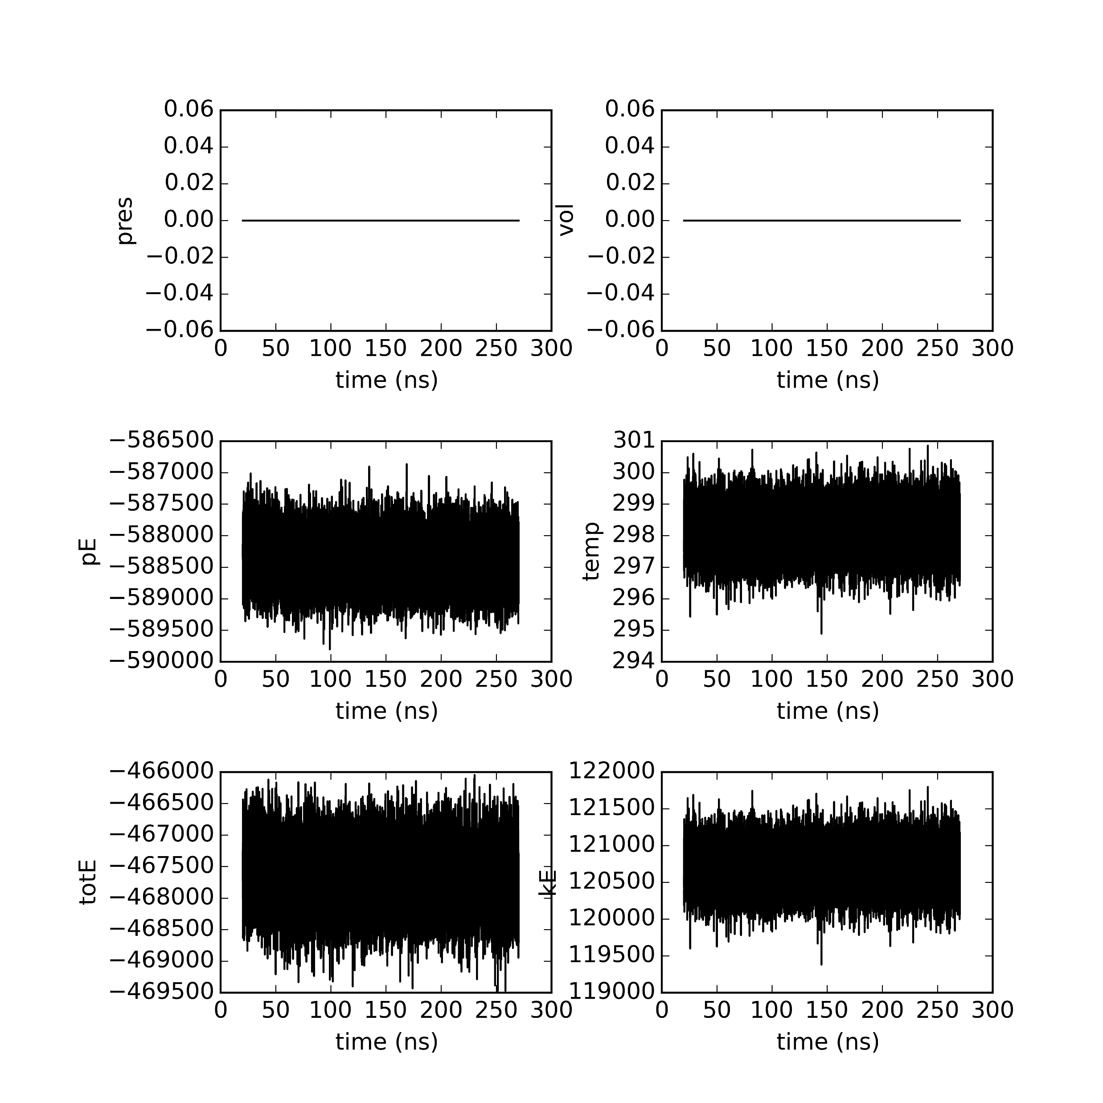
Closed seed 50

Slide 12


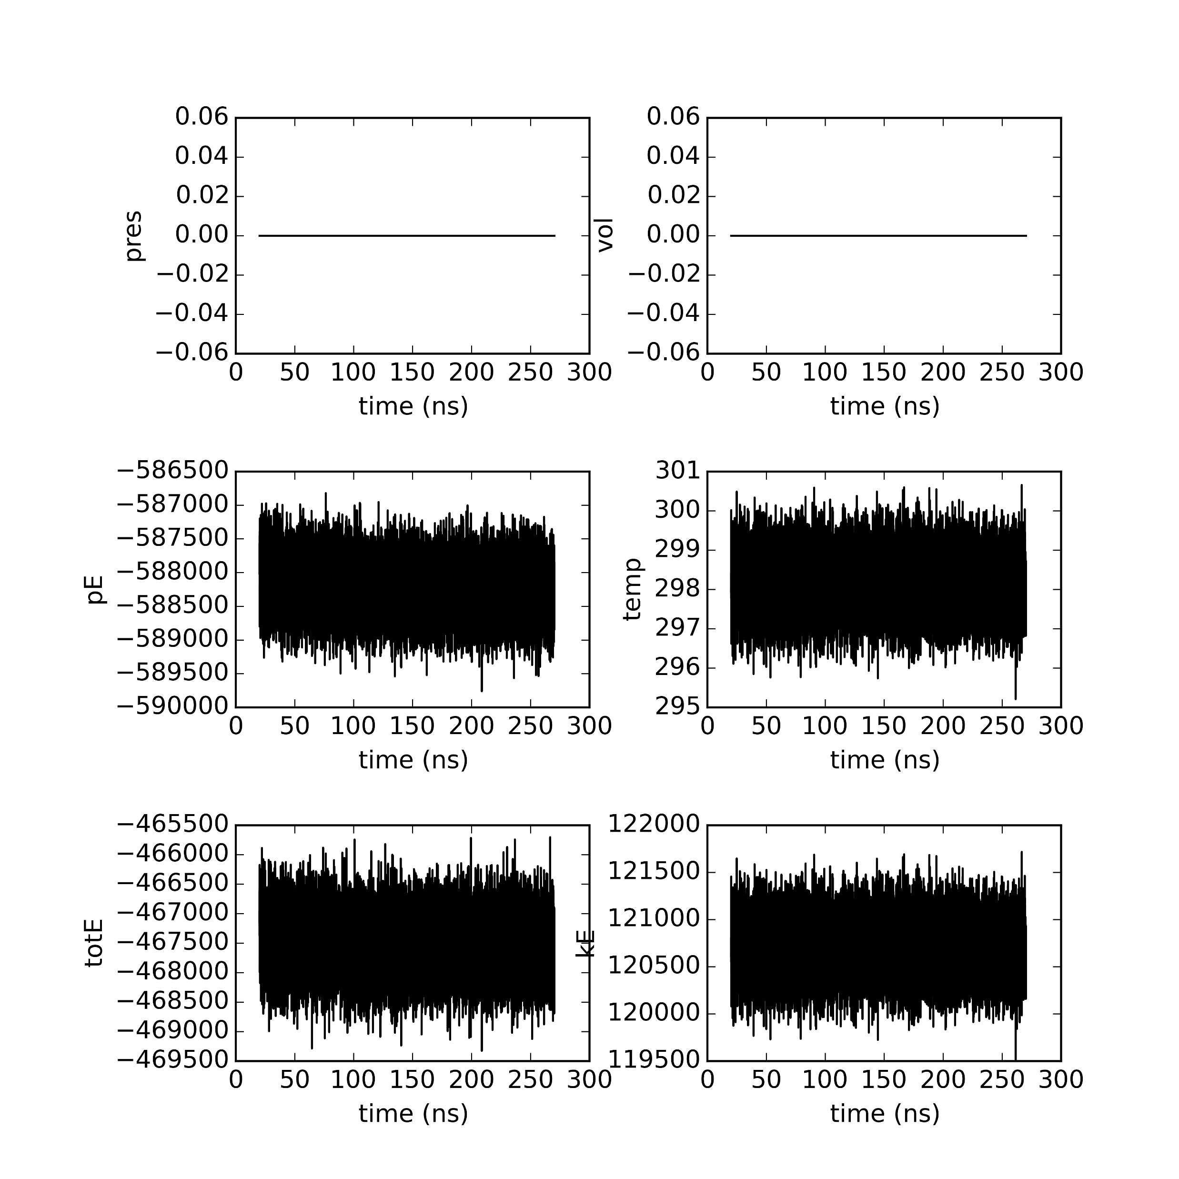
Closed seed 500

Slide 13
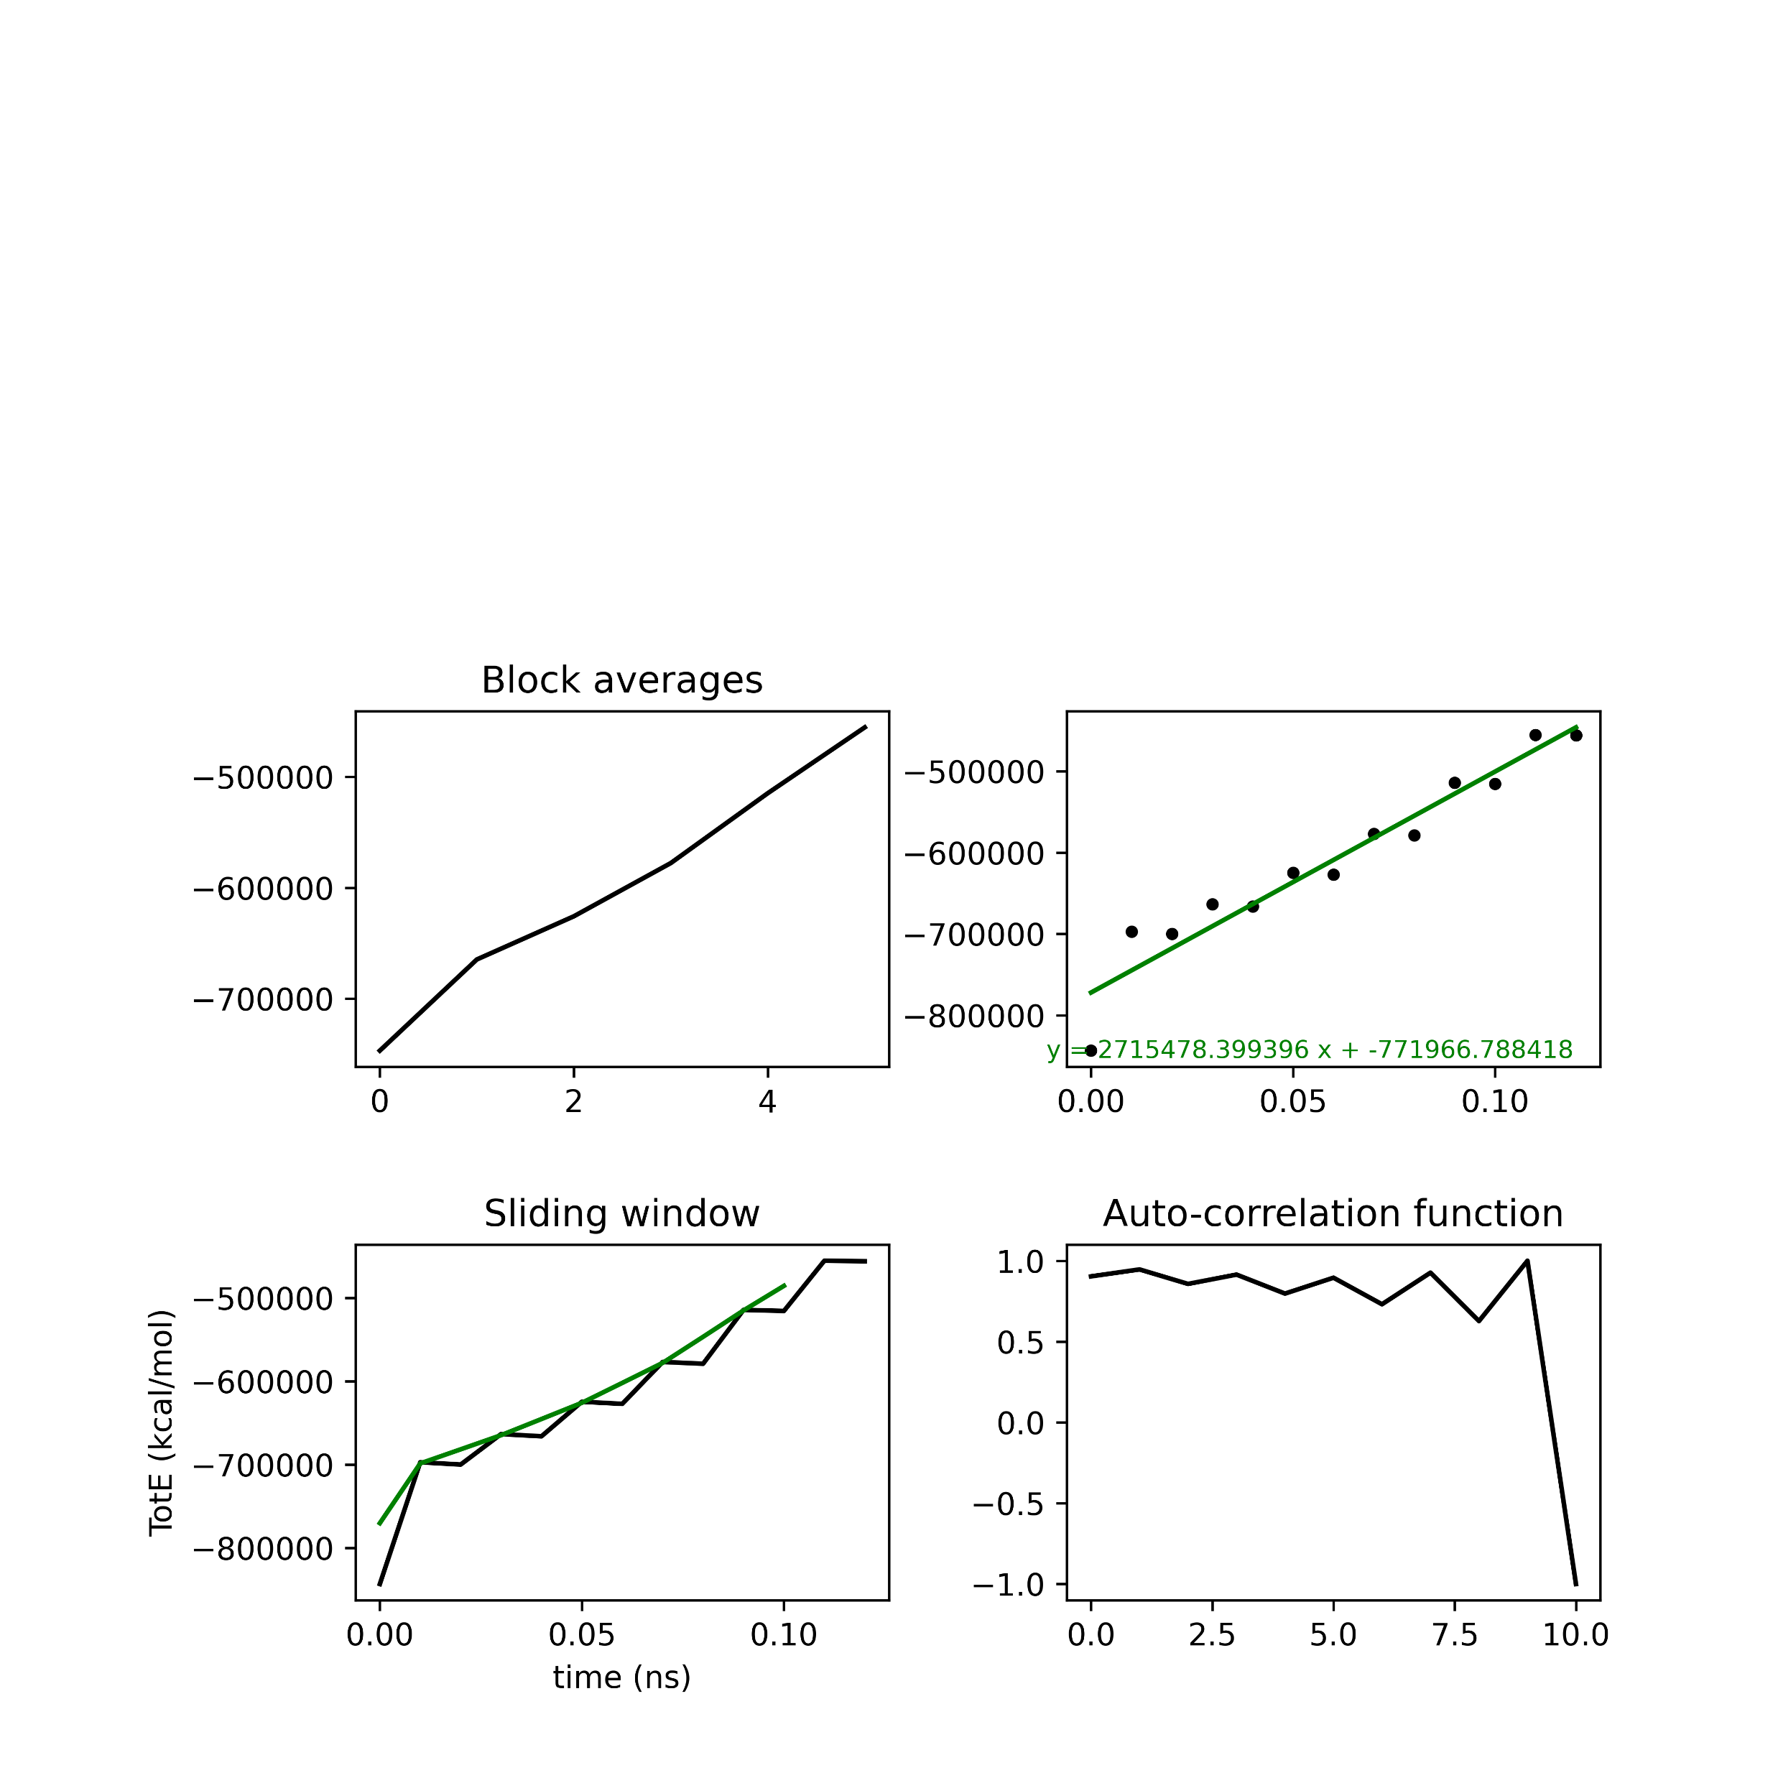
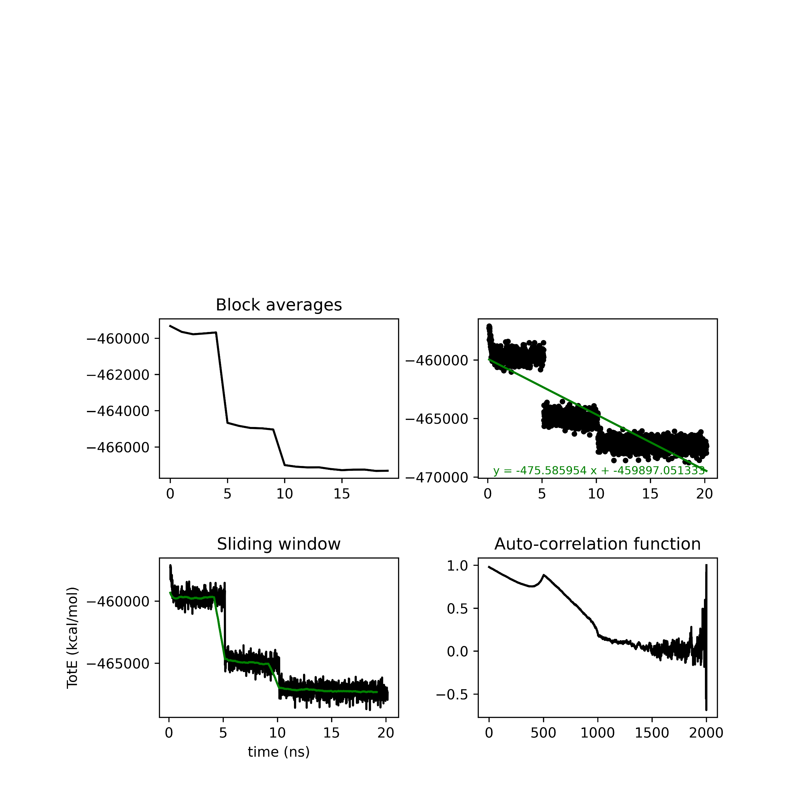
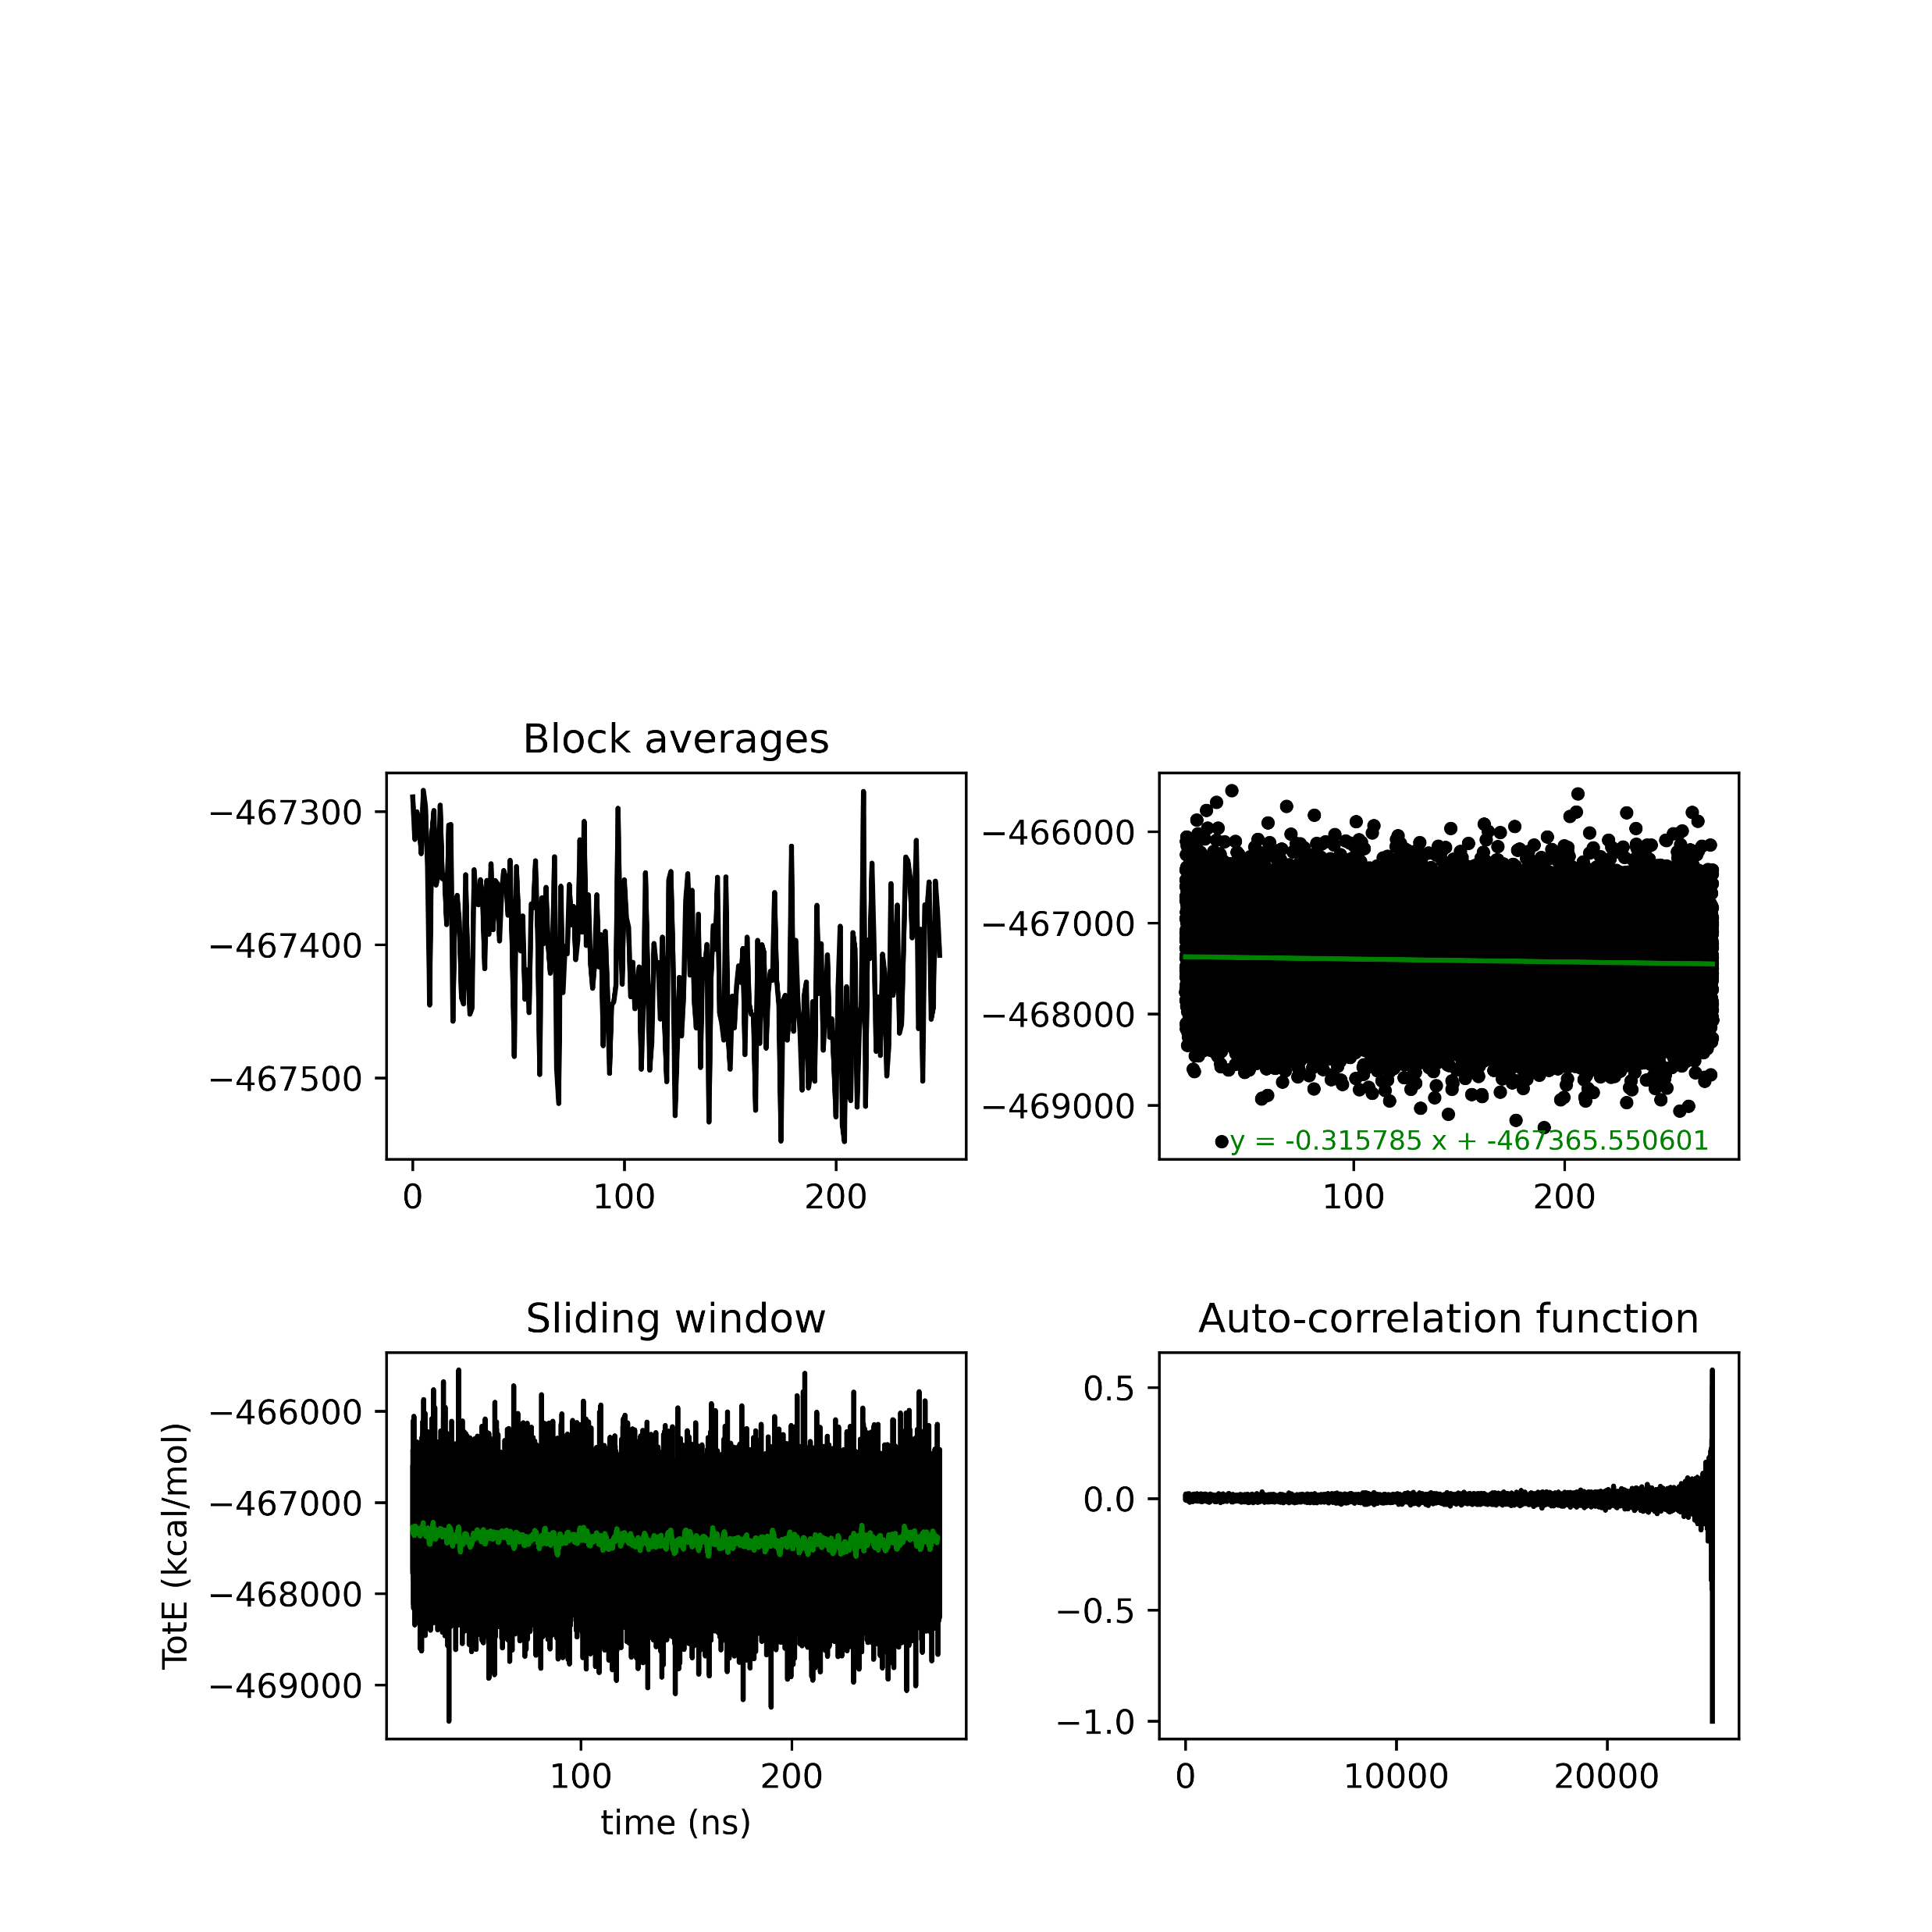
Closed seed 0
0 slope = -0.315785, y-intercept=-467365.550601
5 slope = -0.425087, y-intercept=-467631.998727
50 slope = -0.357102, y-intercept=-467612.854893
500 slope = -0.595478, y-intercept=-467428.776665

Slide 14
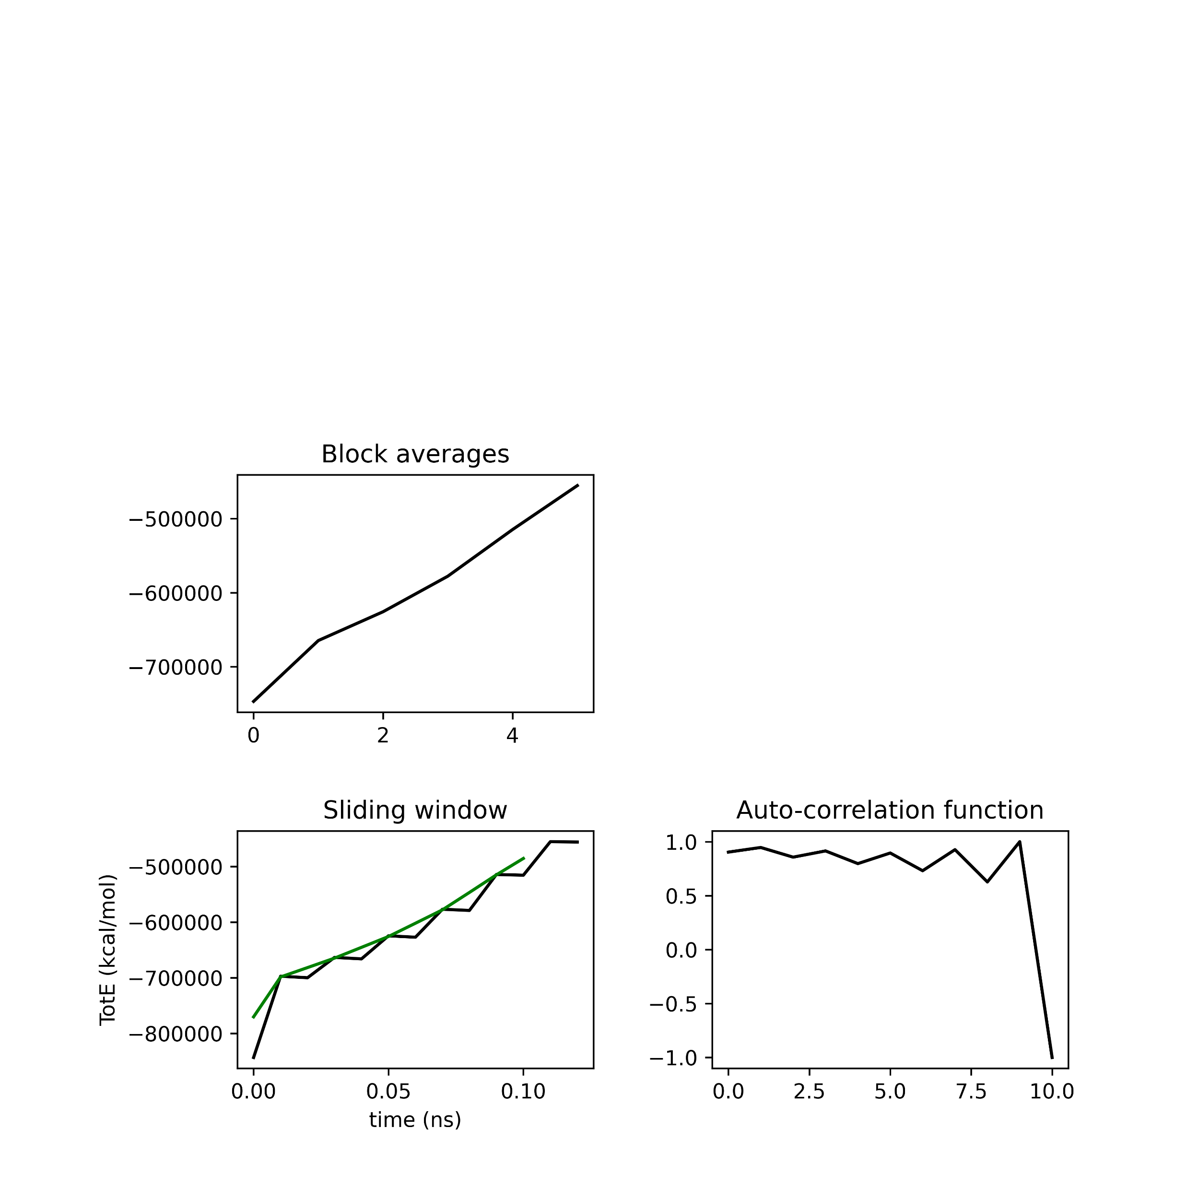
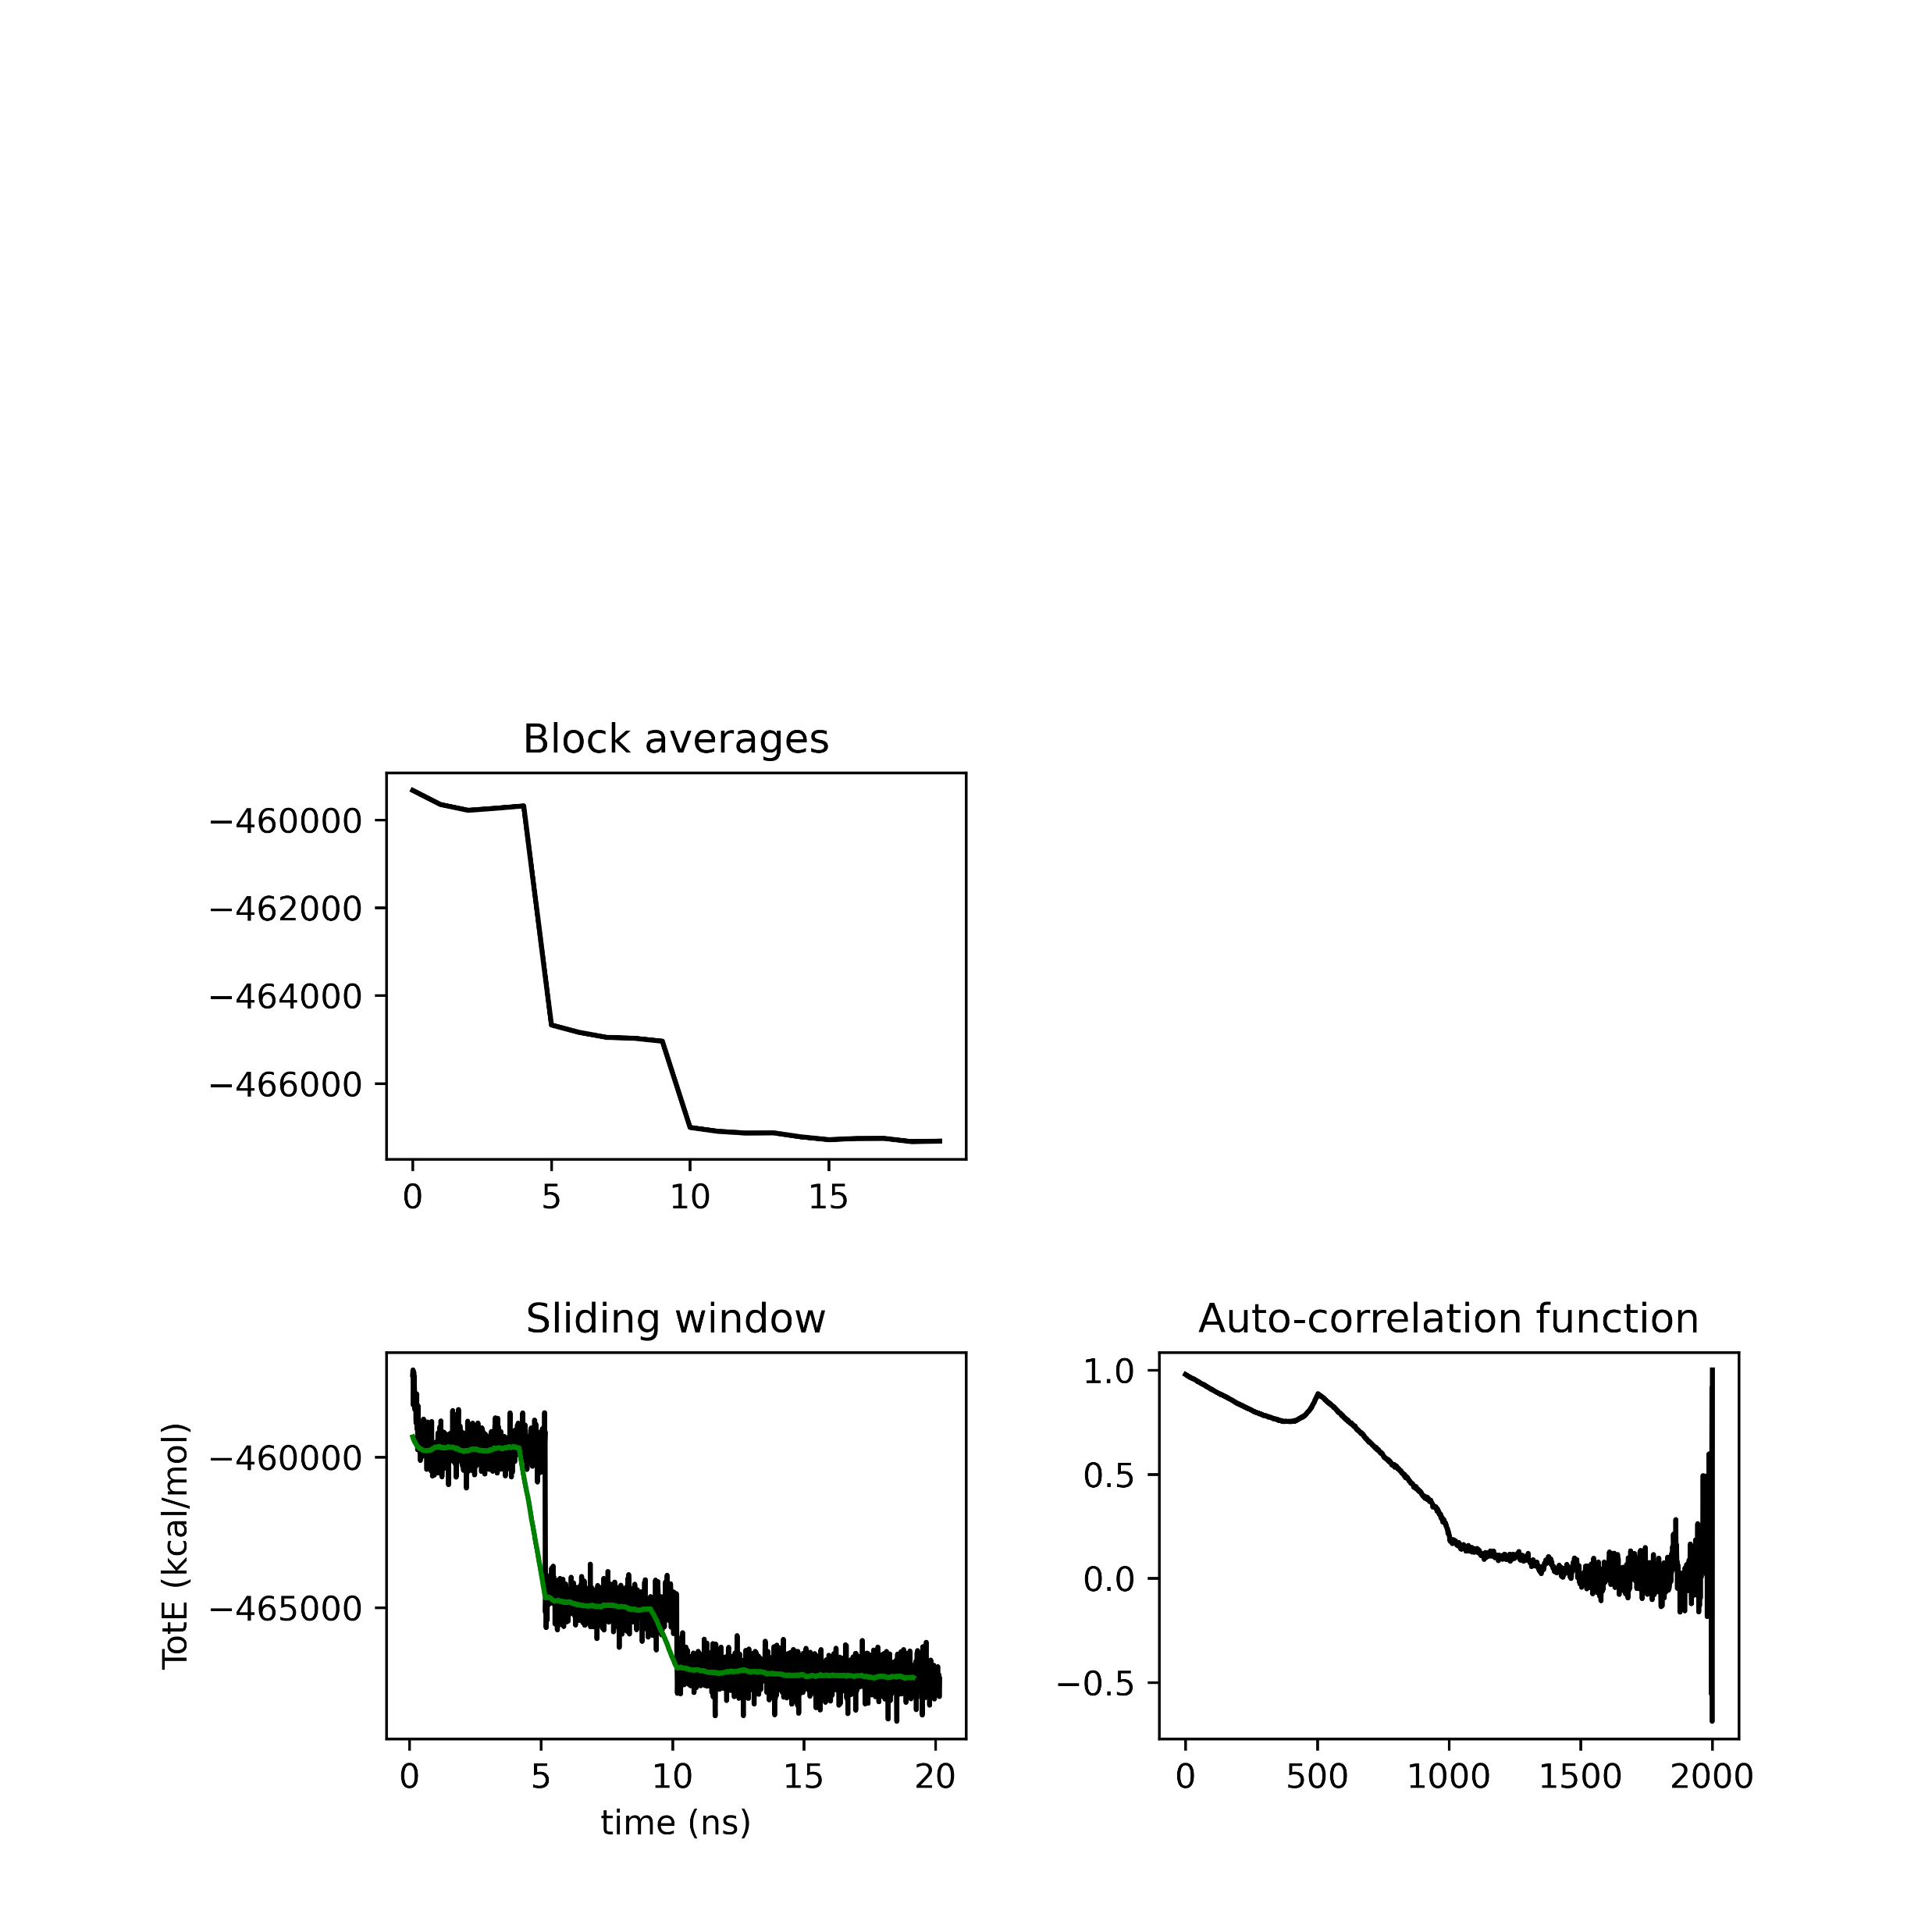
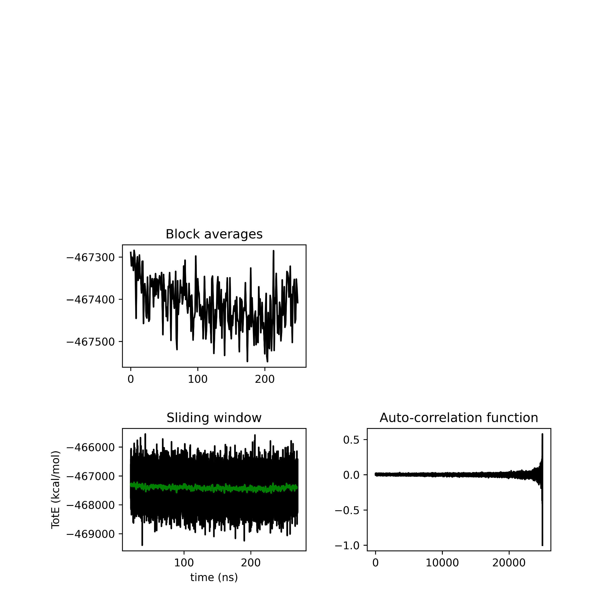
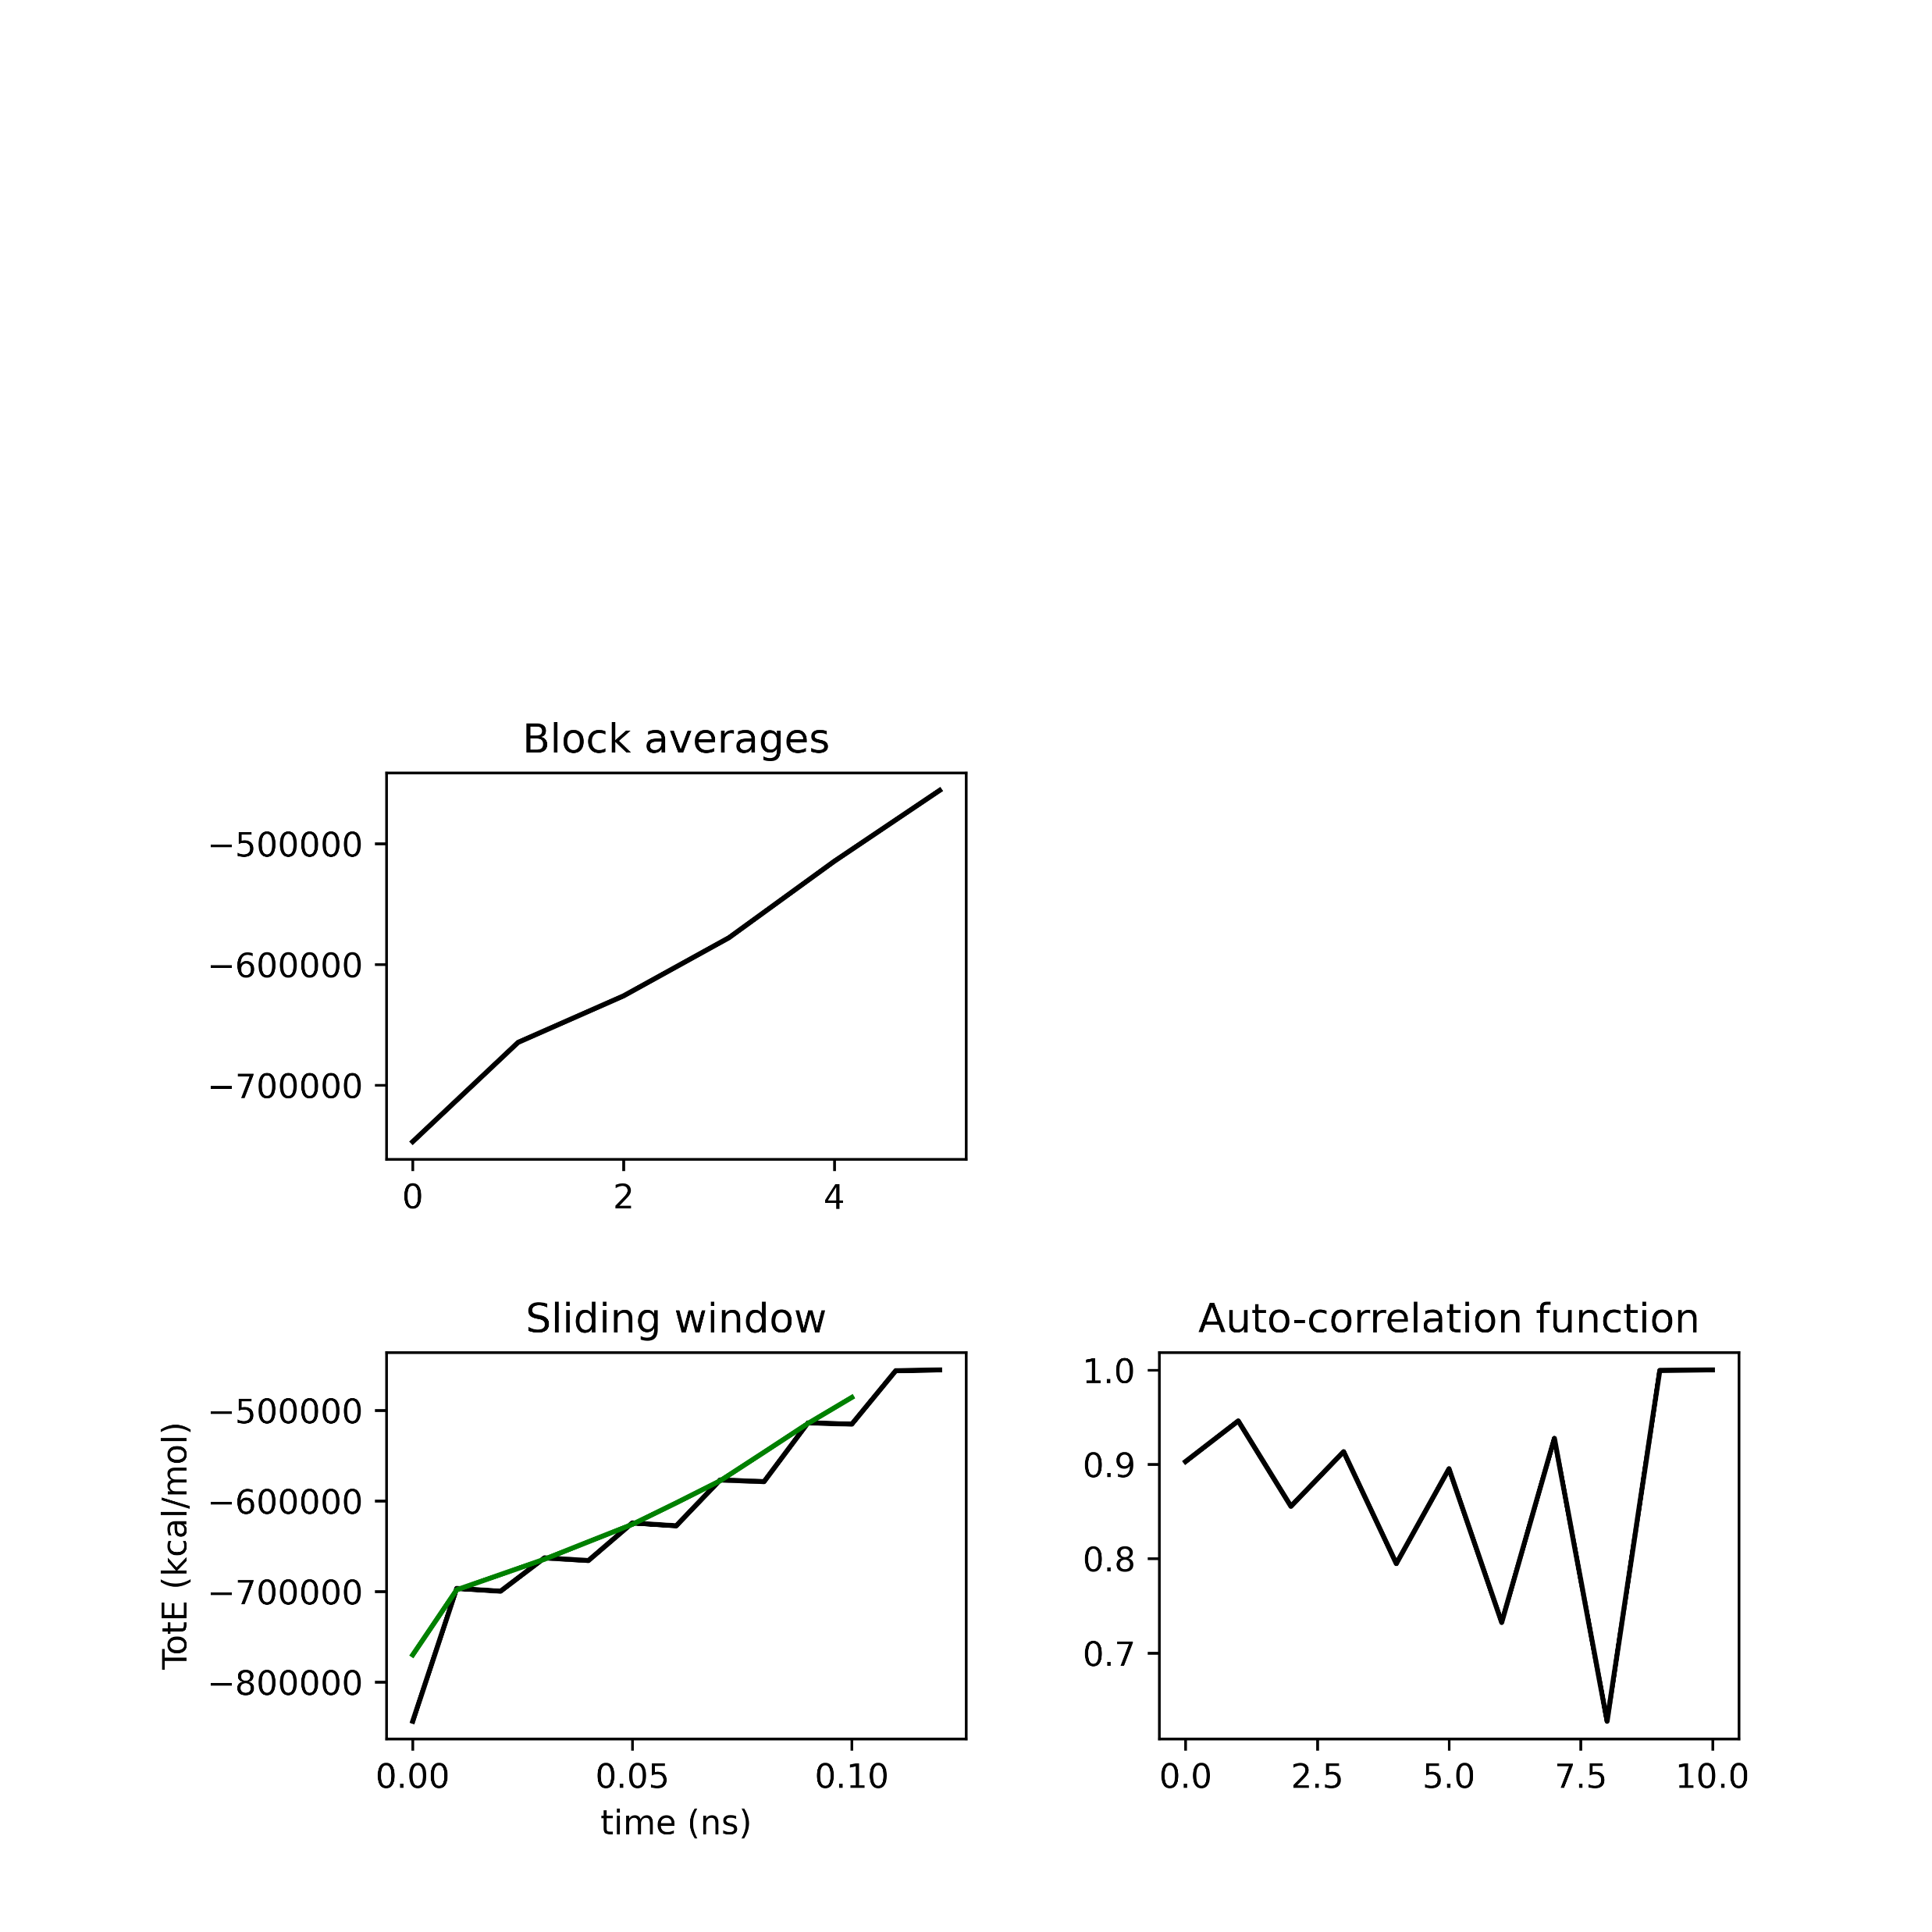
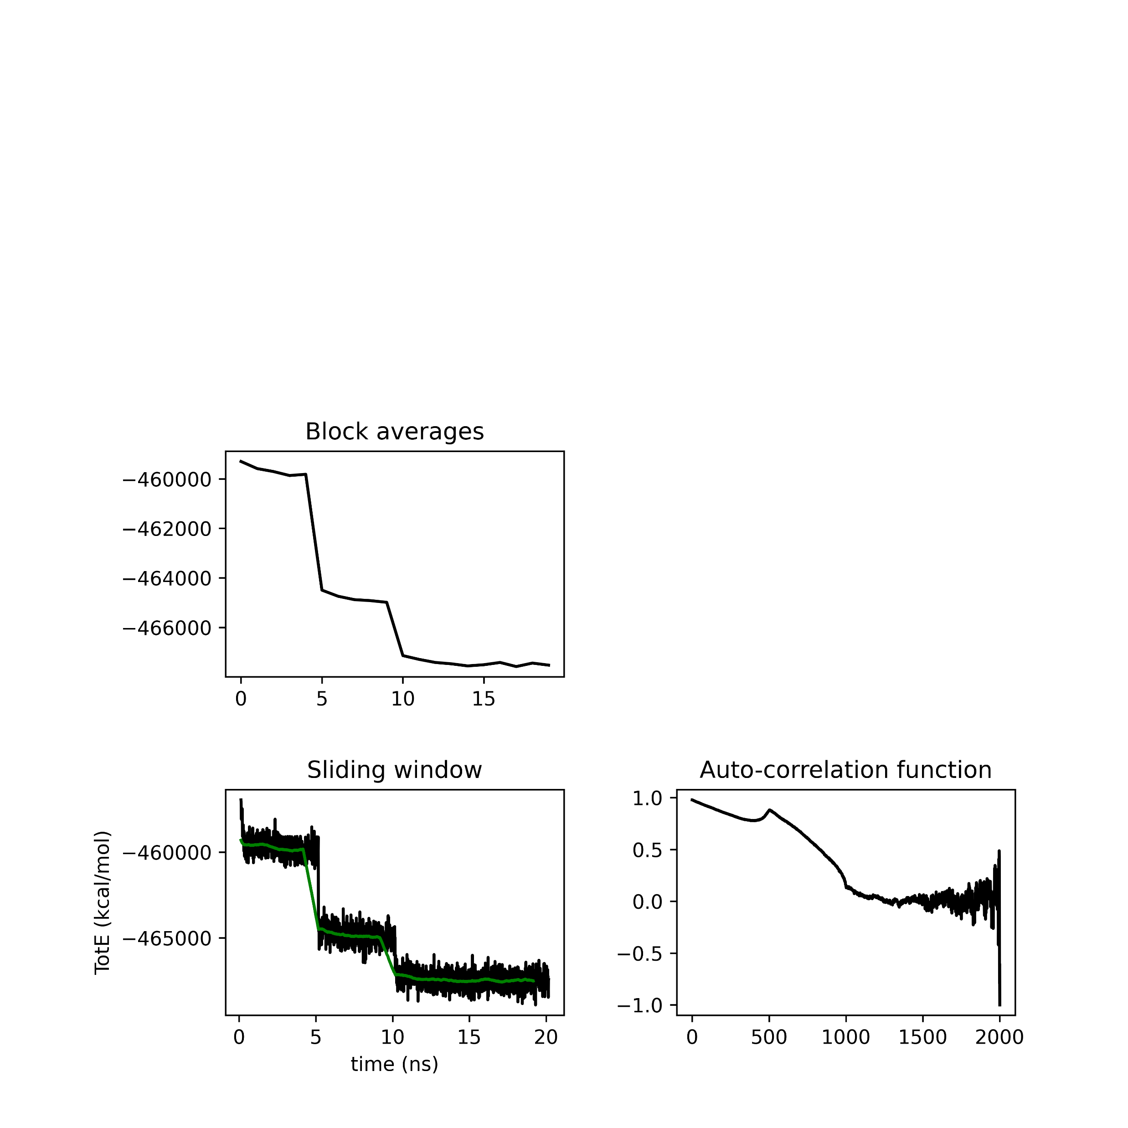
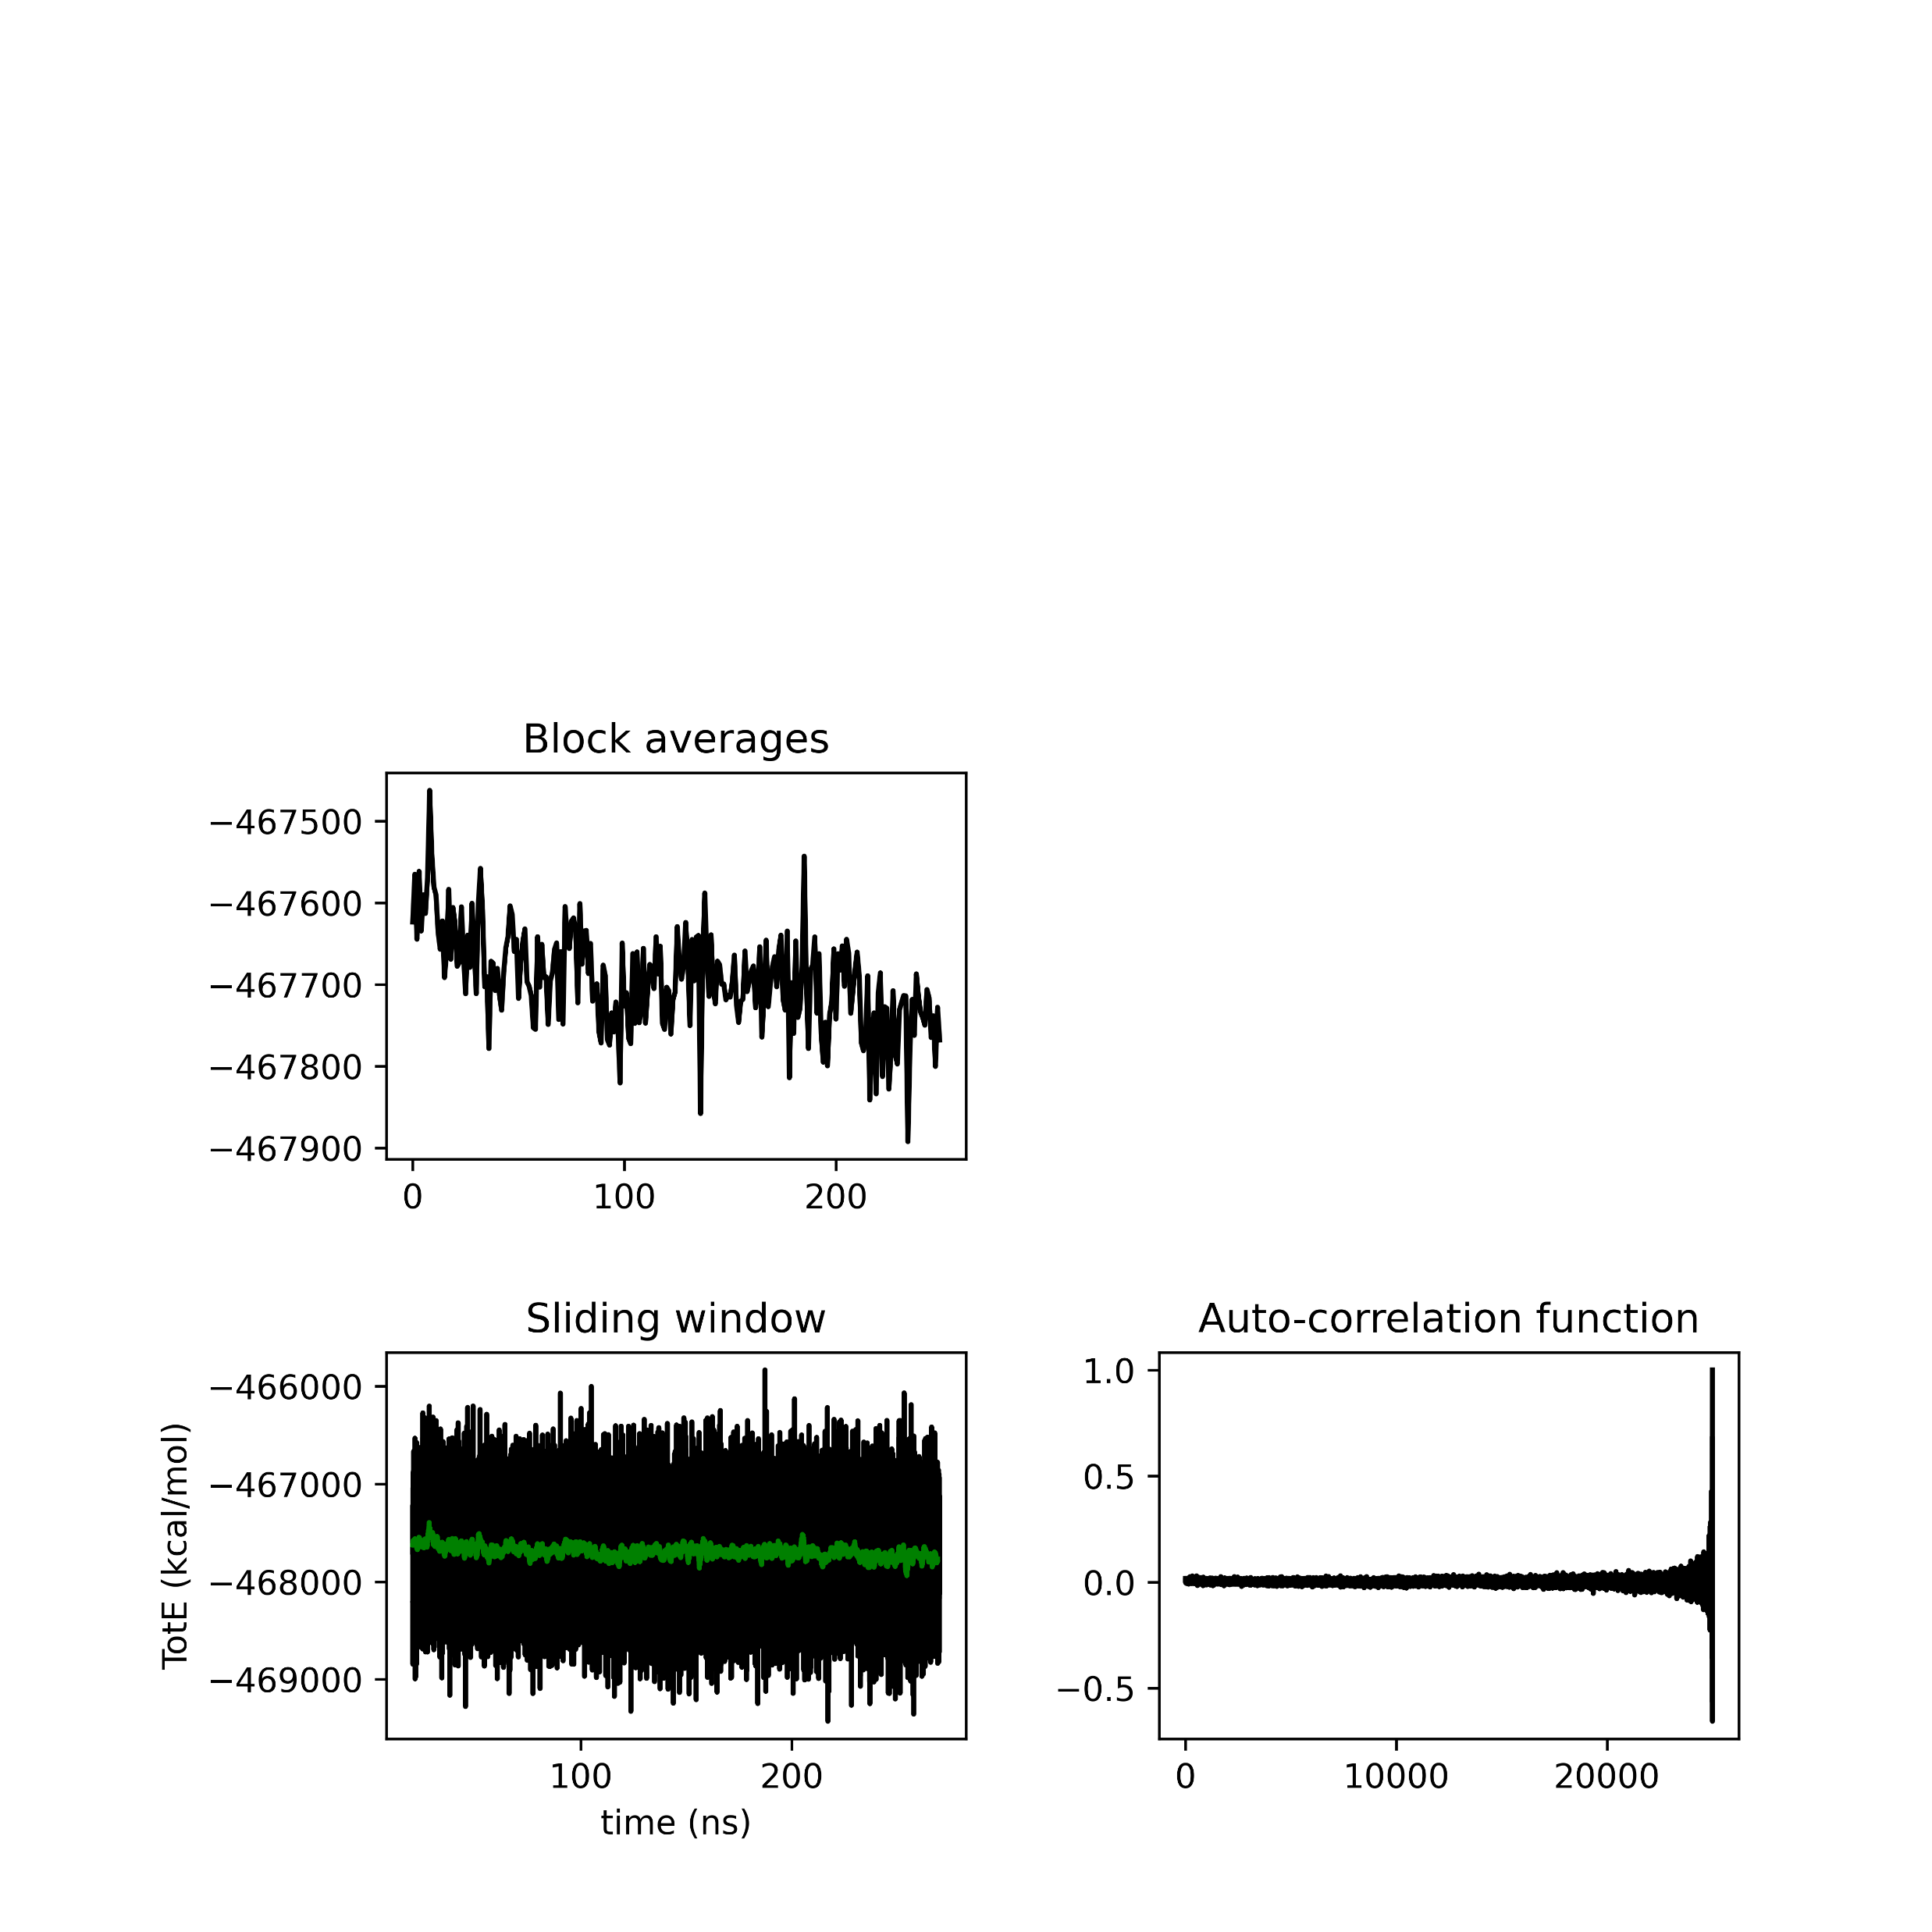
Closed seed 0
BASEM =42811.19
BASEM = 708.81
BASEM = 3.64
Closed seed 5
BASEM = 42819.08
BASEM = 689.00
BASEM = 4.26

Slide 15

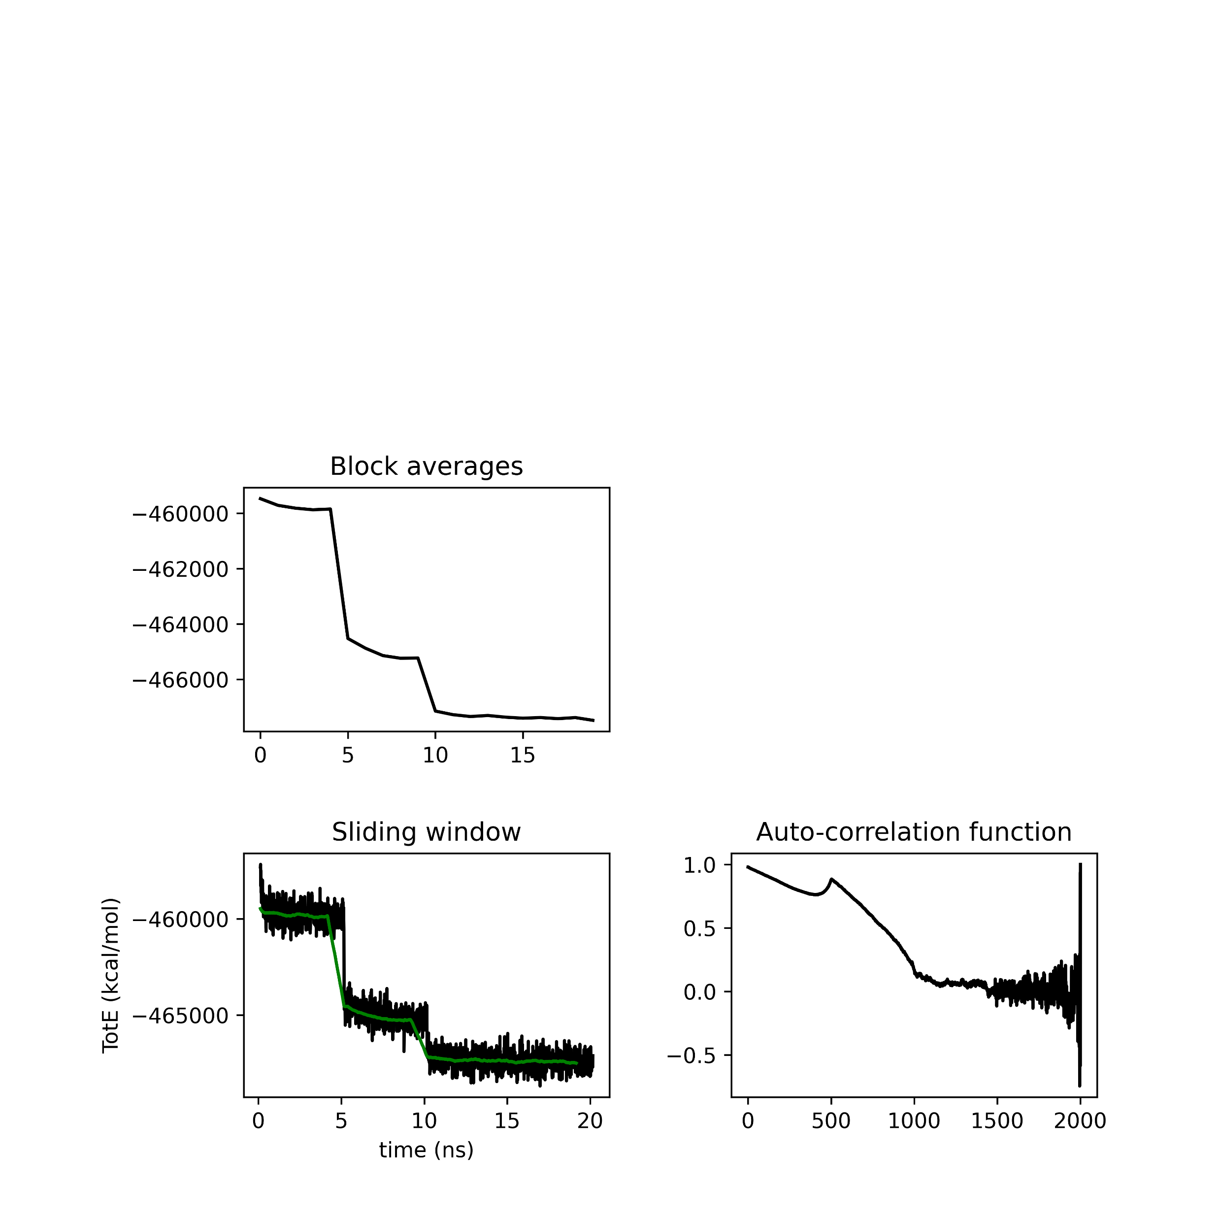
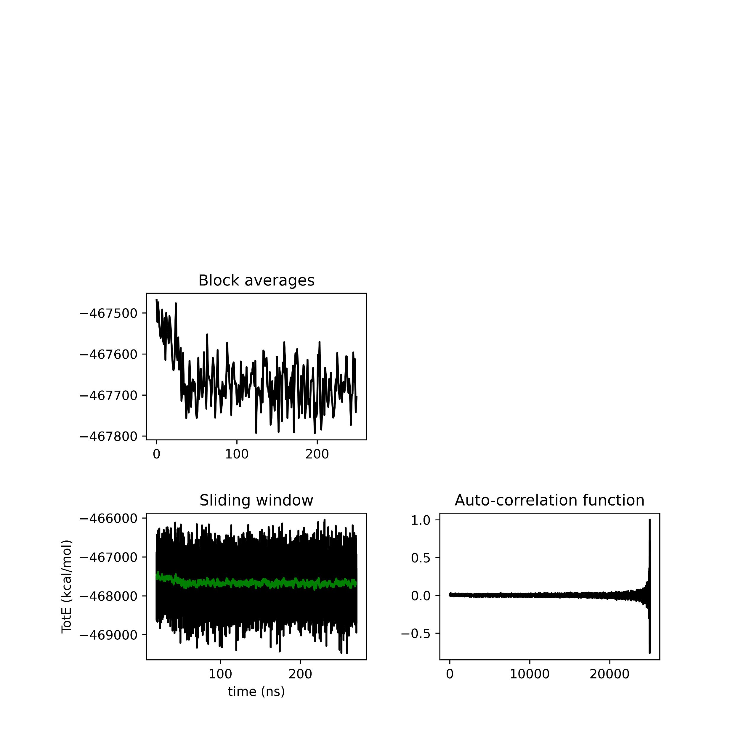

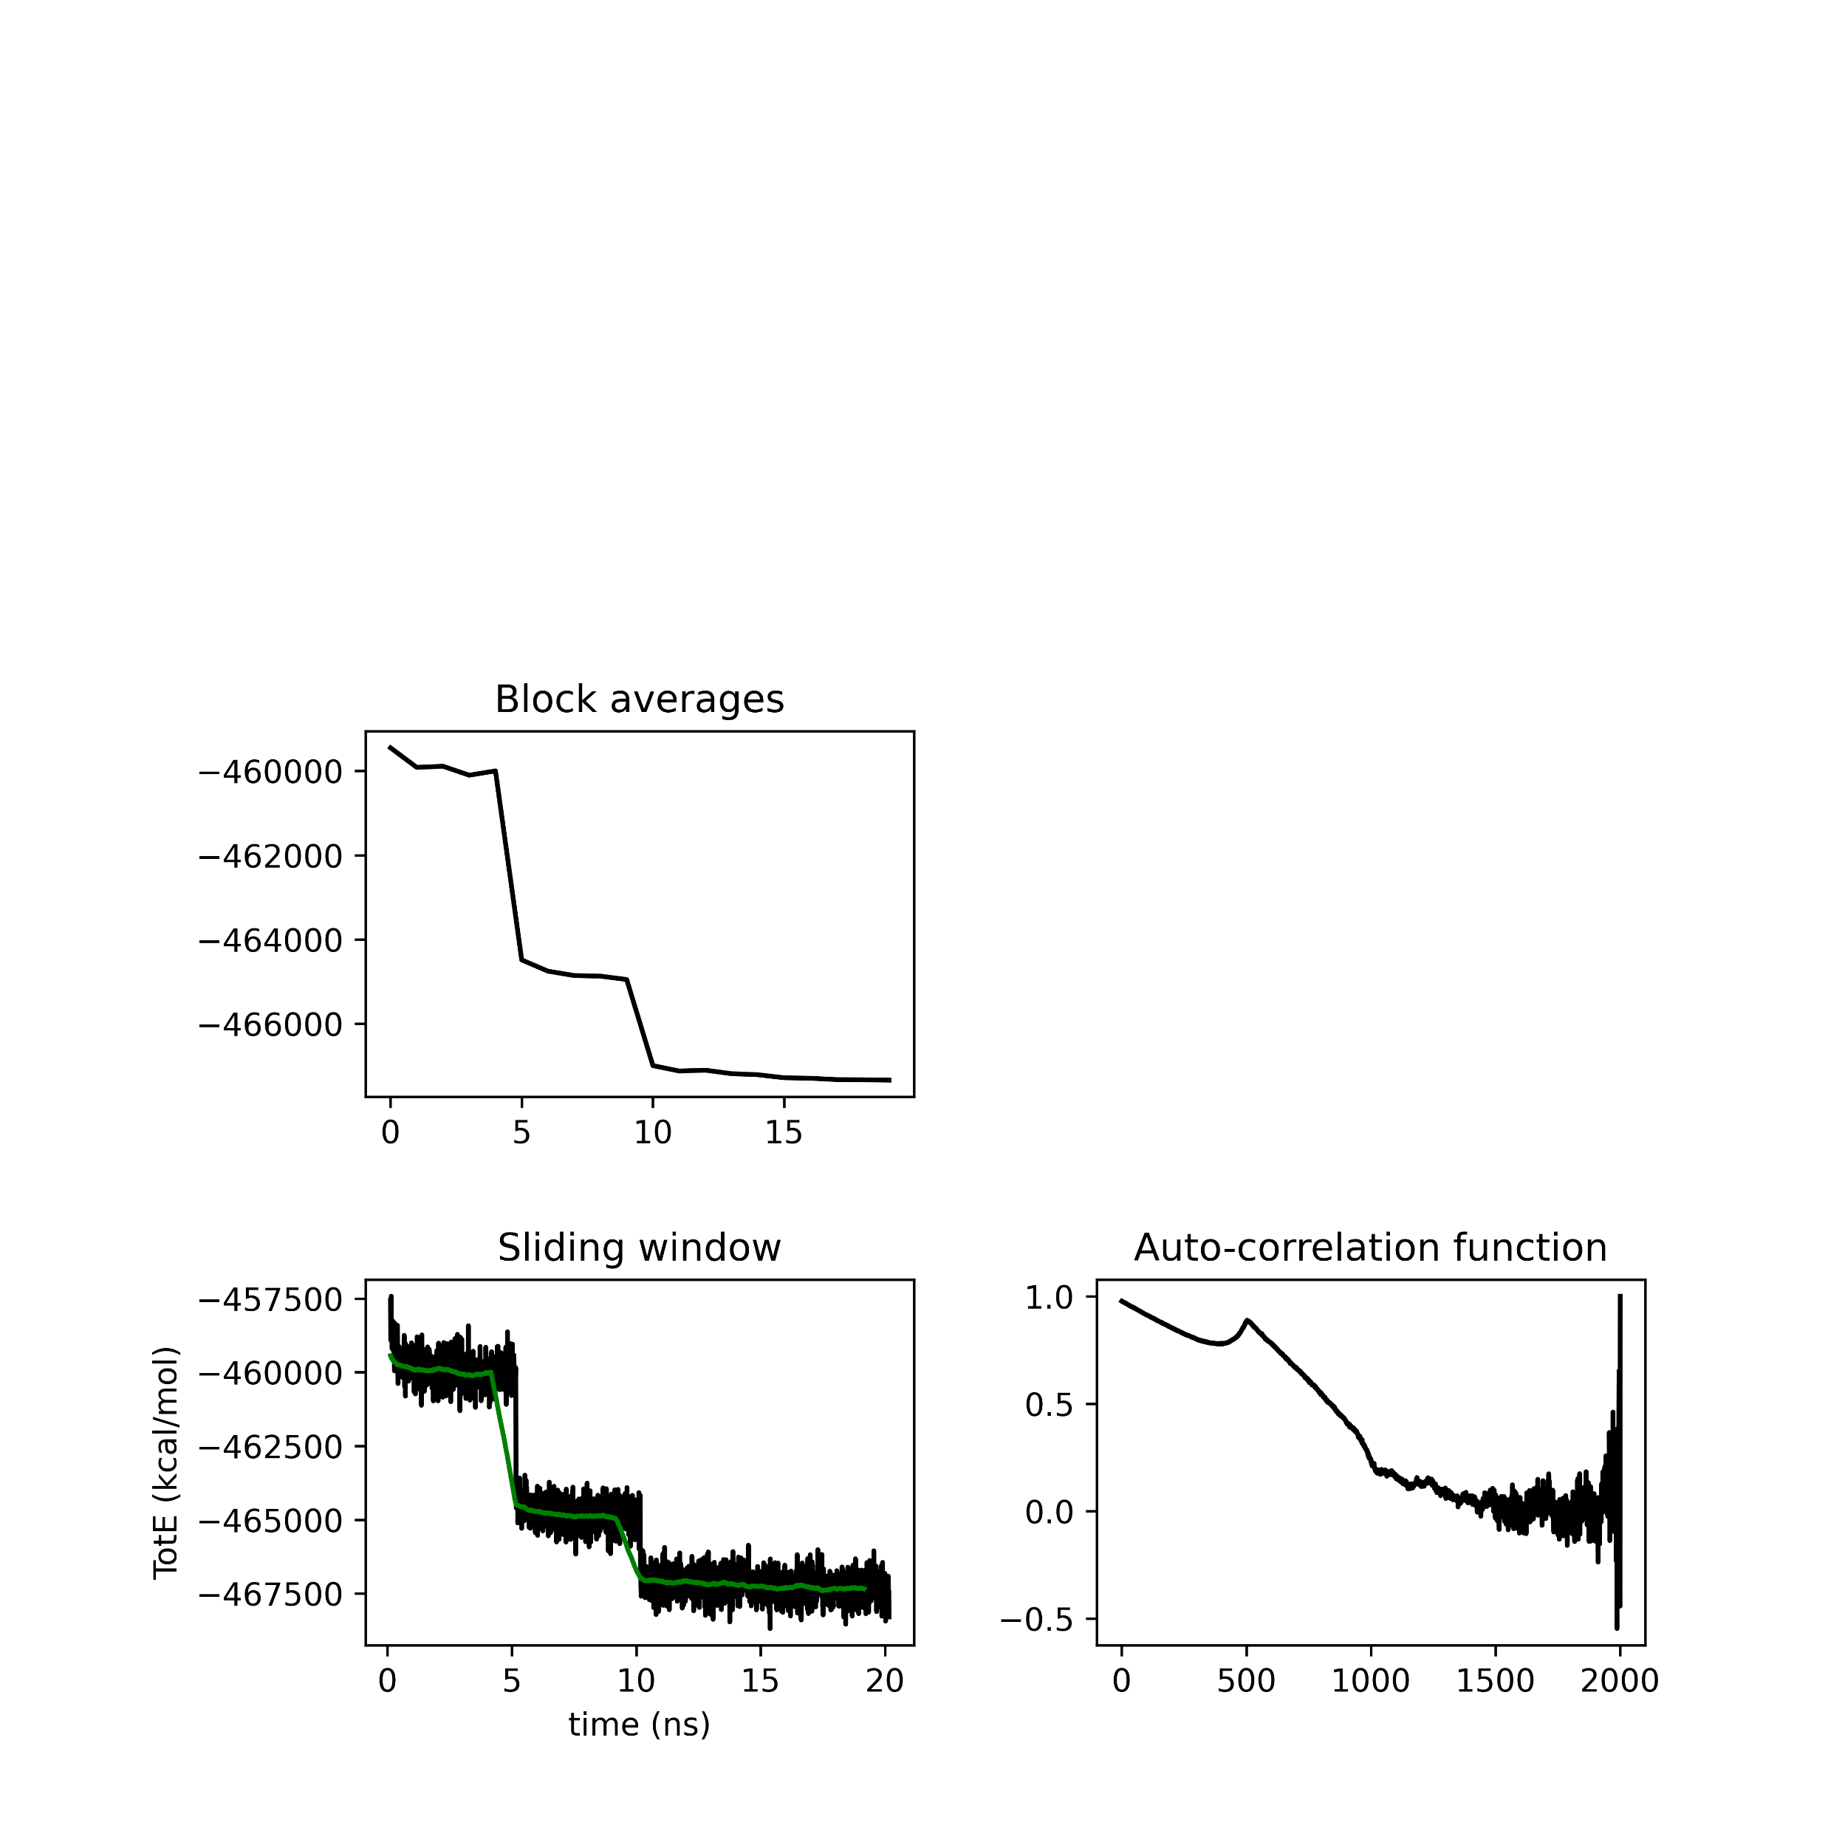
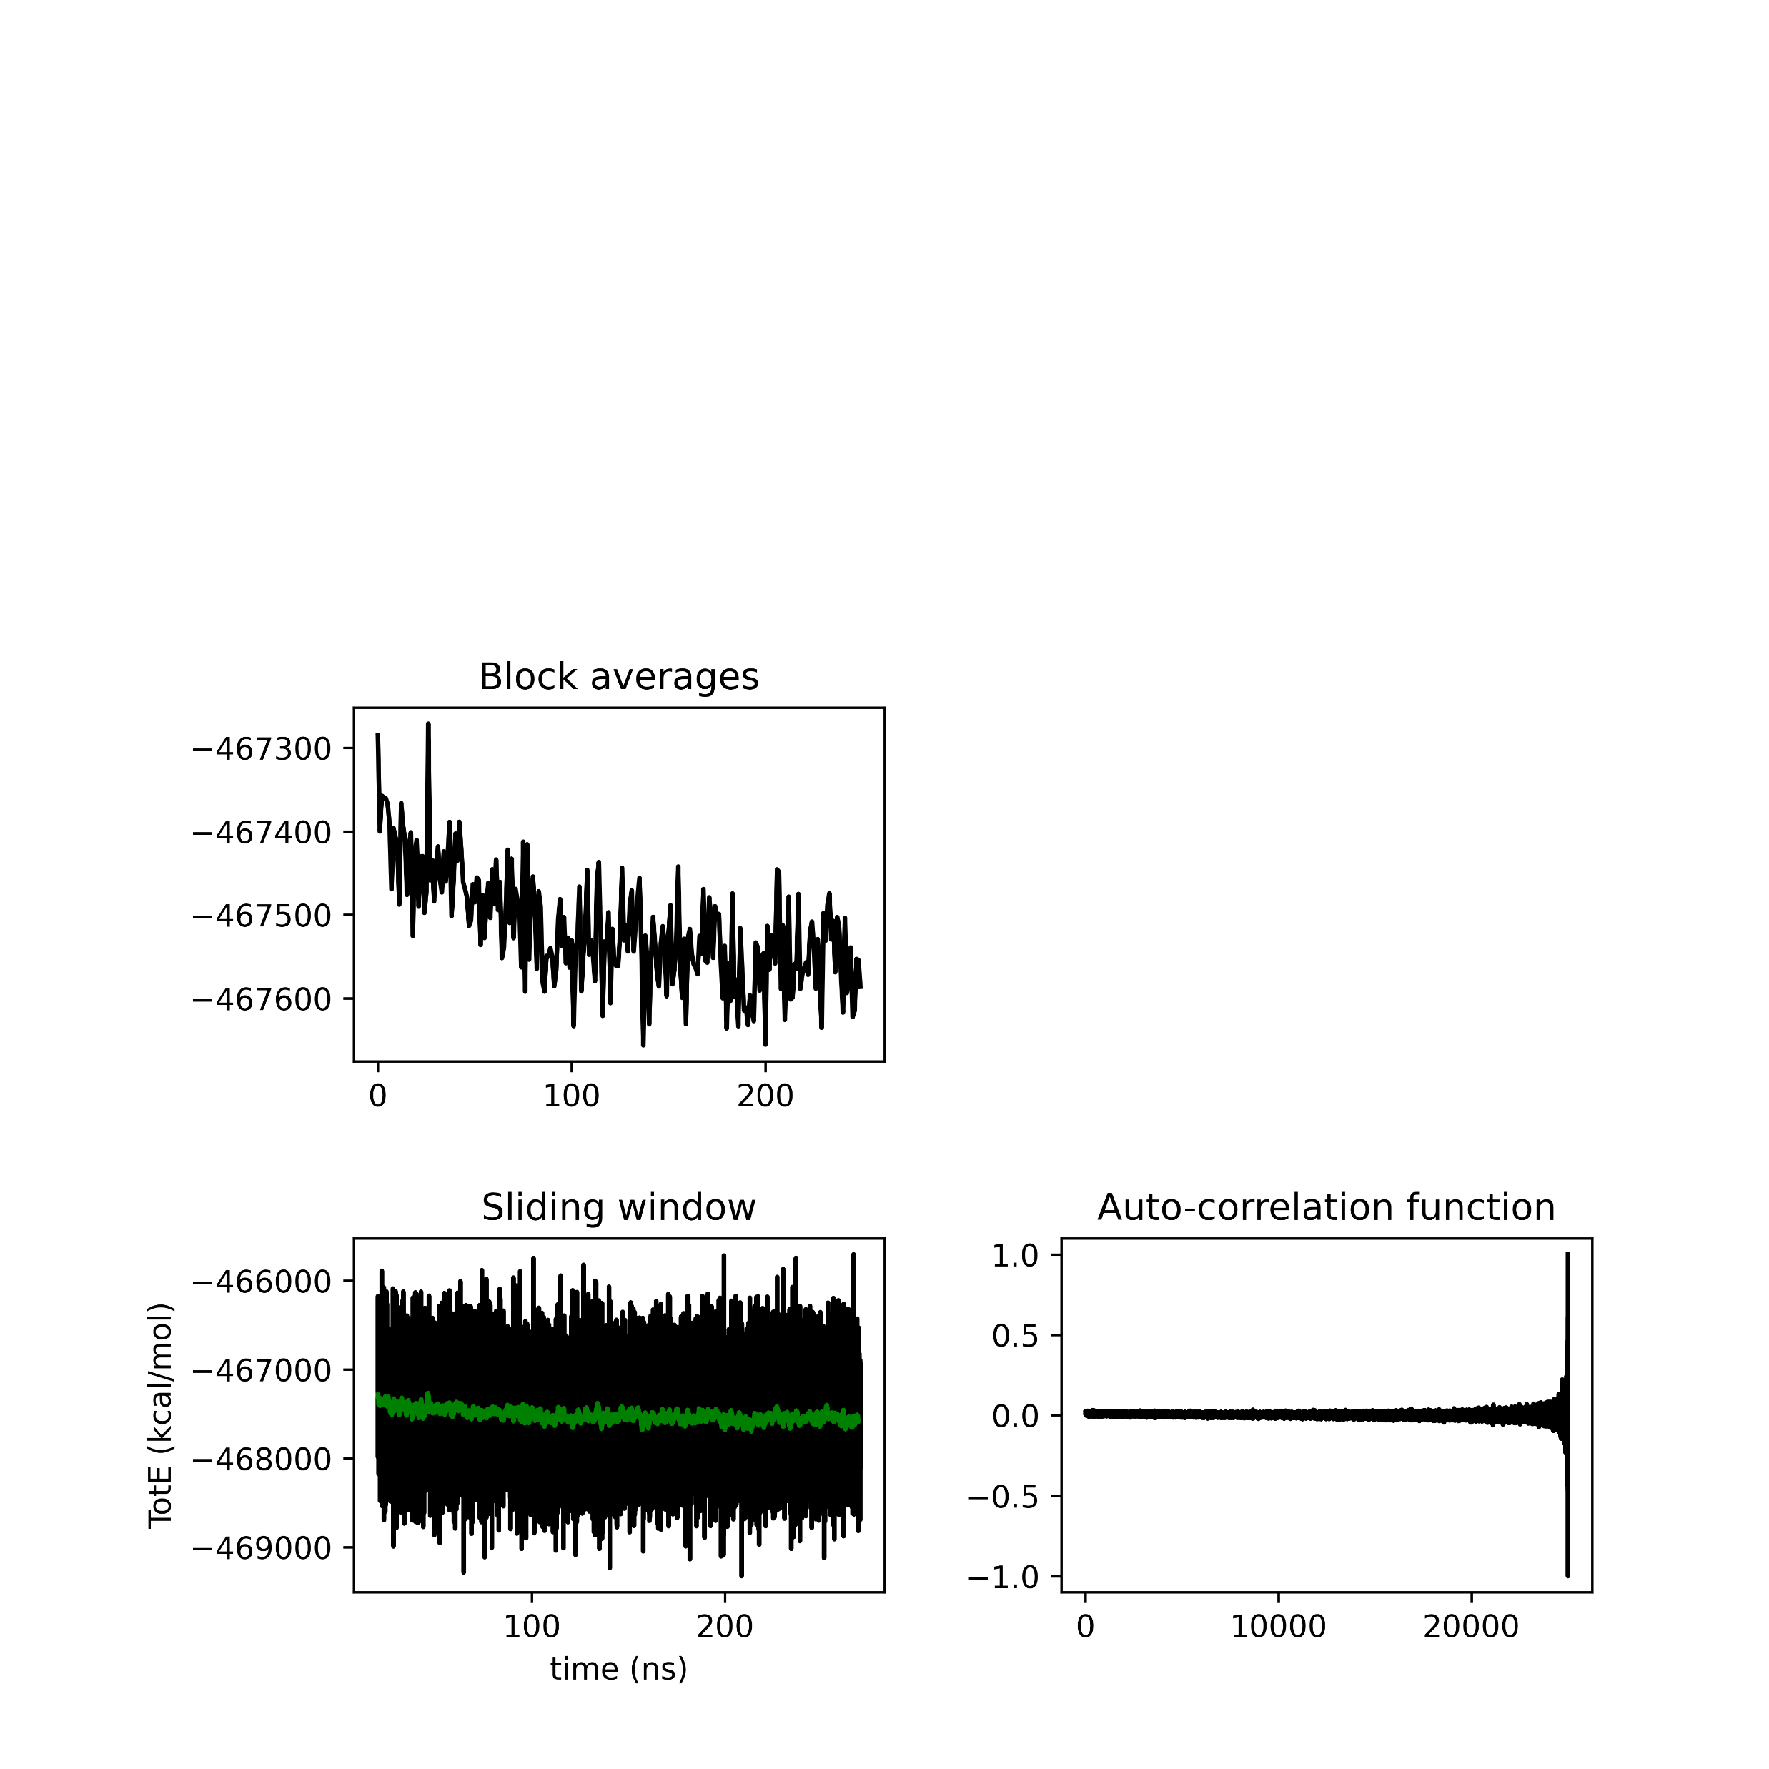
Closed seed 50
BASEM = 42831.45
BASEM = 714.21
BASEM = 4.02
Closed seed 500
BASEM = 42761.61
BASEM = 729.85
BASEM = 3.80

Slide 16


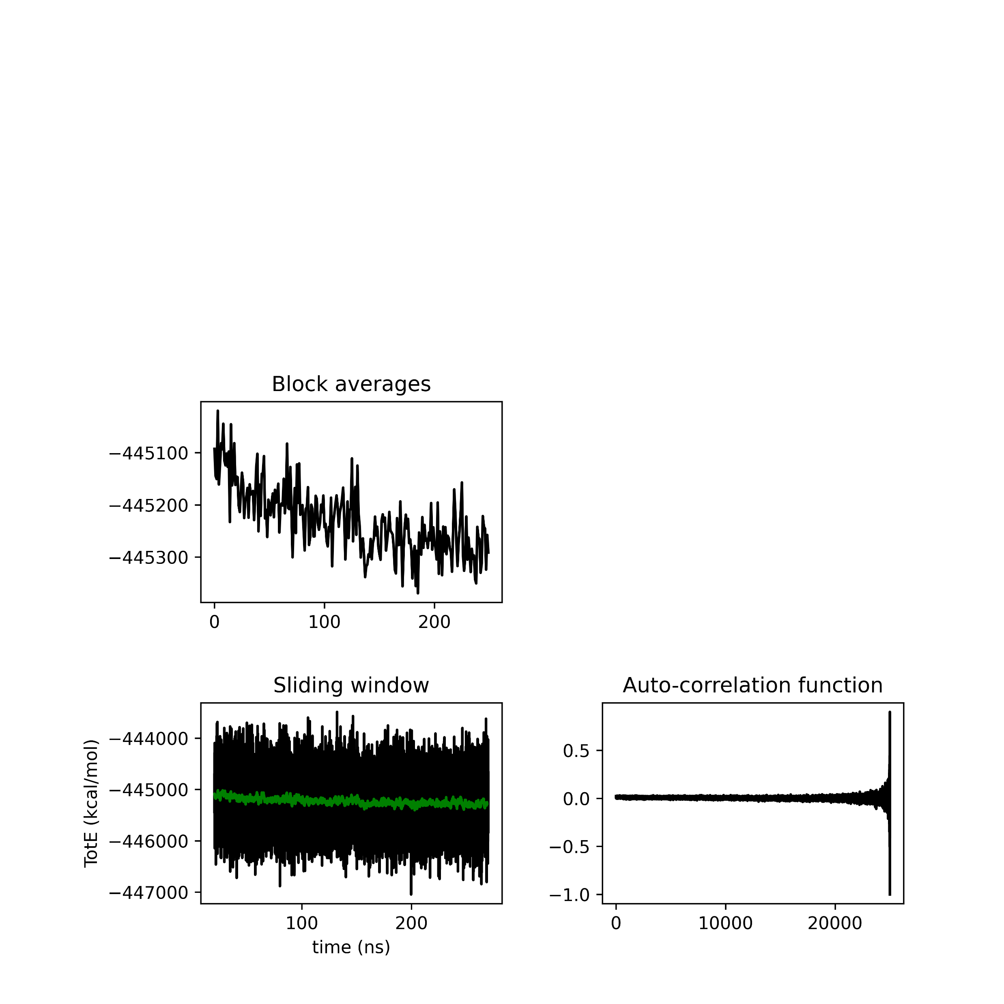
Semi-cross seed 0
BASEM =39834.54
BASEM = 755.29
BASEM = 4.06

Slide 17

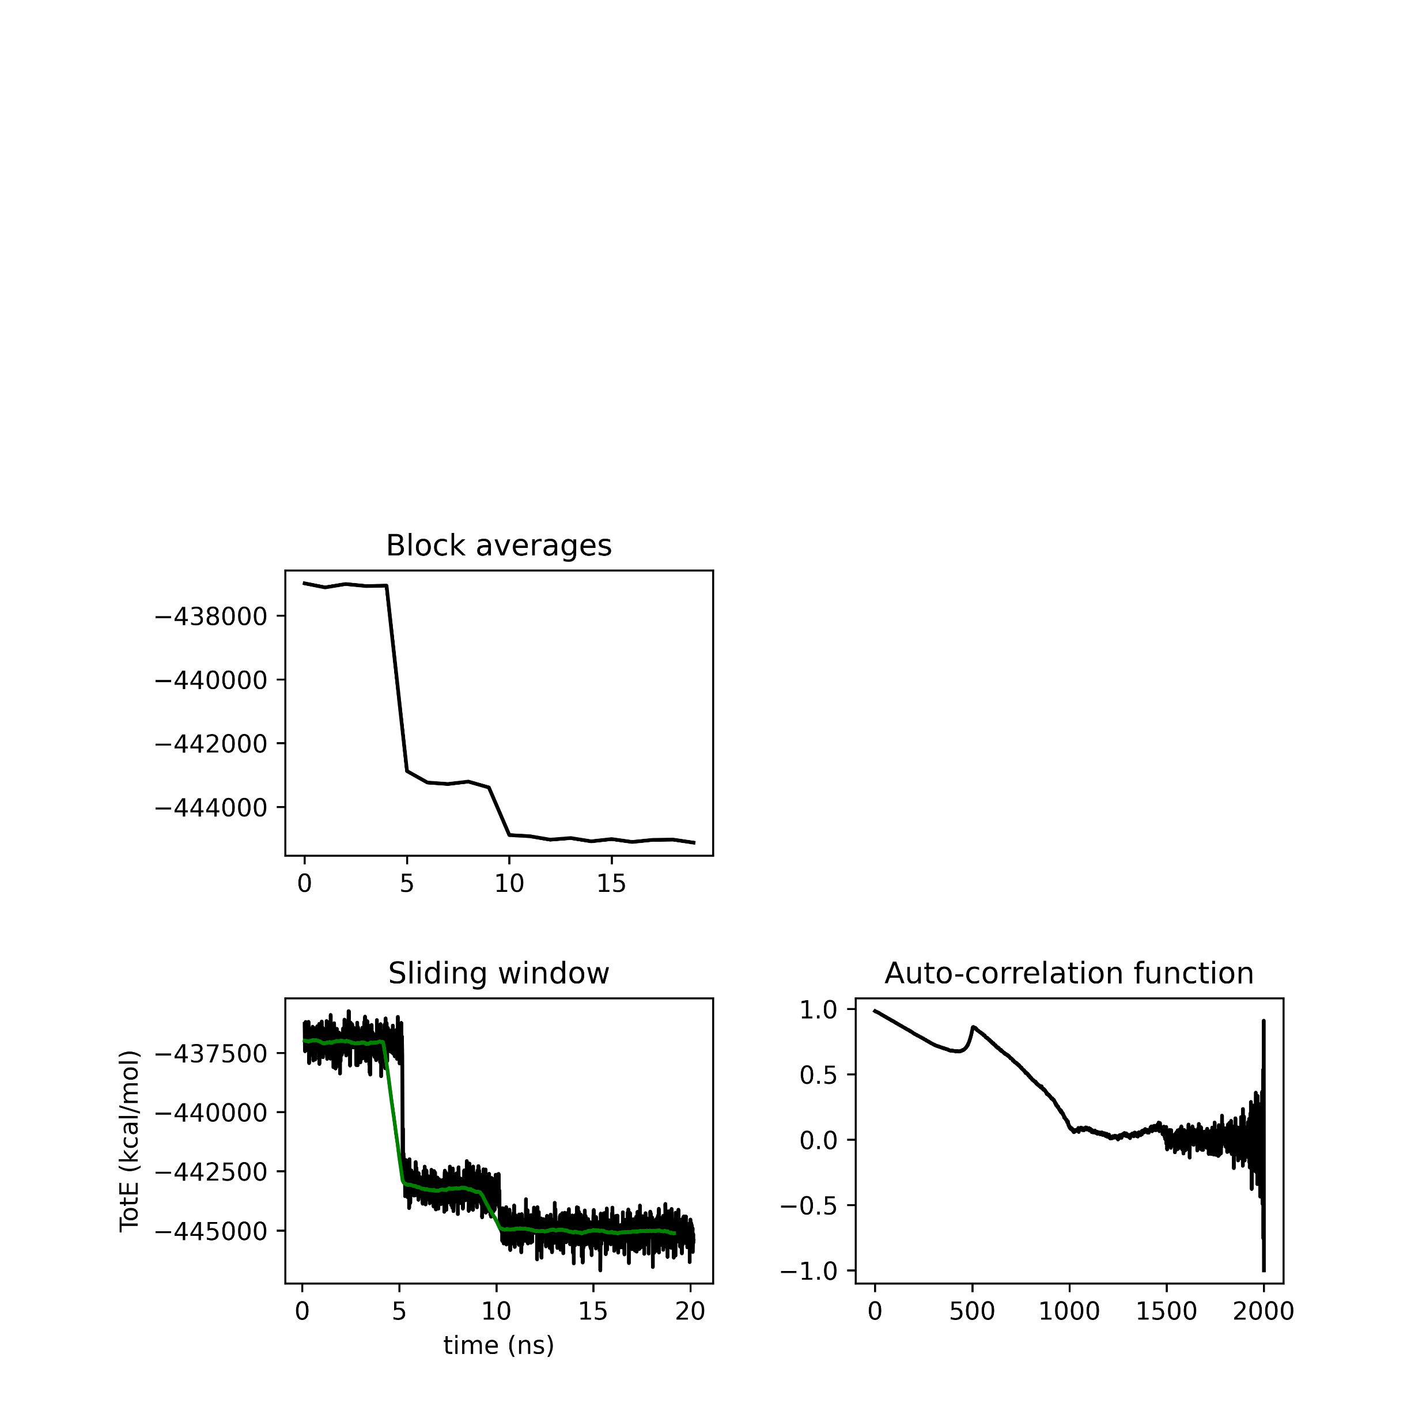

Semi-cross seed 500
BASEM =39828.40
BASEM = 762.20
BASEM = 3.27

Slide 18
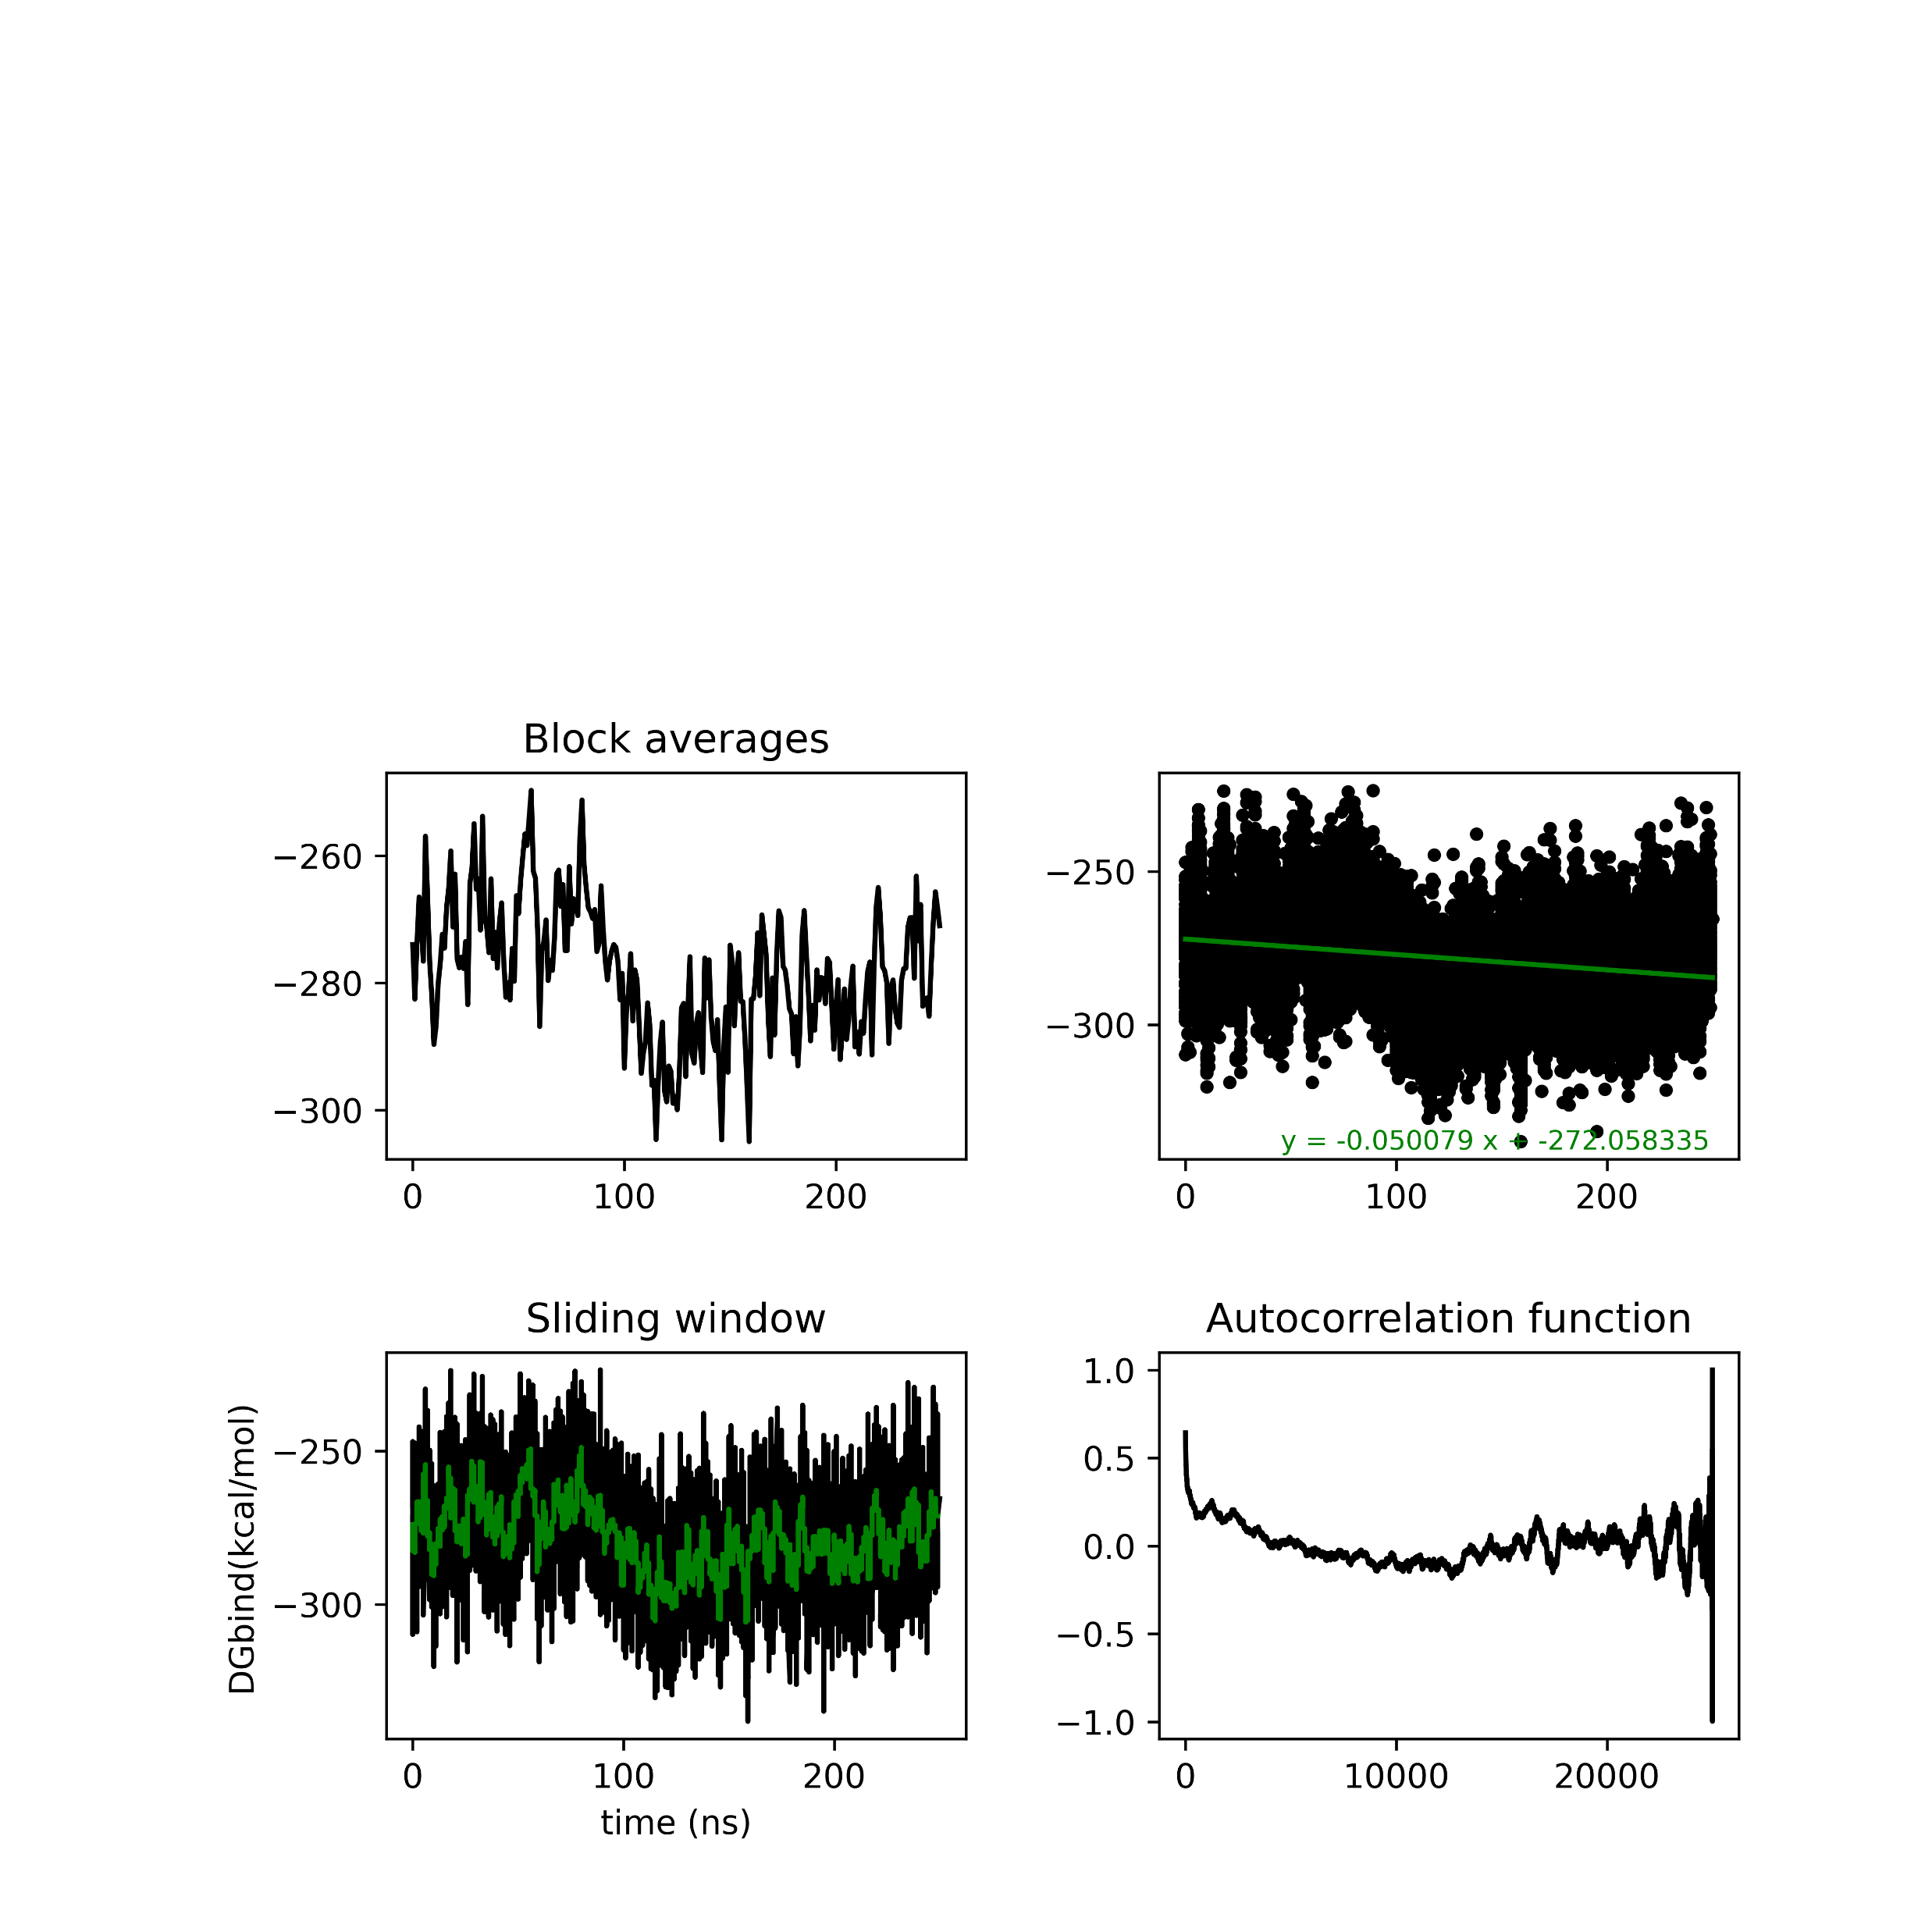
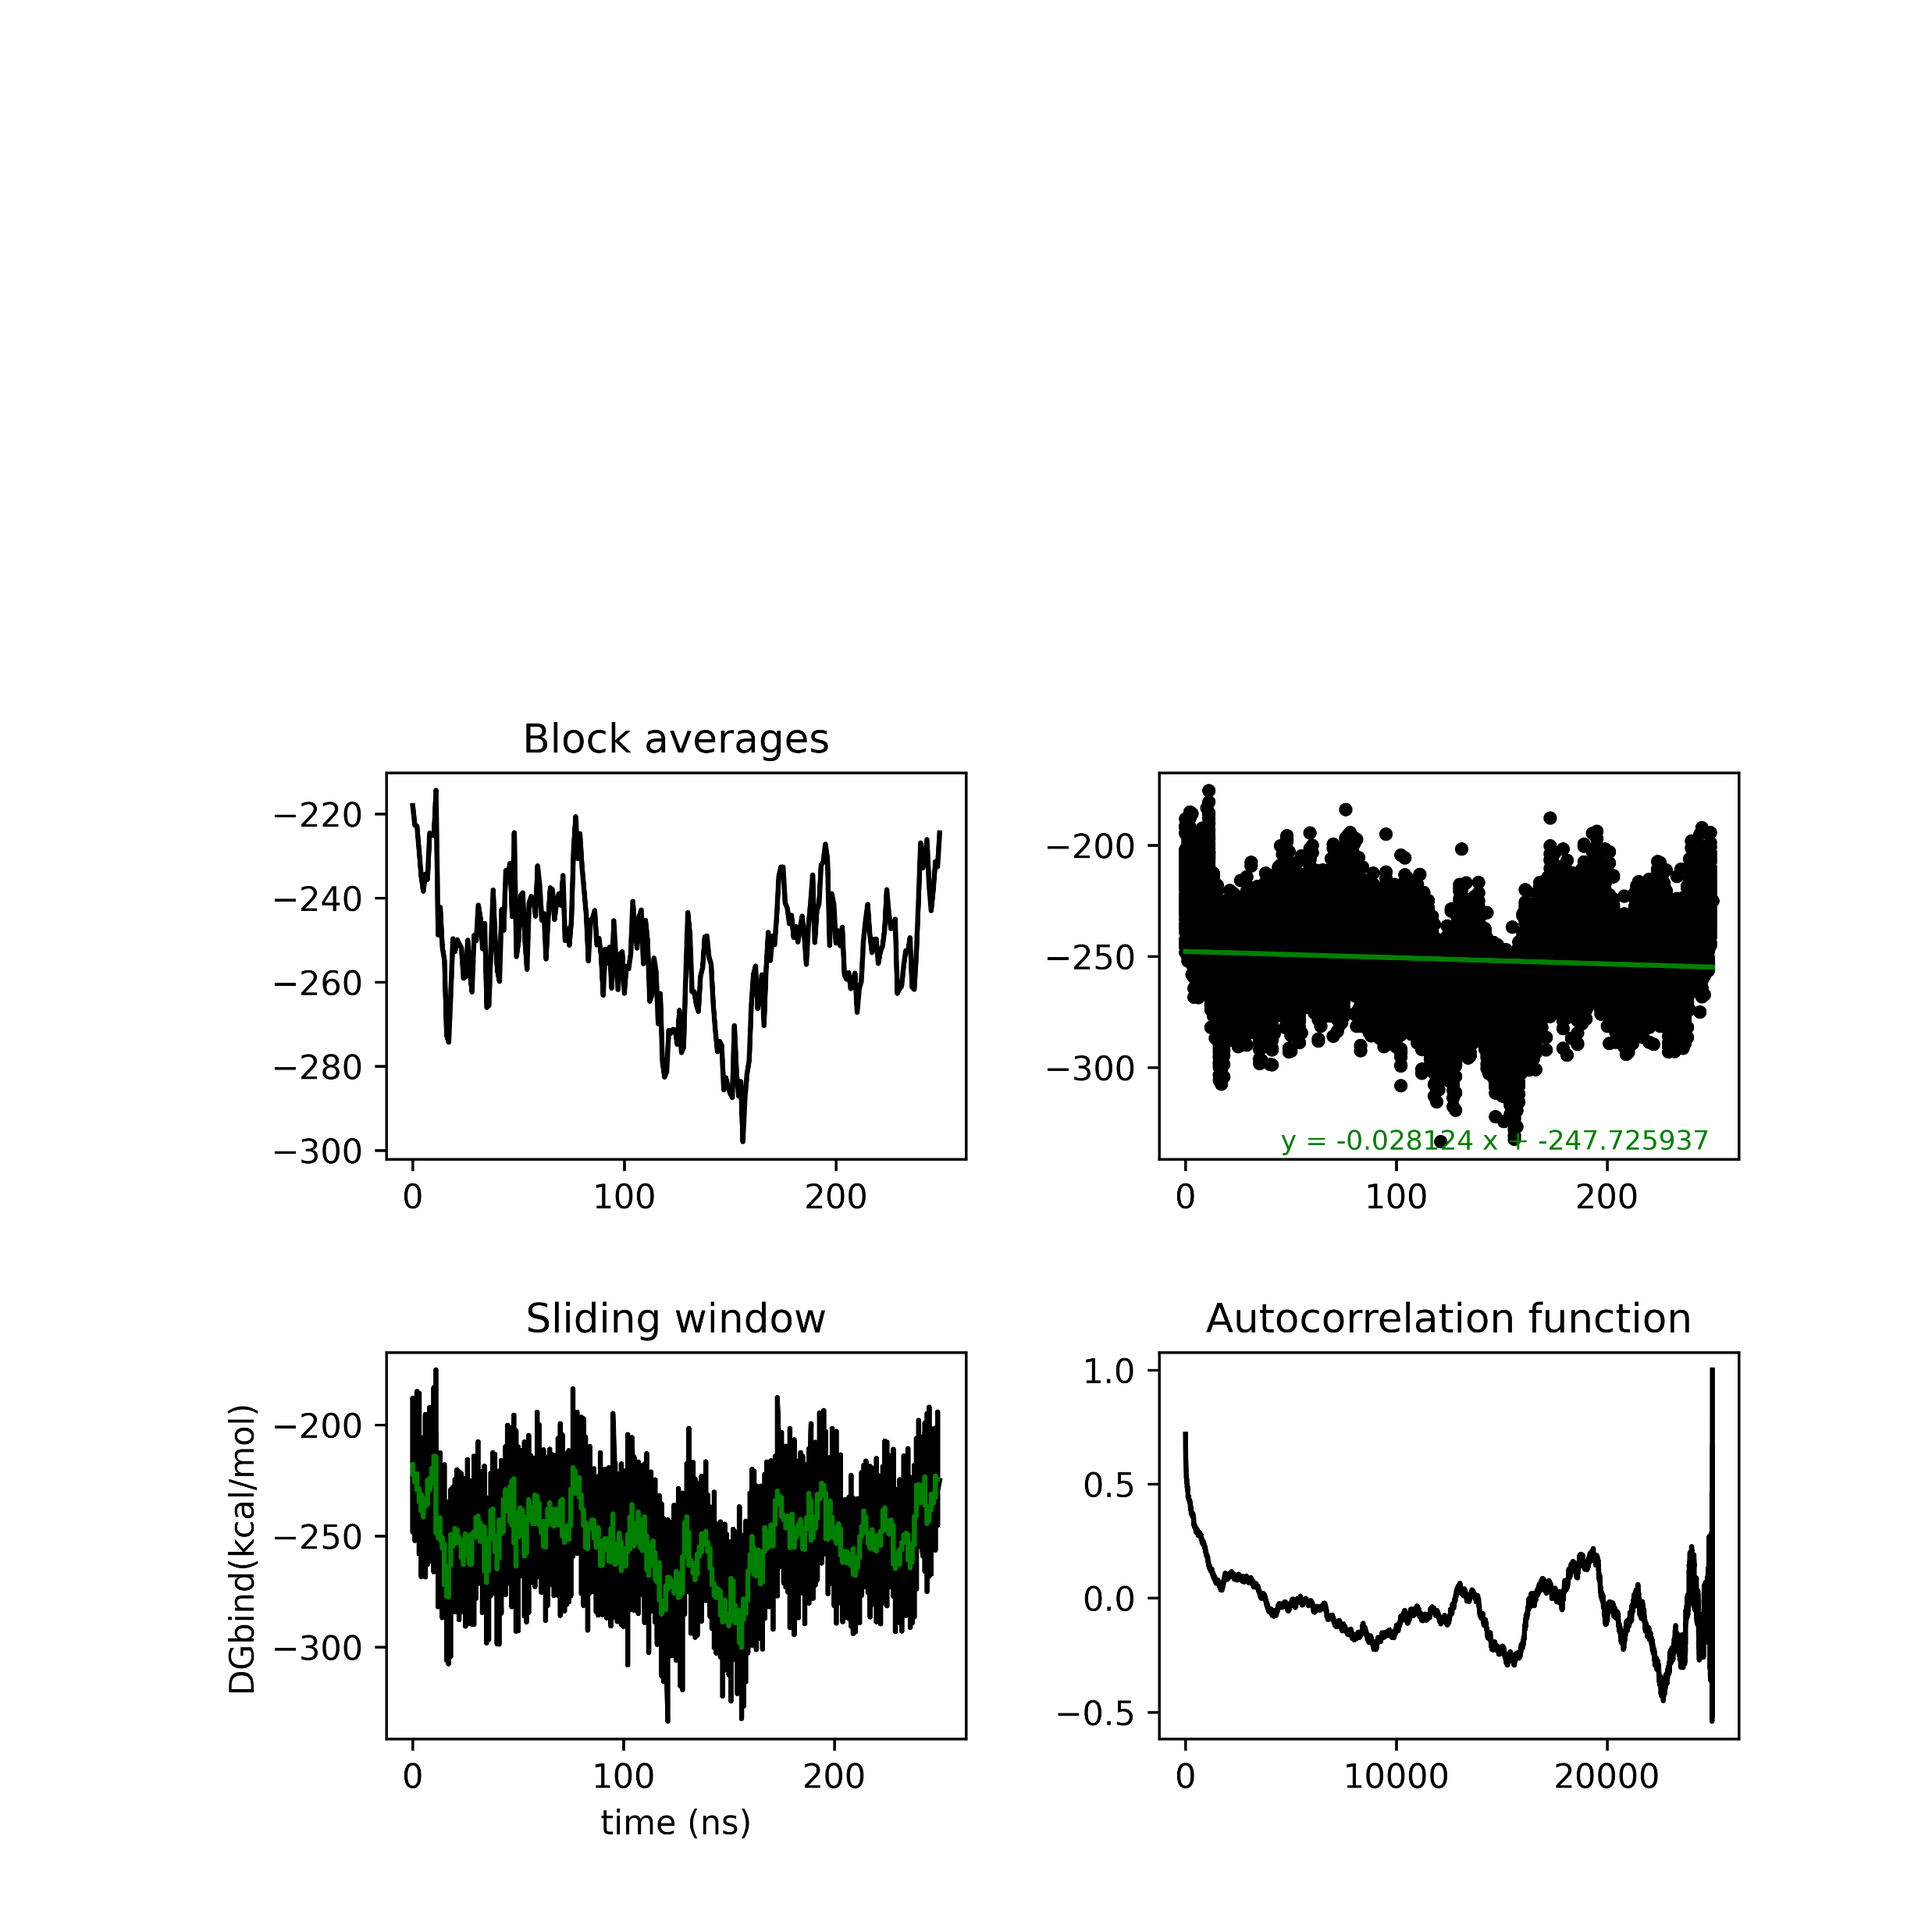
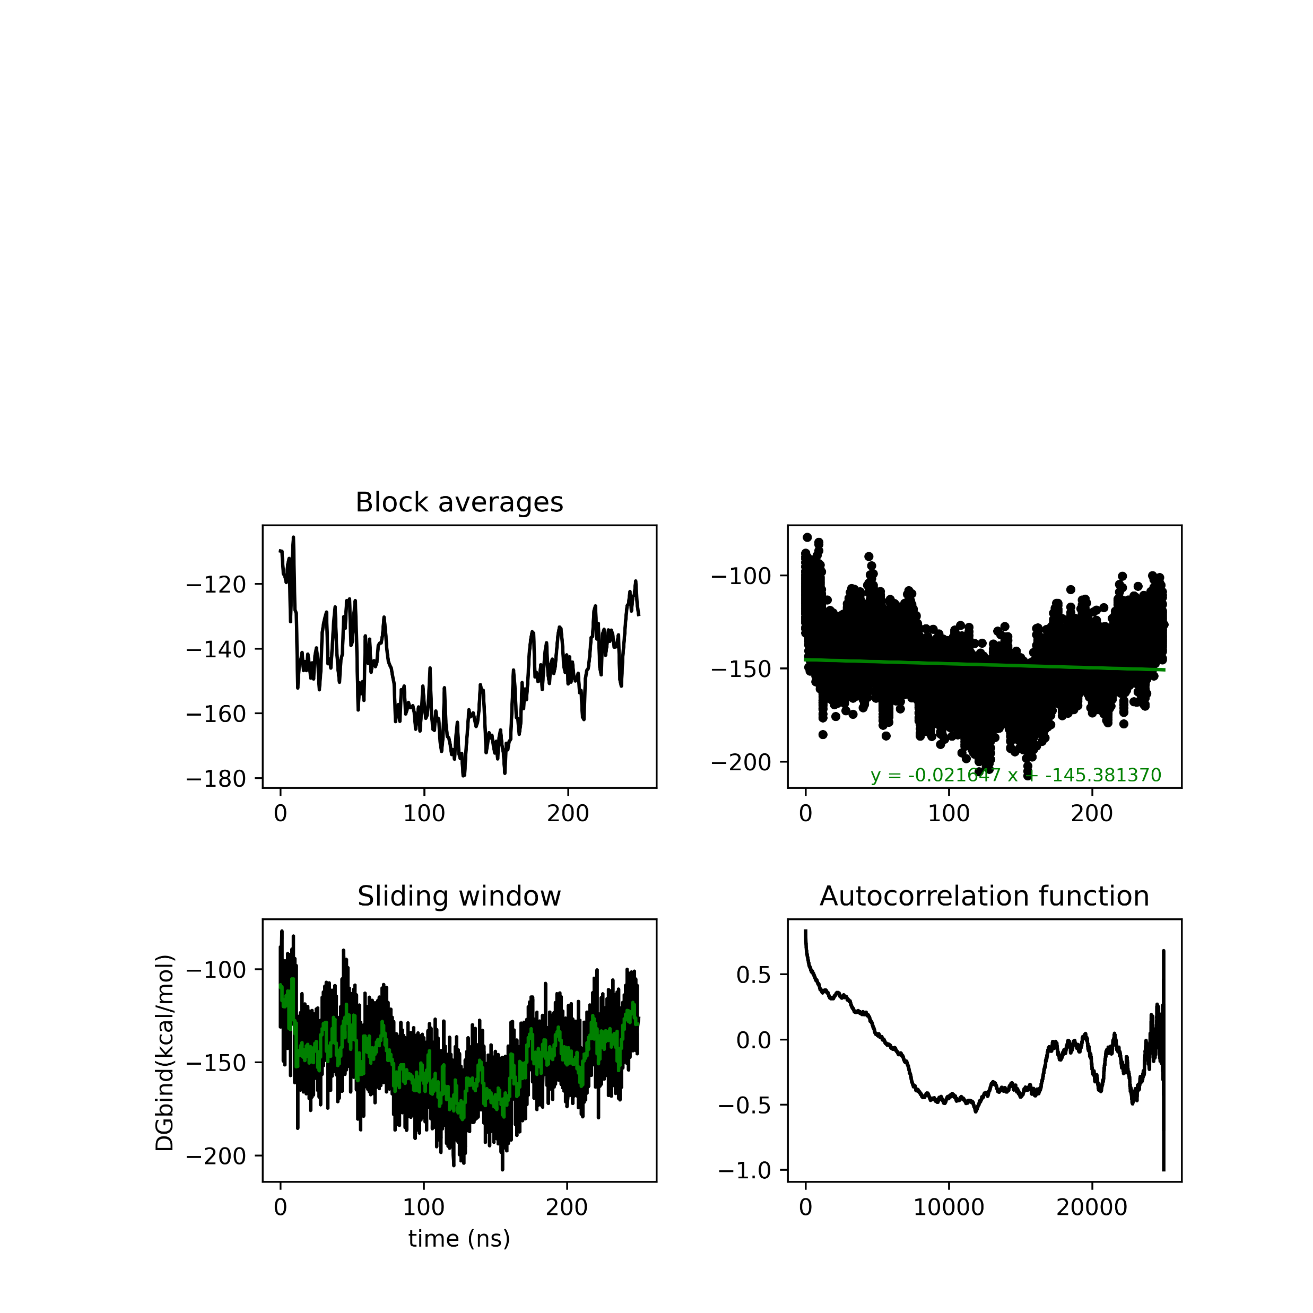
MMGBSA analysis Seed 0

Slide 19

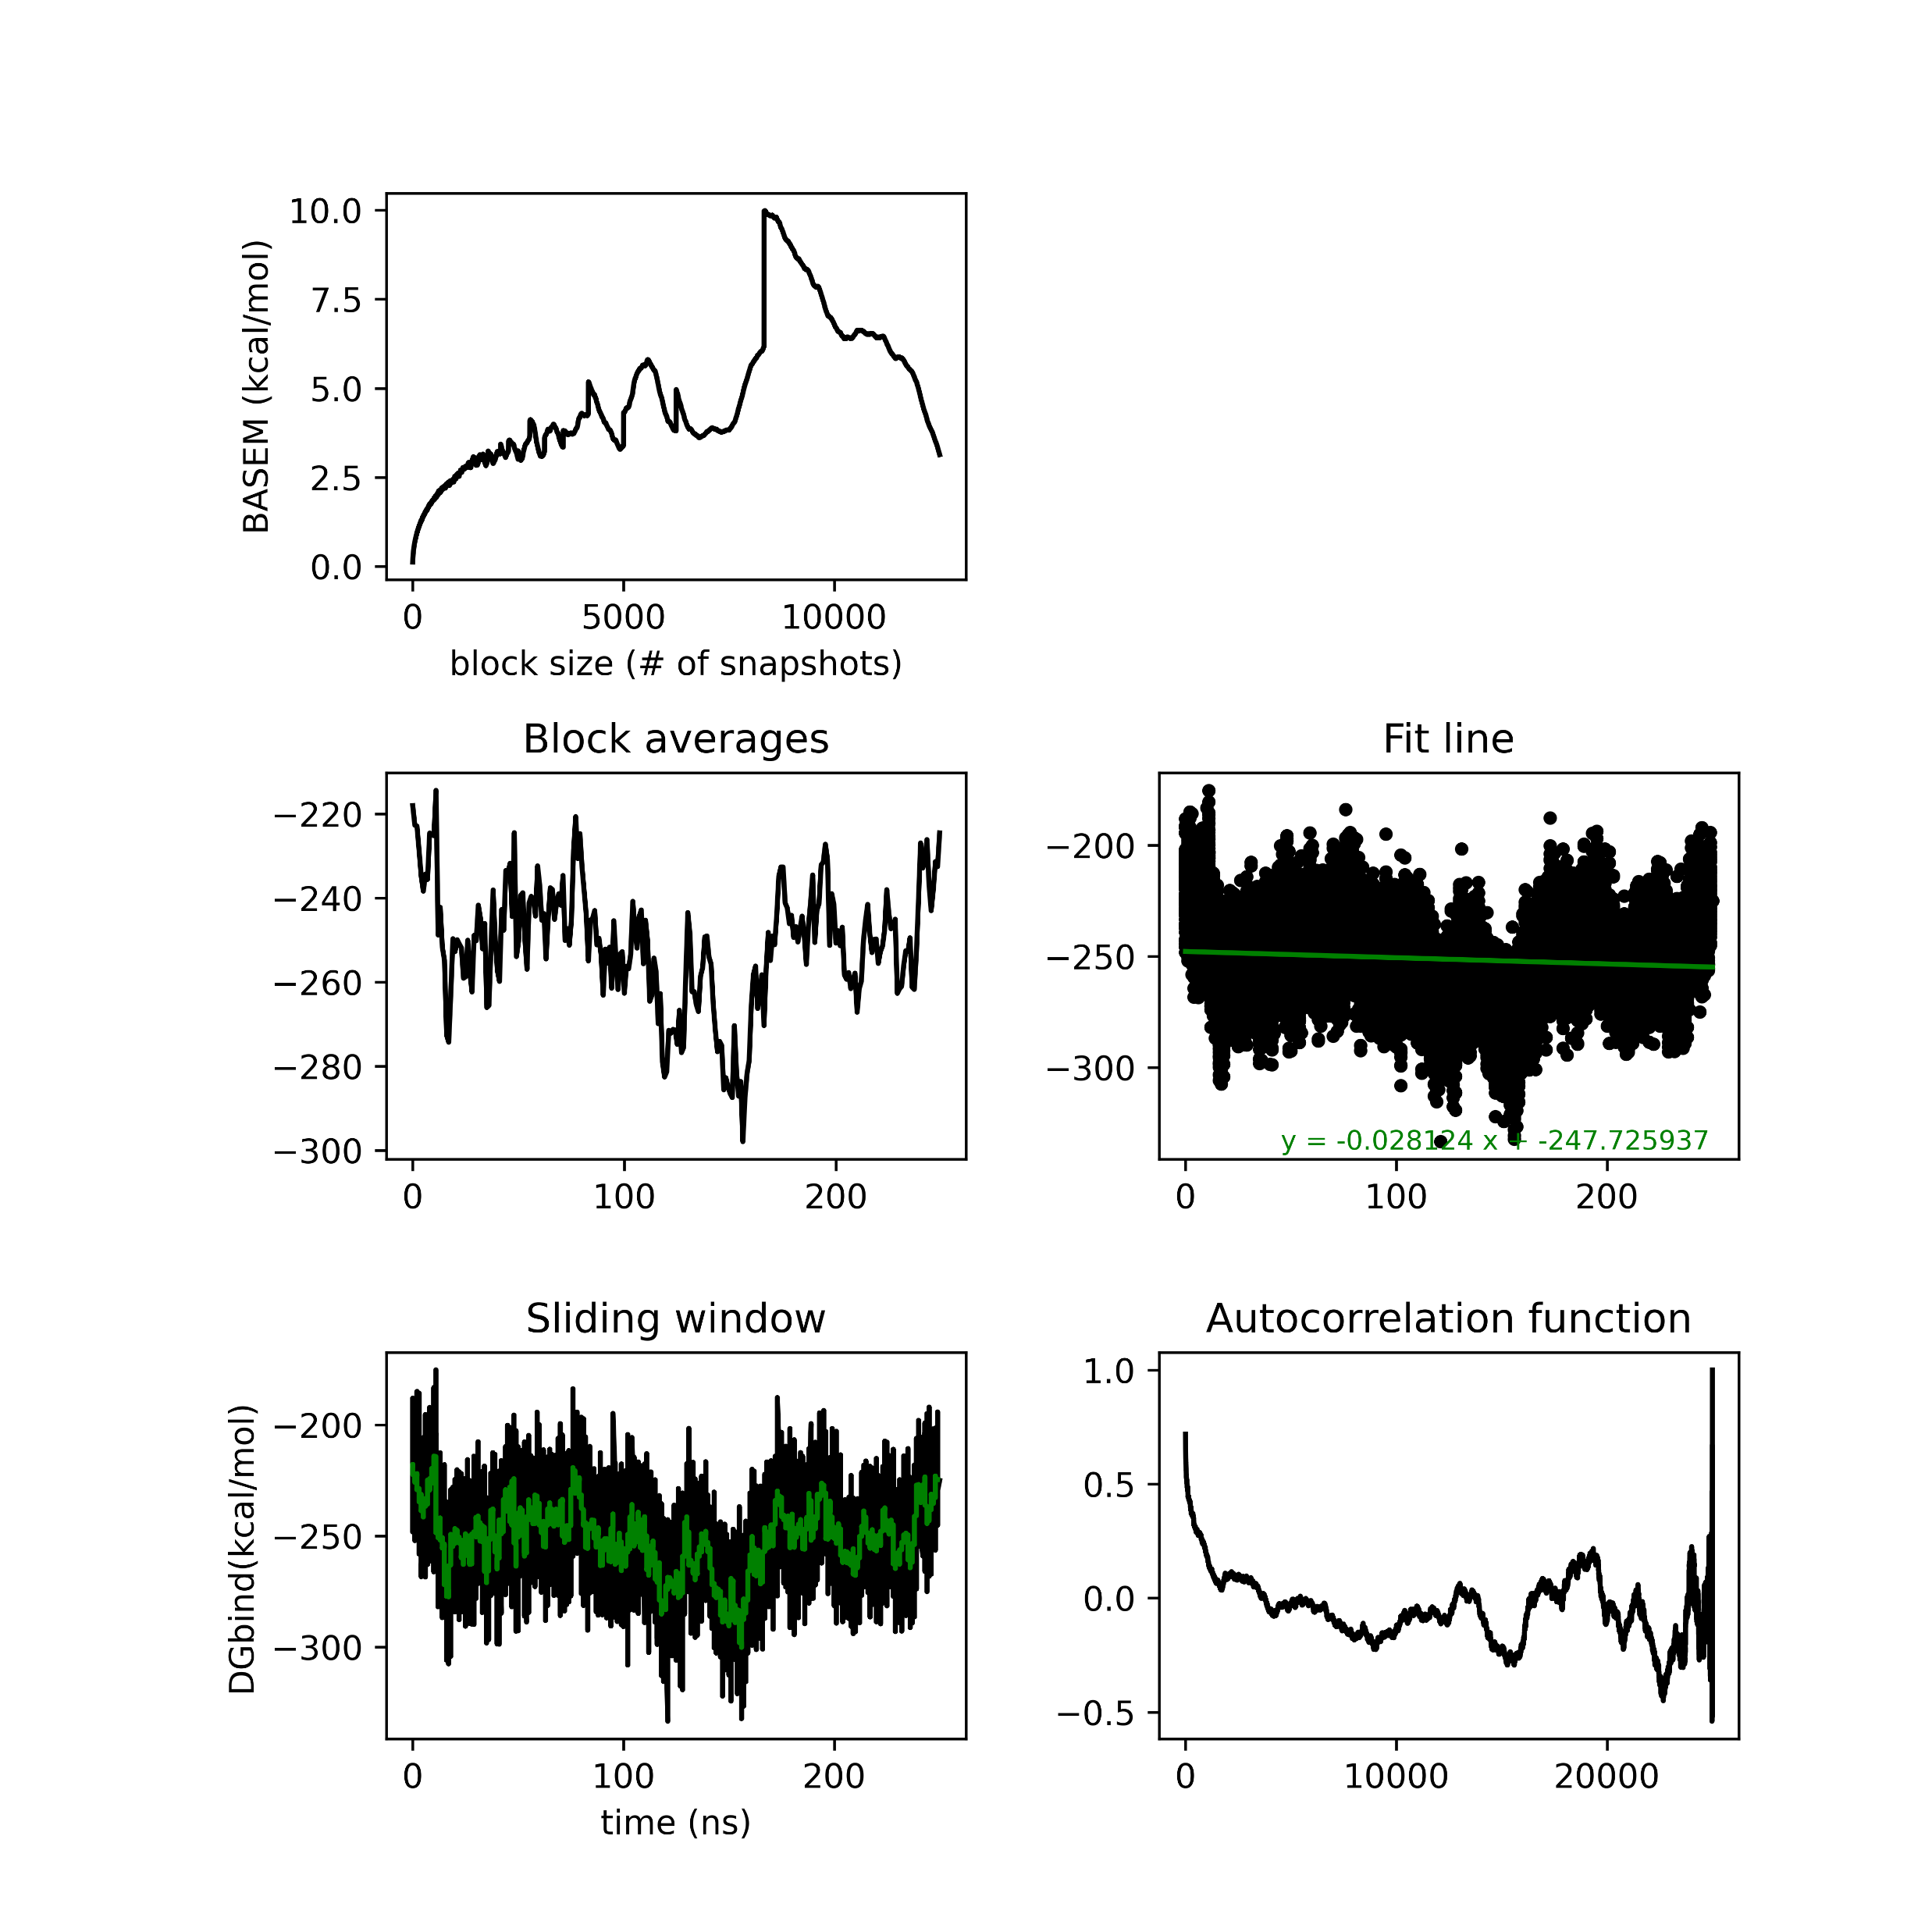
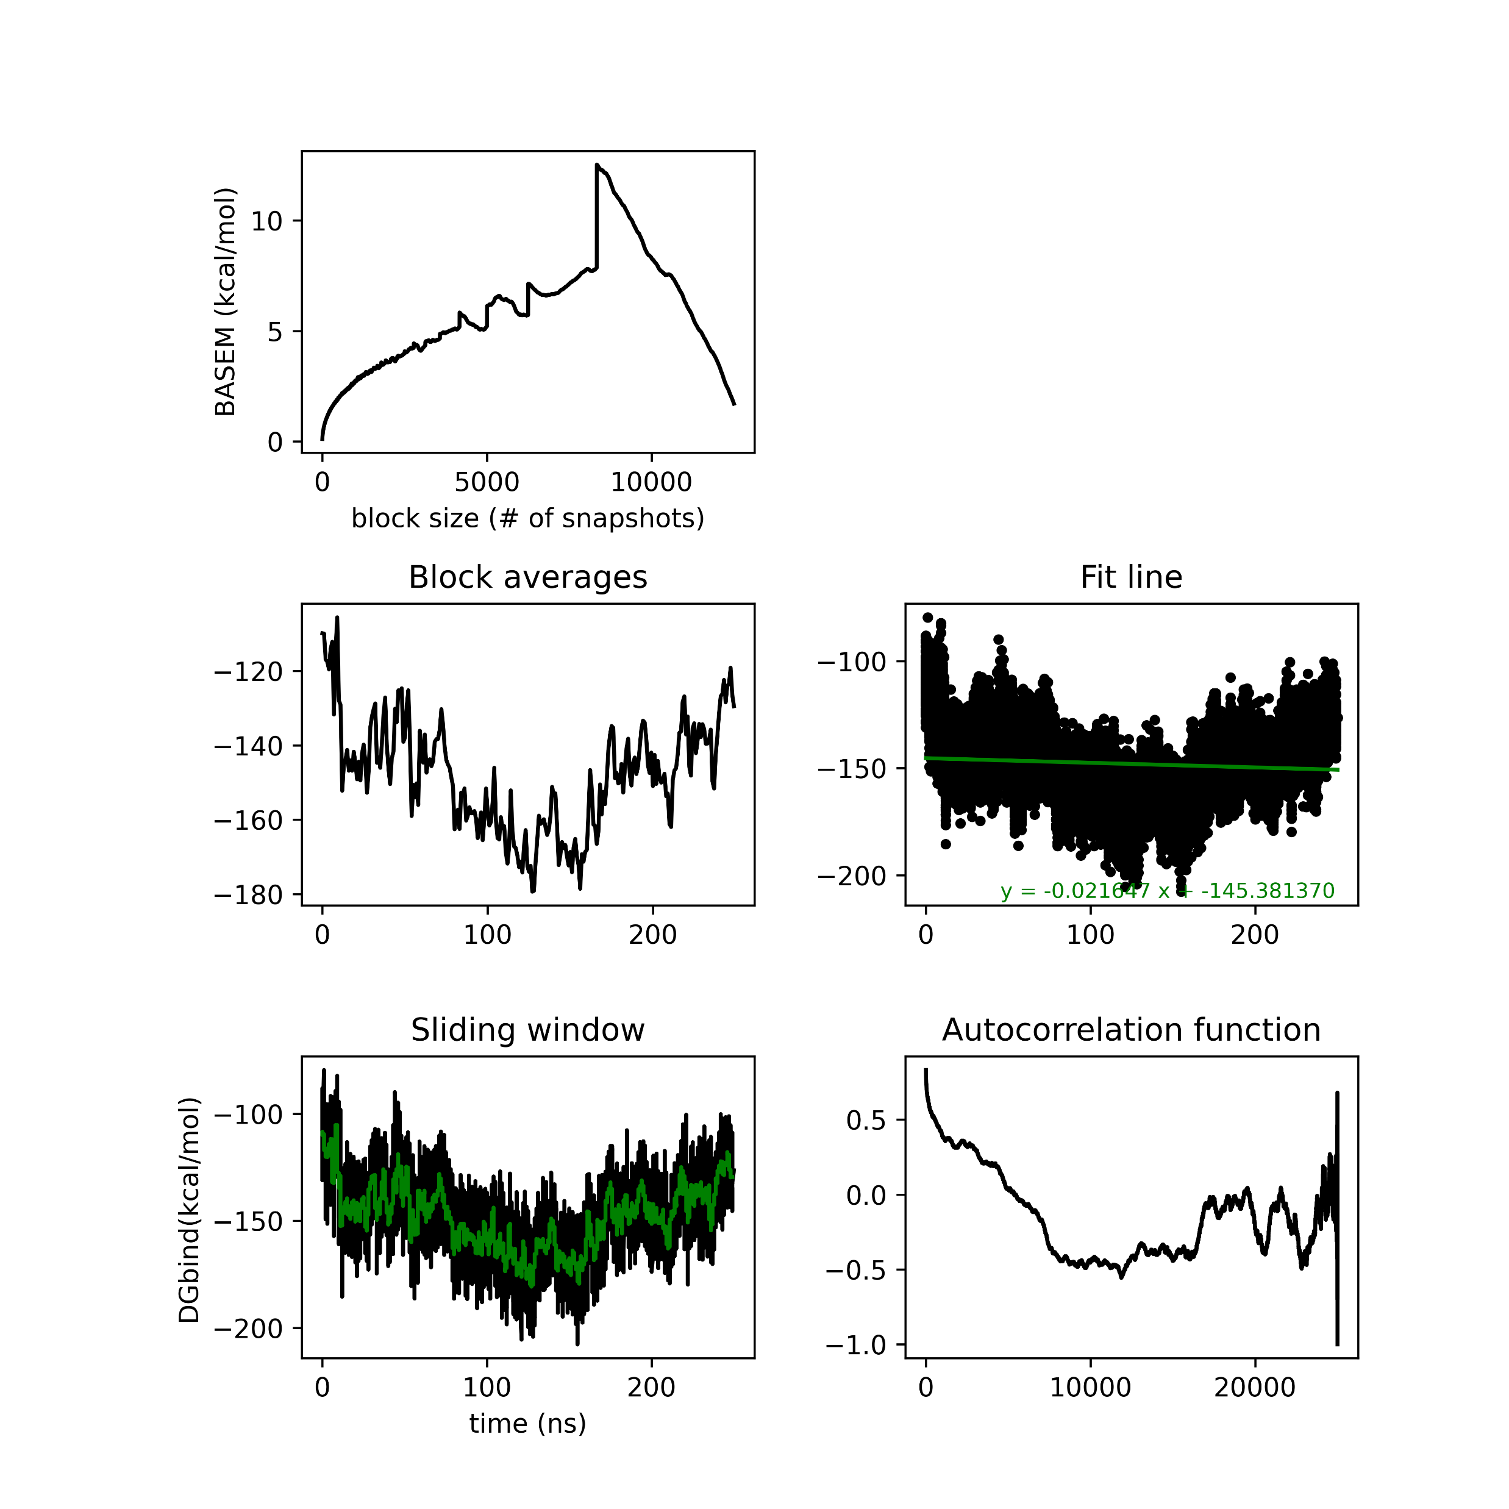
MMGBSA analysis Seed 0

Slide 20
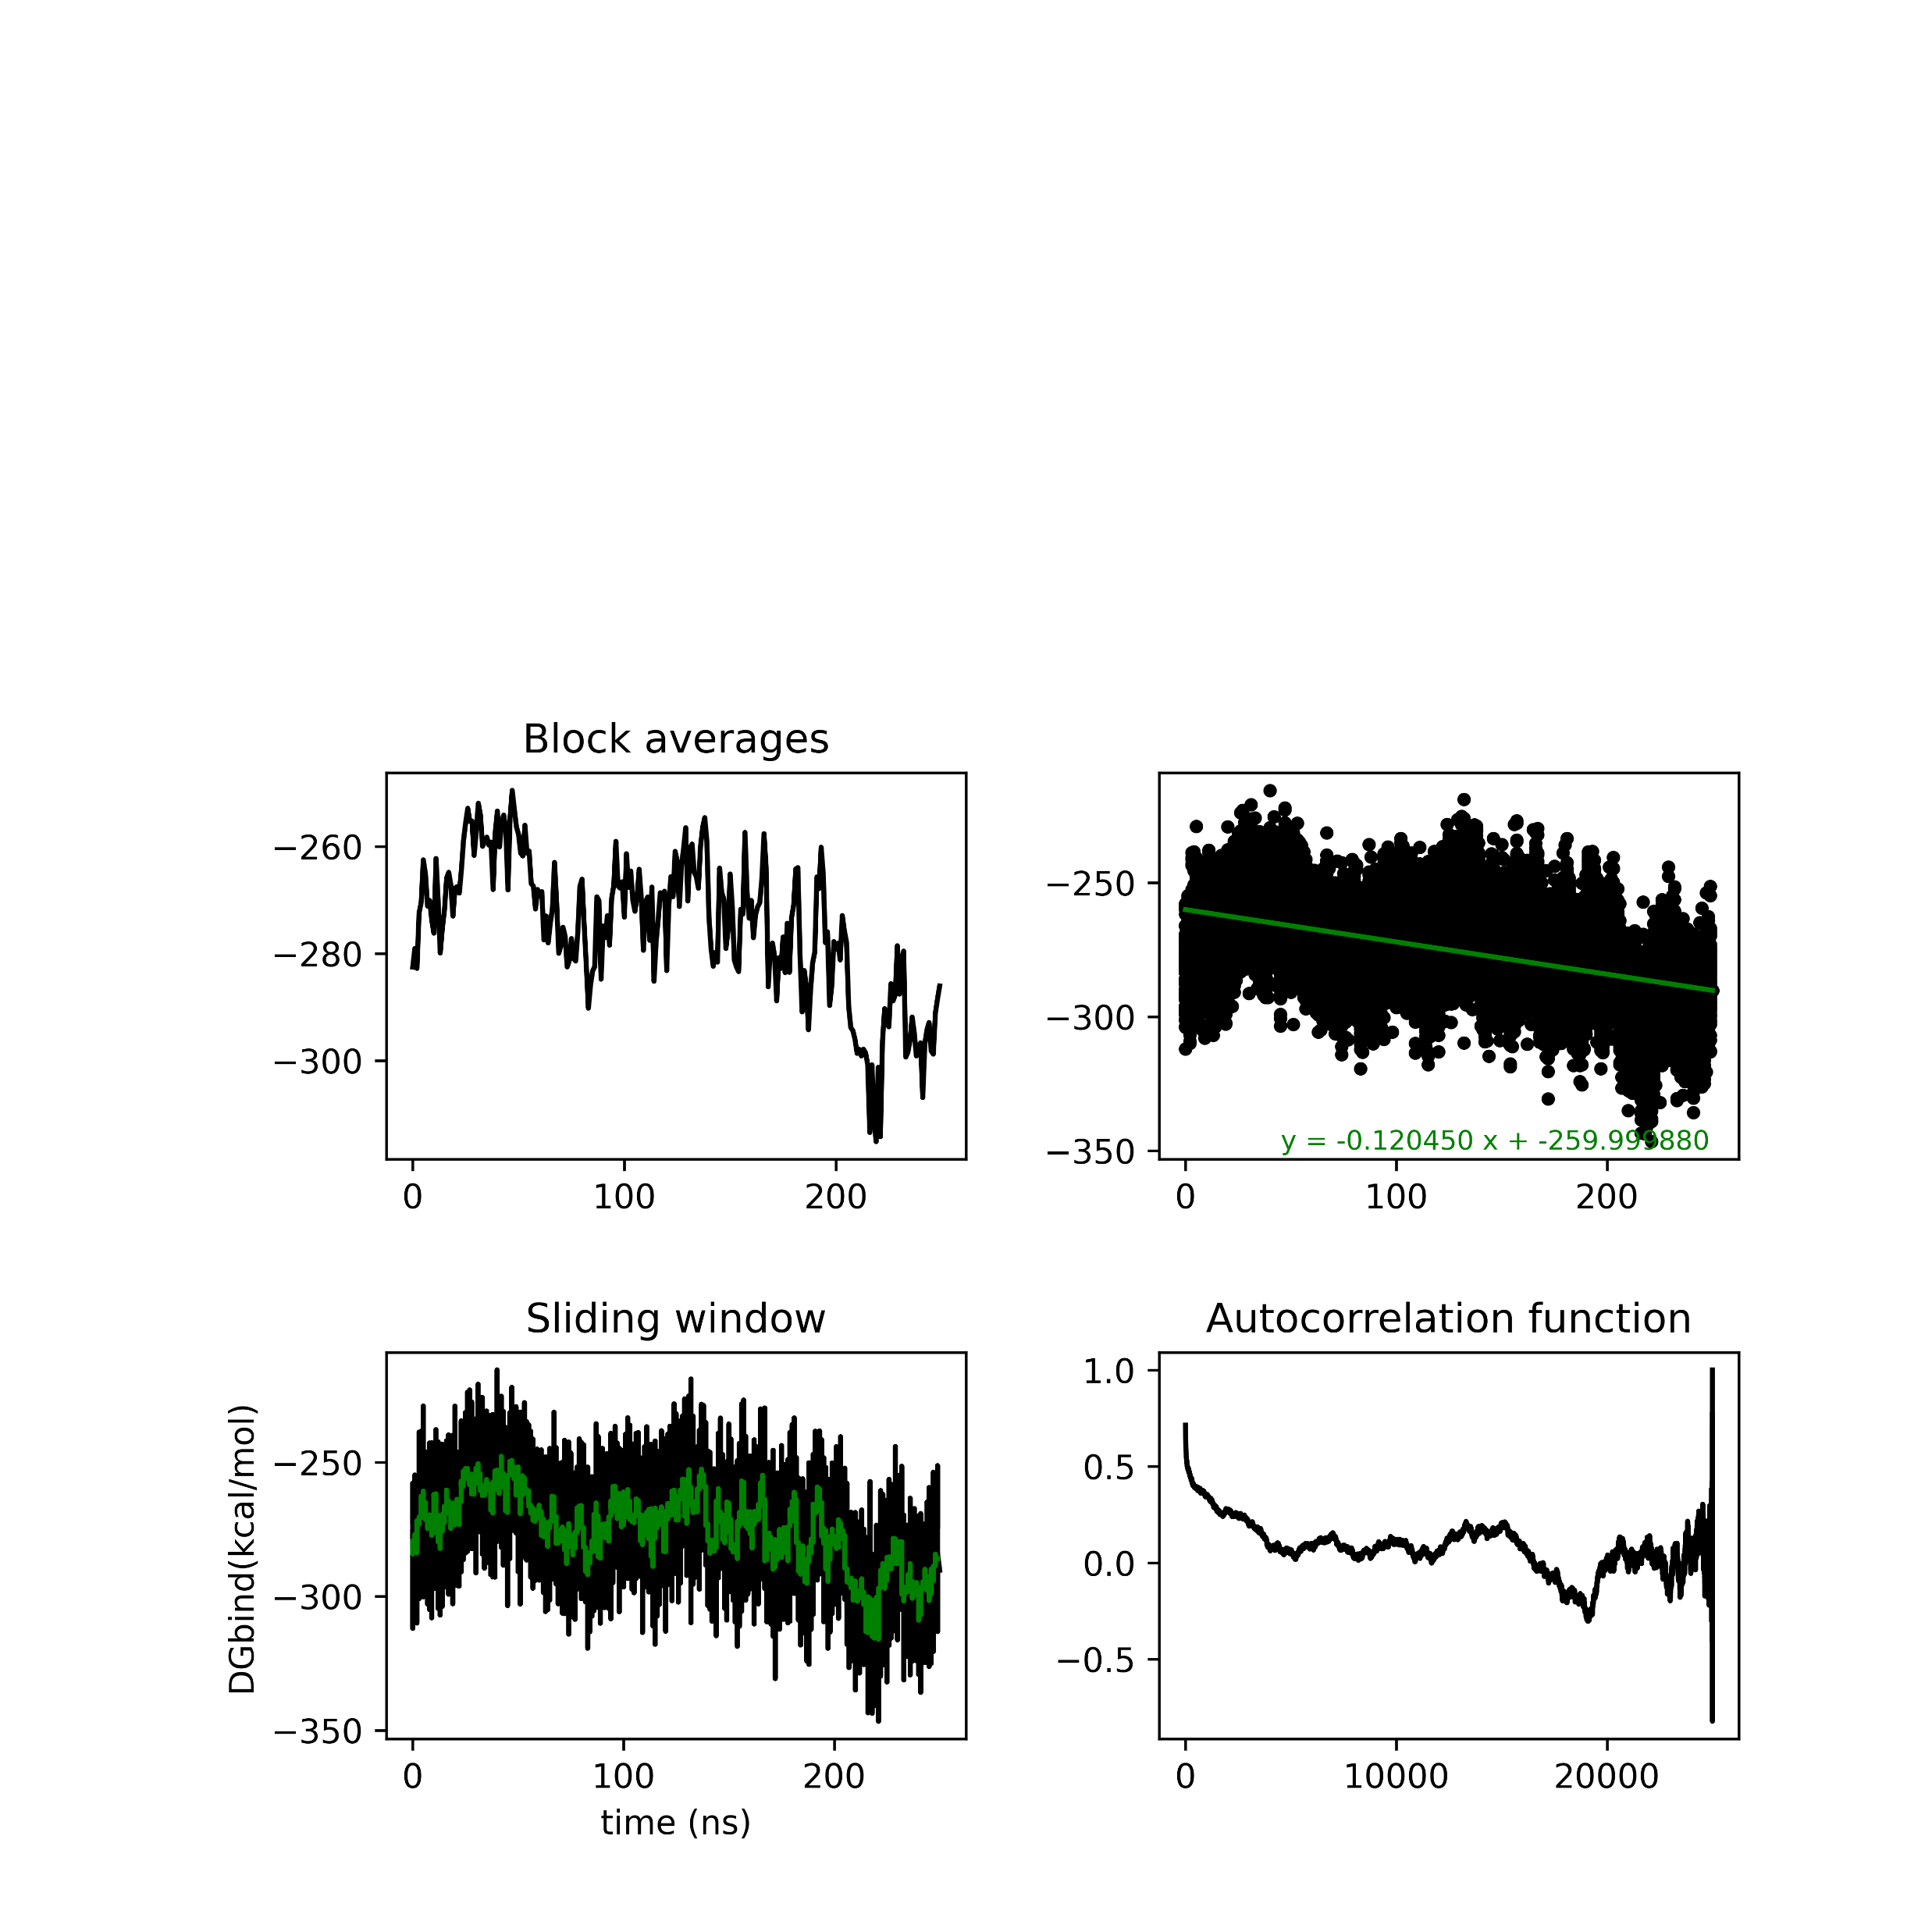
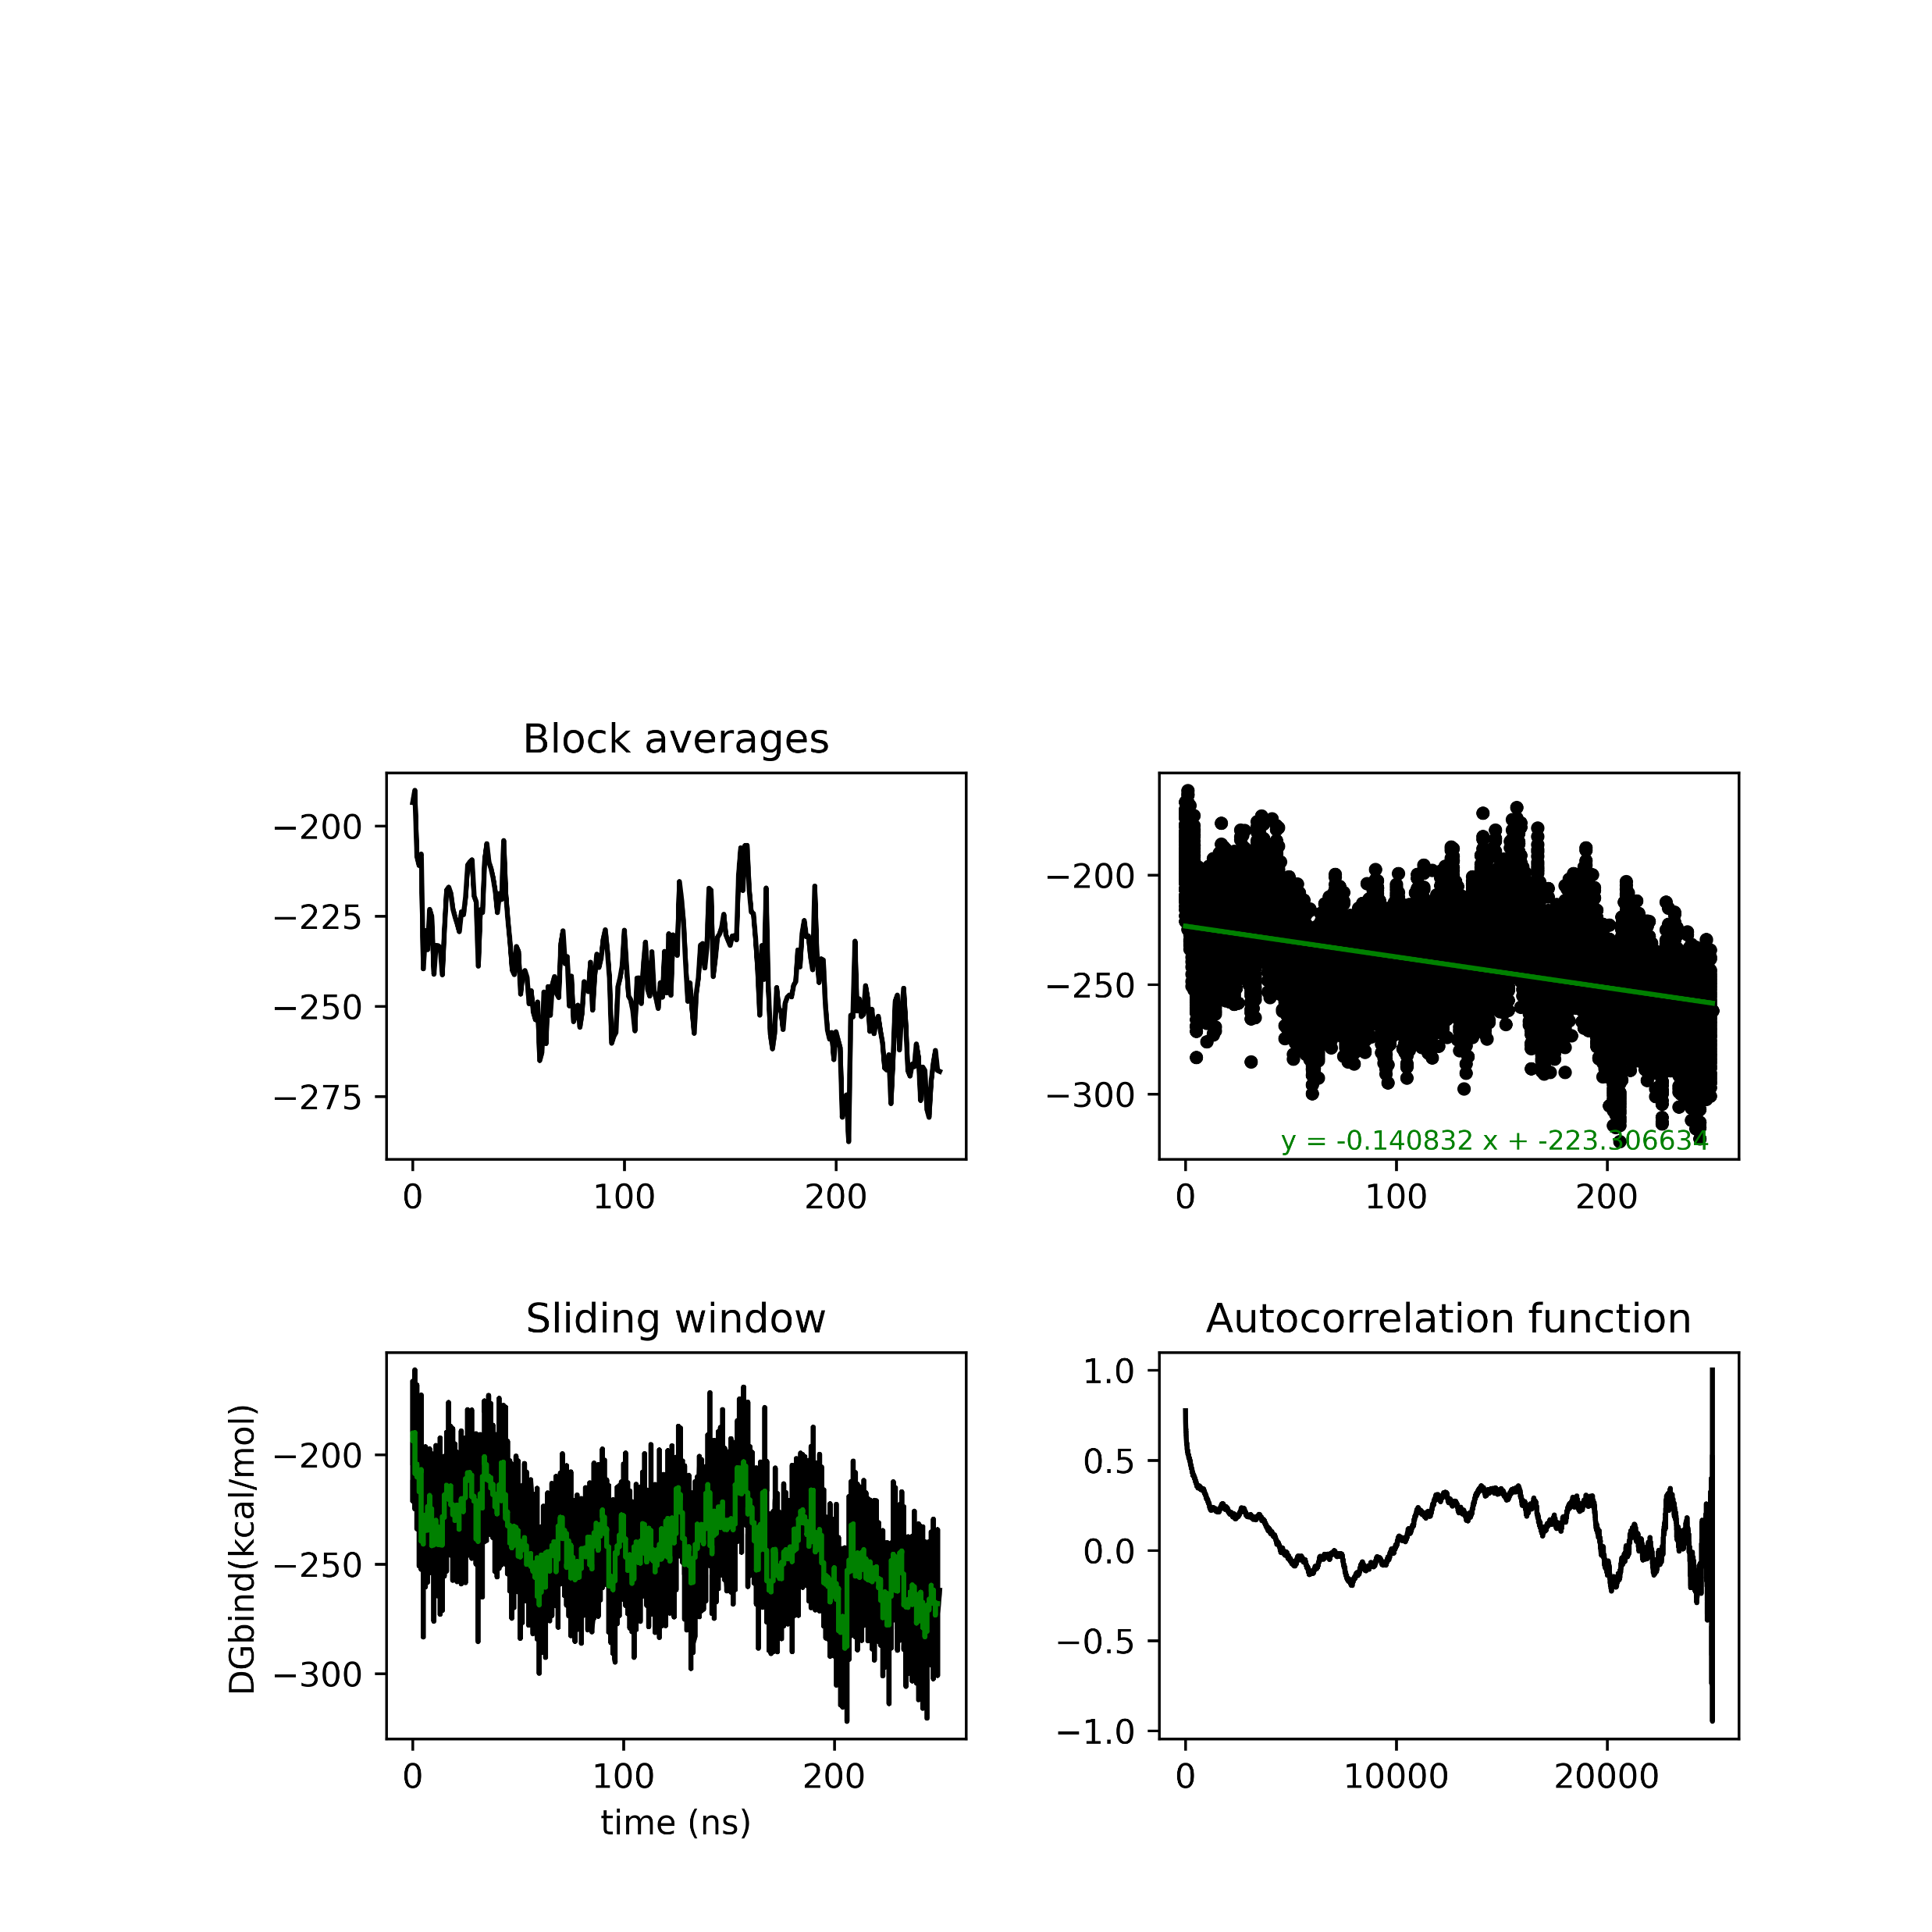
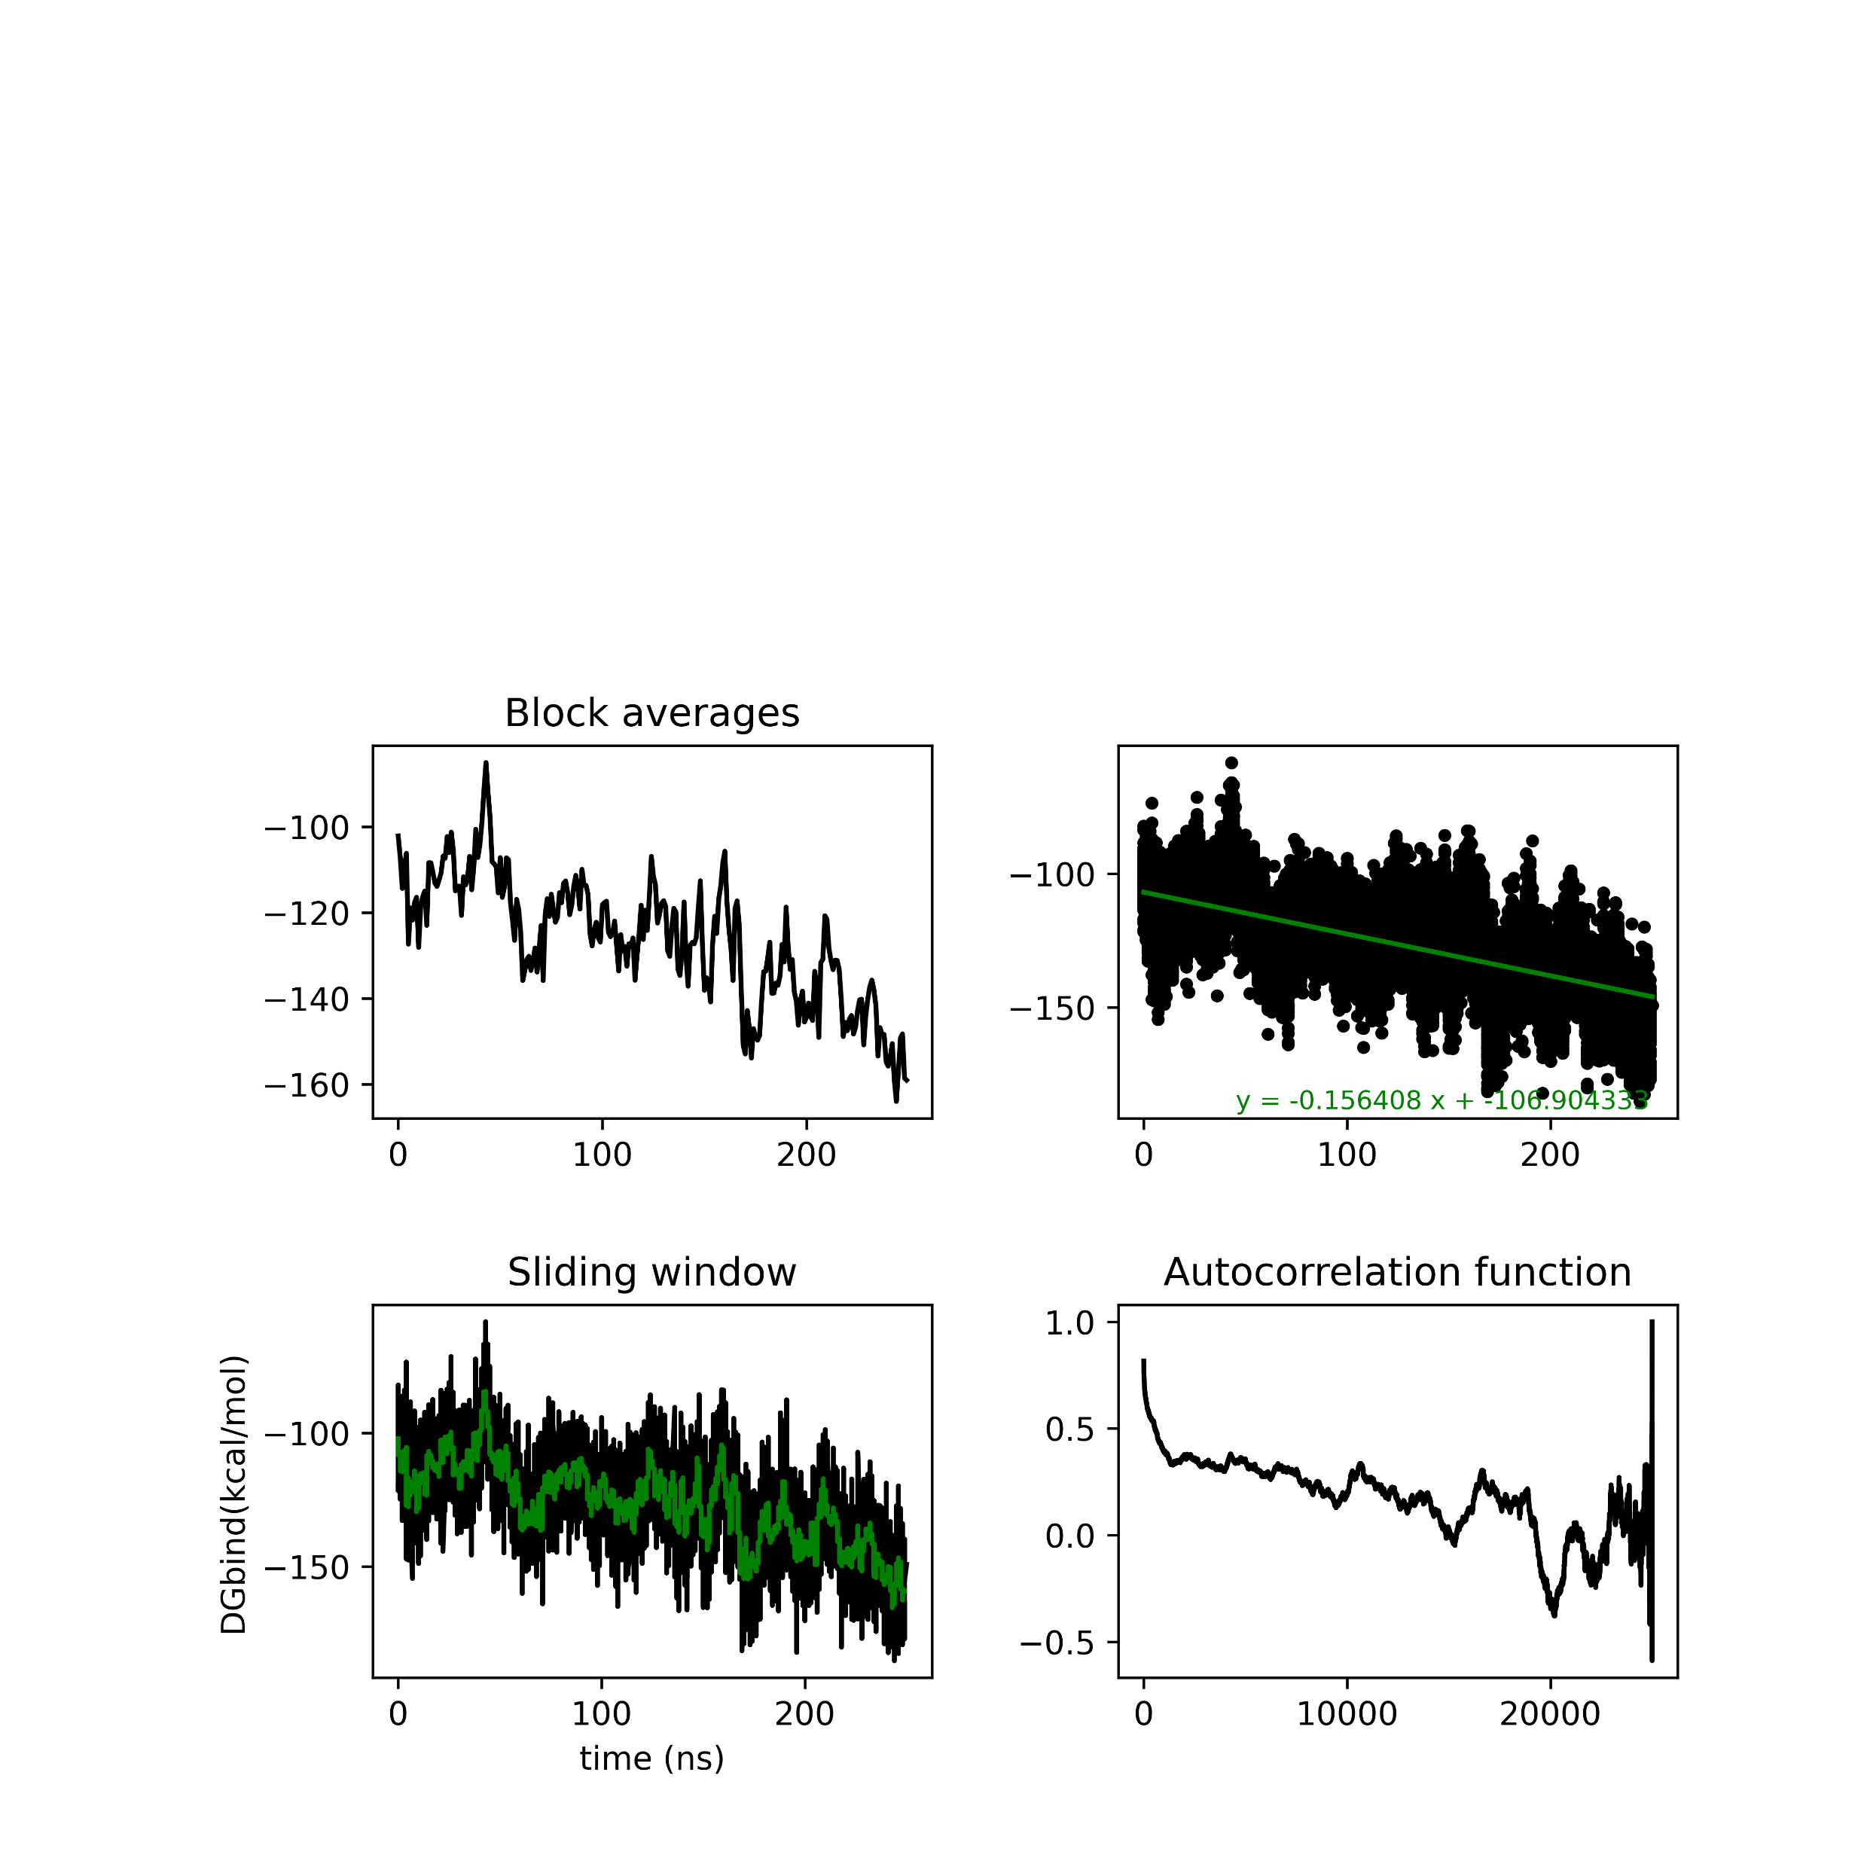
MMGBSA analysis Seed 5

Slide 21
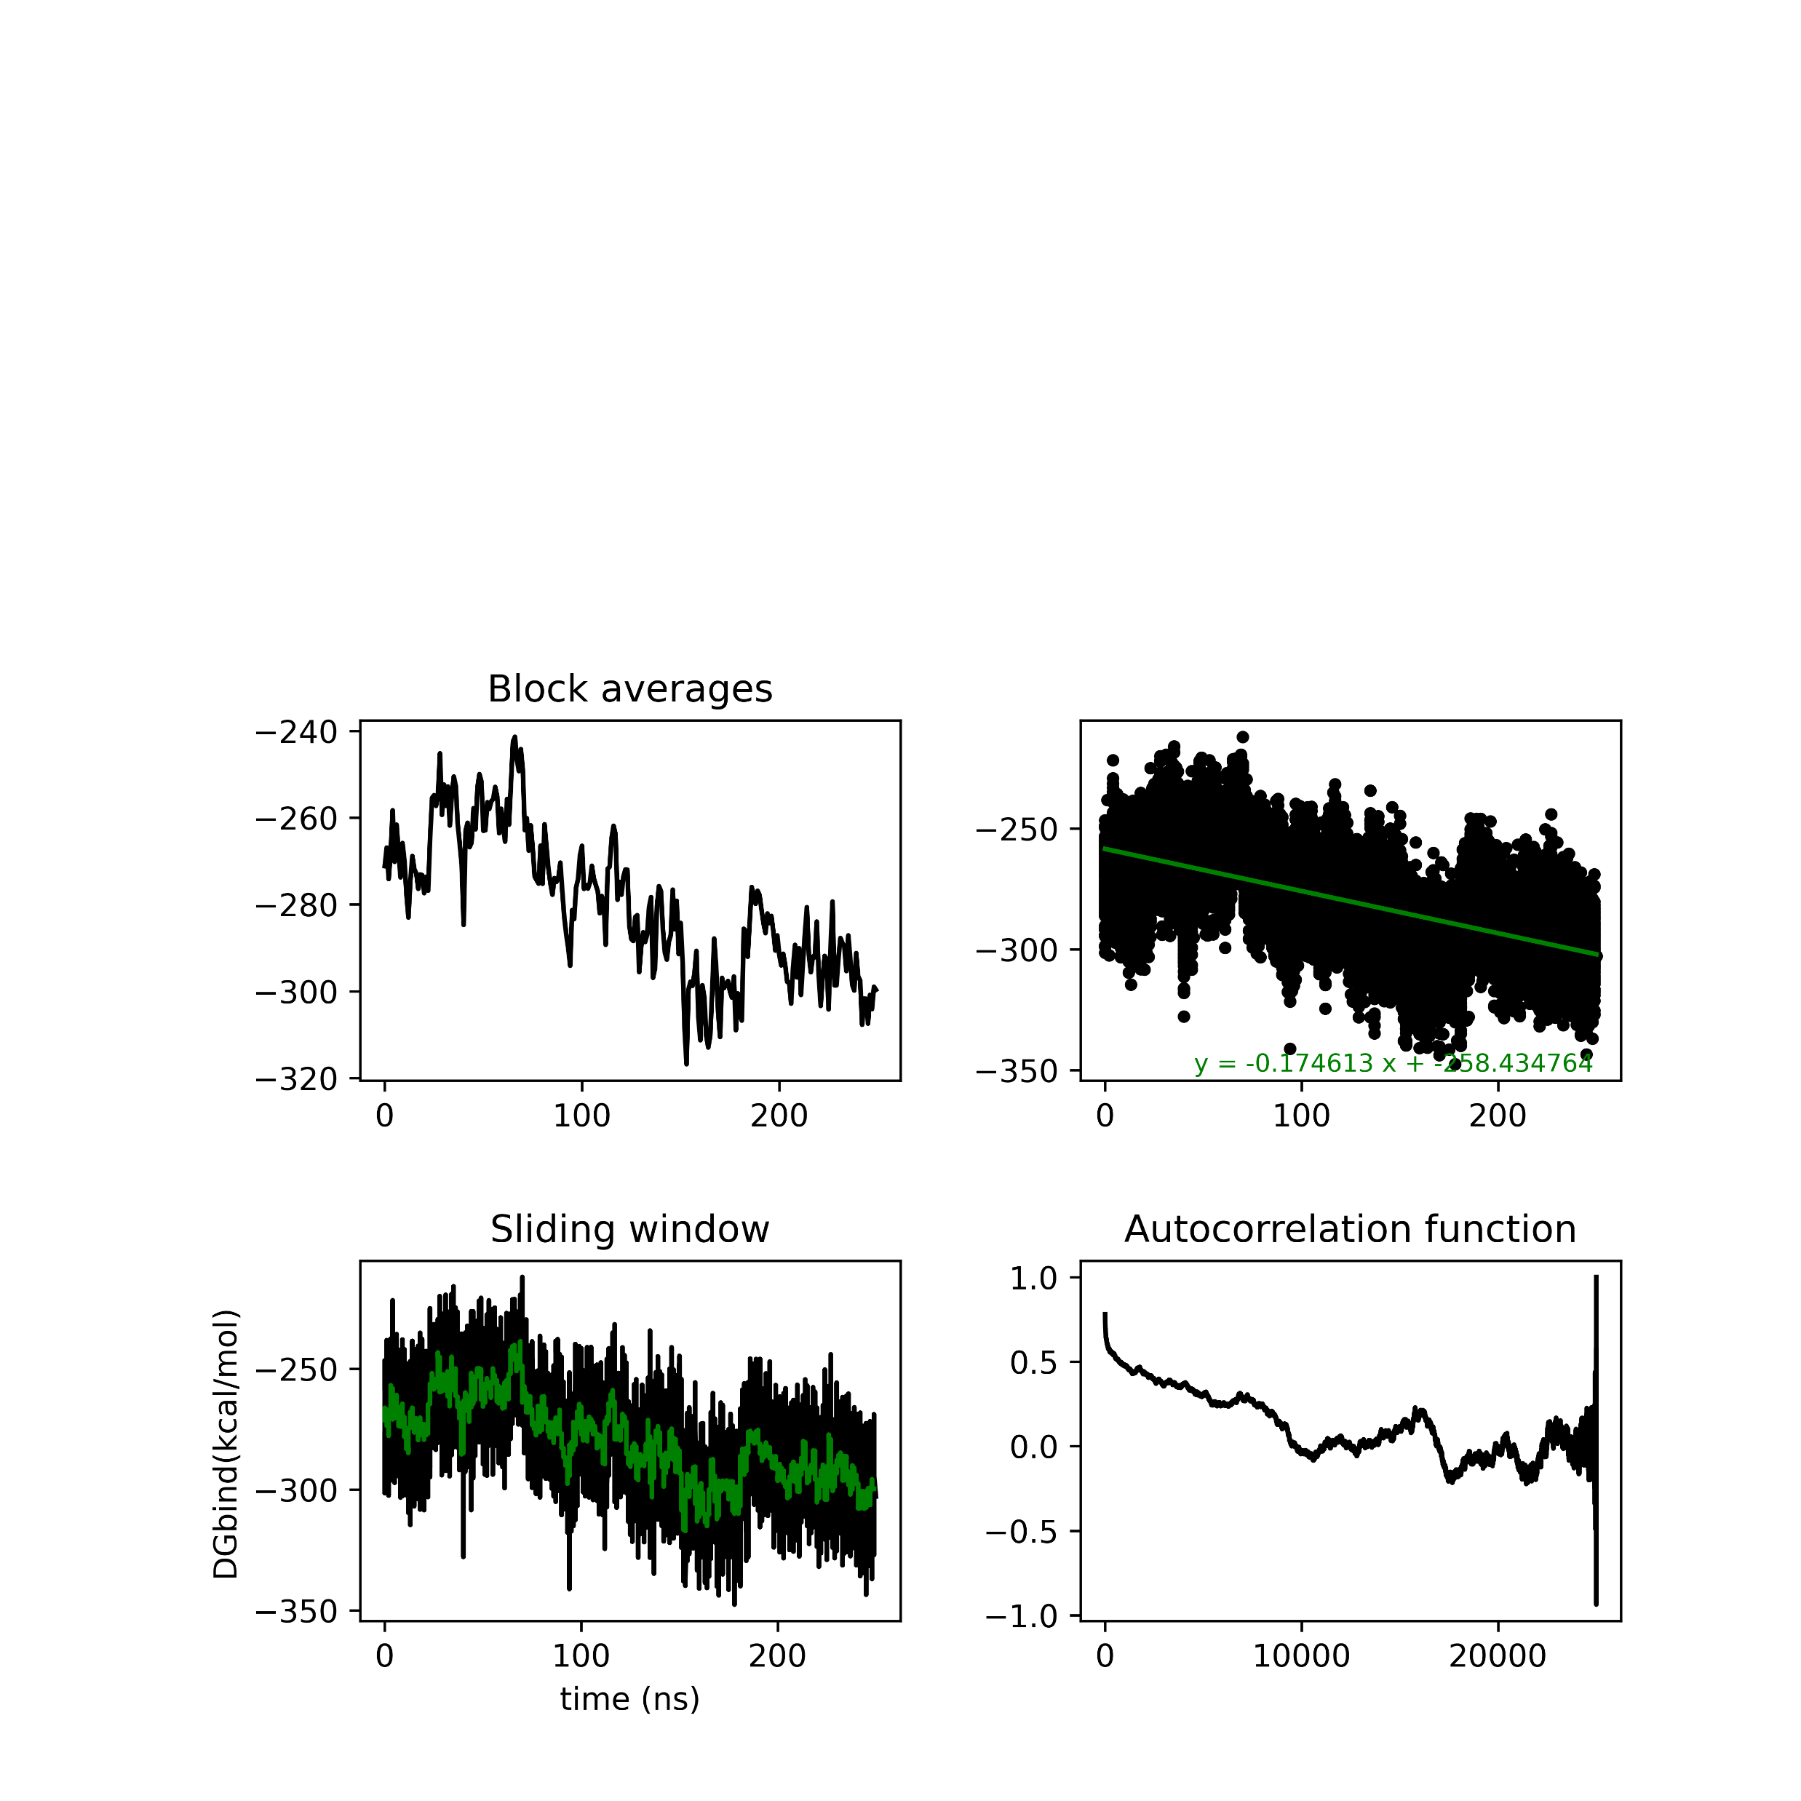
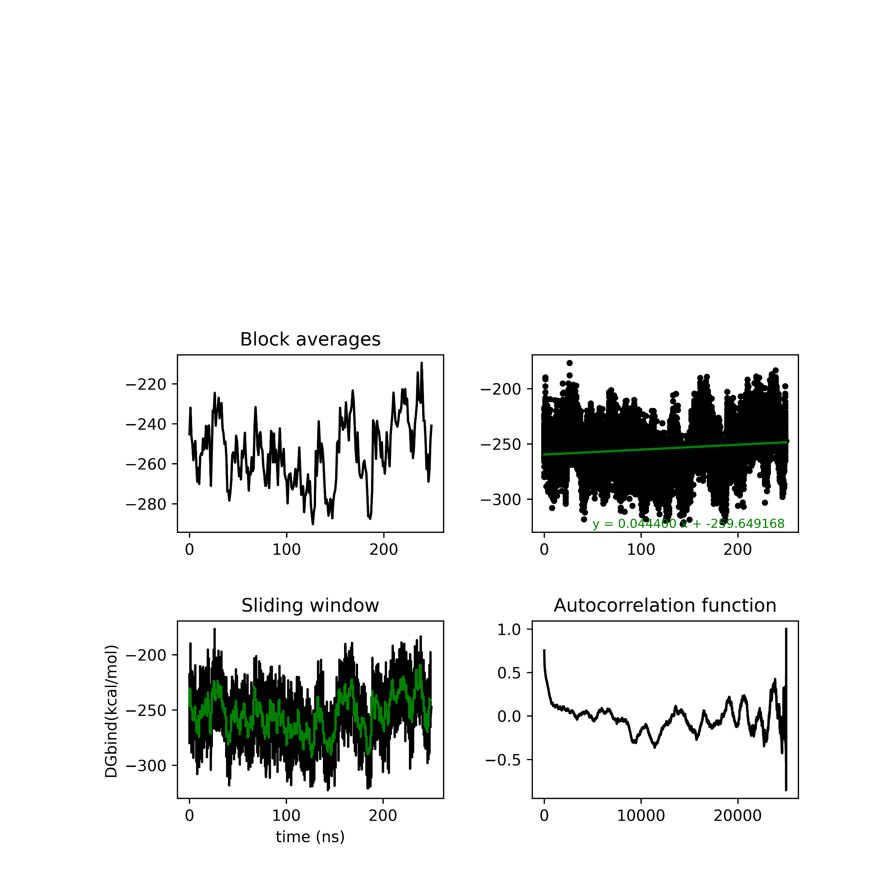
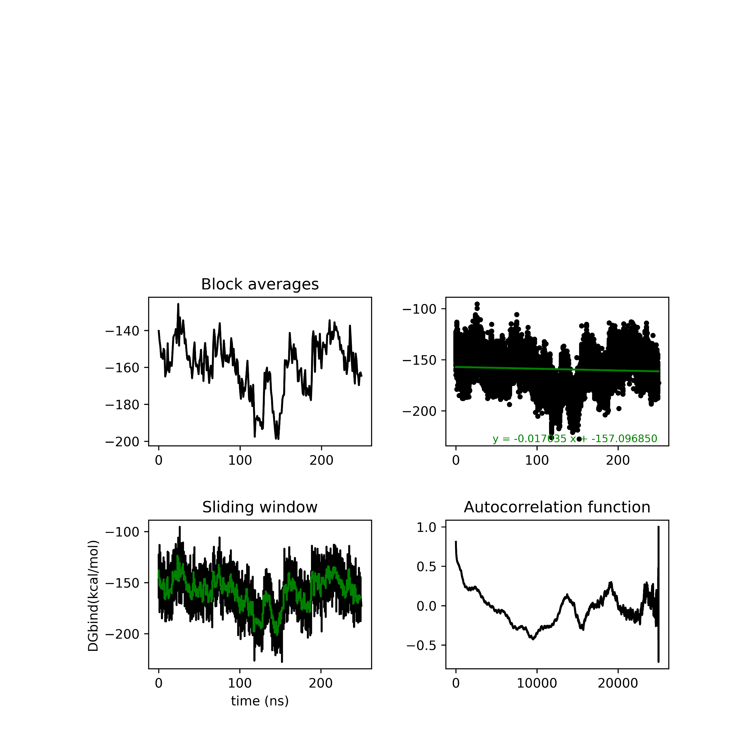
MMGBSA analysis Seed 50

Slide 22
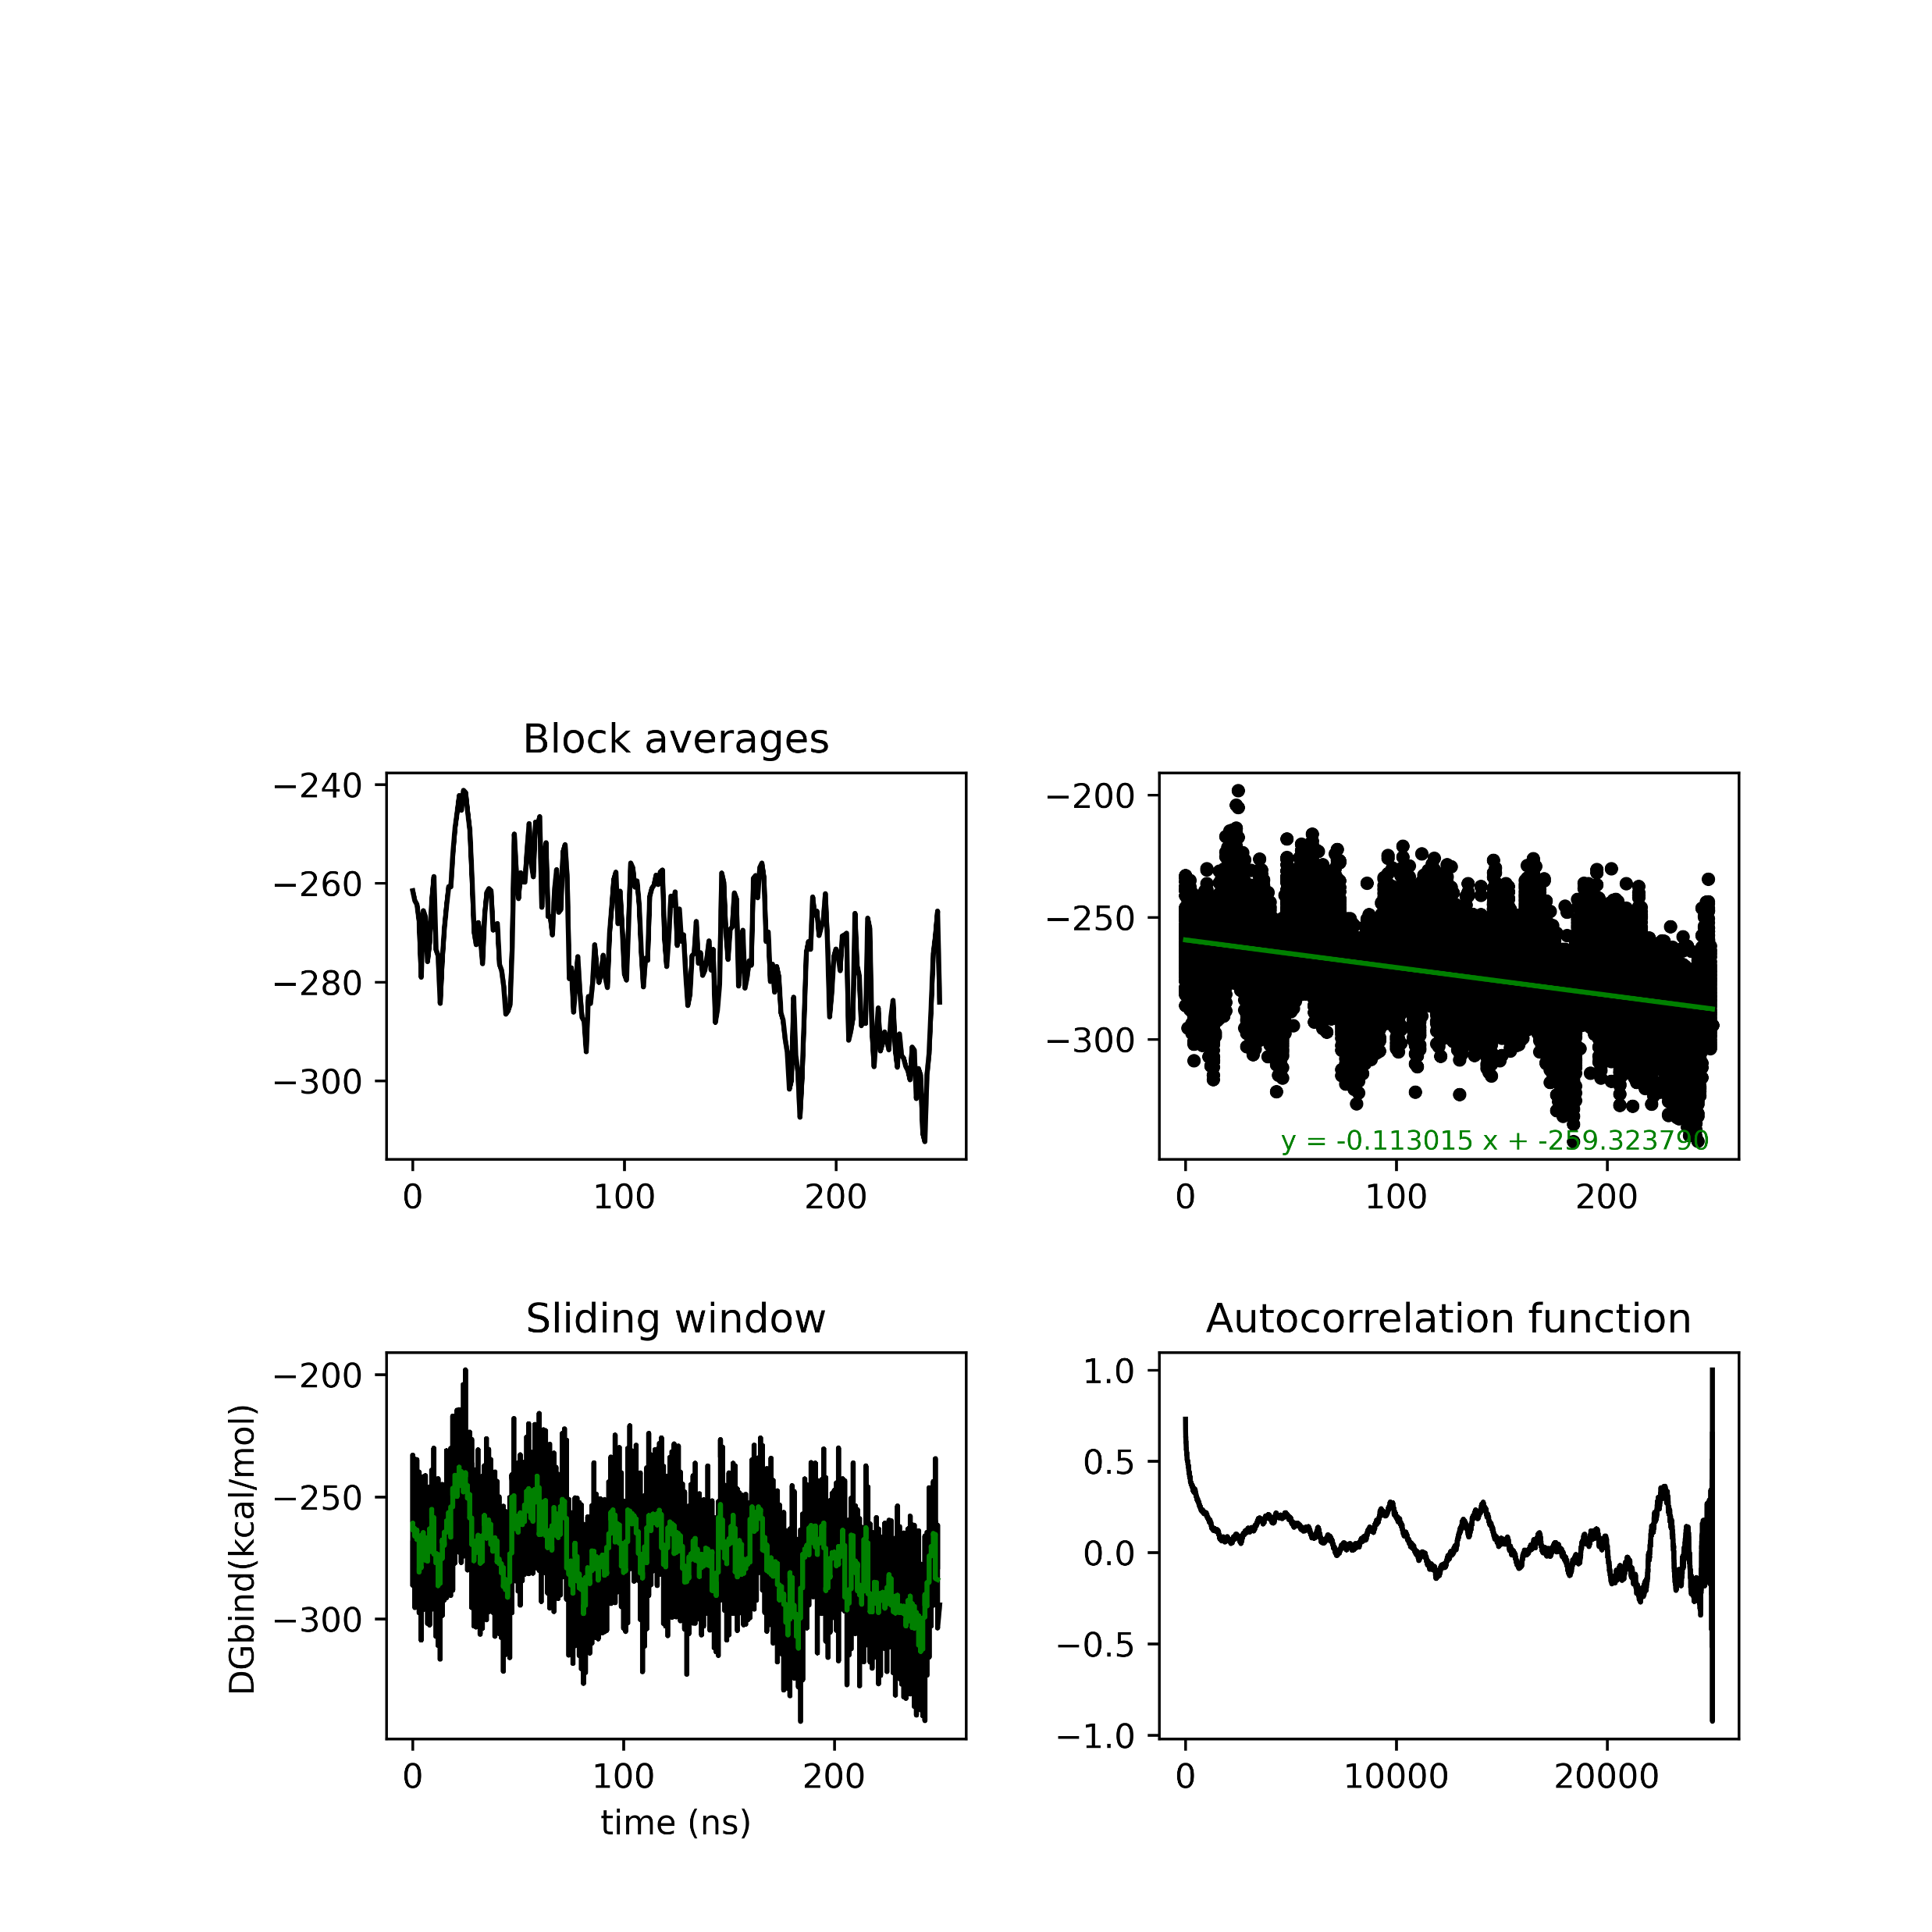


MMGBSA analysis Seed 500

Slide 23


Semi-cross seed 0

Slide 24


Semi-cross seed 5

Slide 25


Semi-cross seed 50

Slide 26


Semi-cross seed 500

Slide 27


closed seed 0

Slide 28


closed seed 5

Slide 29


closed seed 50

Slide 30


closed seed 500

Slide 31


Seed 0
LYS B 405-- SEP D 13
mean=0.482499,var=2.869714
mean=-175.679962,var=46.672448
996, 11, LYS B 405, SEP D 13, -171.108901, 14.608868
k=0;val=-175.679962
k=1;val=-169.017350
k=2;val=-173.748083
k=3;val=-165.990209

Slide 32


Seed 500
LYS B 405-- SEP D 13
mean=-0.126512,var=2.490929
mean=-165.990209,var=494.827431

Slide 33





Slide 34


Seed 0
1202, 8, ARG B 611, GLU C 425, -109.671392, 24.664746
k=0;val=-112.976763
k=1;val=-101.084179
k=2;val=-112.163409
k=3;val=-112.461218
mean=2.434351,var=3.870369
mean=-112.976763,var=21.638635

Slide 35


Seed 5
ARG B 611, GLU C 425
mean=1.492855,var=3.094320
mean=-101.084179,var=18.692984

Slide 36



Slide 37


Seed 0
287, 30, ARG A 337, ASP C 447, -60.565174, 87.754662
k=0;val=-56.790753
k=1;val=-76.493223
k=2;val=-56.634785
k=3;val=-52.341933
mean=0.124215,var=0.937282
mean=-56.790753,var=371.358748

Slide 38


Seed 5
ARG A 337, ASP C 447
mean=1.492855,var=3.094320
mean=-76.493223,var=548.449813

Slide 39




Slide 40
 |  | Avg | Variance | Stand Dev | SEM
ARG A 337 | ASP C 447 | -60.565174 | 87.754662 | 9.37 | 4.68
ARG B 611 | GLU C 425 | -109.671392 | 24.664746 | 4.97 | 2.48
LYS B 405 | SEP D 13 | -171.108901 | 14.608868 | 3.82 | 1.91

